Slide 1
Annual Work Plan & Budget, 2018-19 [Mid Day Meal Scheme]
MDM - PAB Meeting
23.05.2018
Arunachal Pradesh

Slide 2
OVERVIEW
Initiatives taken up by State Government. Other Issues.

Slide 3
INITIATIVES OF STATE GOVERNMENT
1. Action Taken on 10th JRM Report
The State Government has been briefed about the 10th JRM report through Hon’ble Minister of Education, Arunachal Pradesh. Monthly meetings of all DDSEs of the Districts & State level officers are being conducted to check records regularly & to fix responsibility if any such thing is noted in any school. DDSE have been directed to hold meeting under convergence with PHED under chairmanship of DC for water supply and provision. Inspection schedule of officers to monitor the MDM scheme has been prepared so that fix number of schools at a predefined frequency are monitored. Payment of FCI bills has started from January, 2018 through PFMS system & full payment made of Rs.108.92 lakh for FY 2017-18.

Slide 4
INITIATIVES OF STATE GOVERNMENT
1. Centralized Kitchen
An agreement has been arrived with Akshay Patra to run mid day scheme for hot cooked meals on centralized kitchen model with a grant of Rs.2 crore in Itanagar. A Centralized kitchen shall also be established in Pasighat to be run by Government for which an allocation of Rs.1 crore is being provided. This has been announced in State Budget Speech 2018-19.

Slide 5
INITIATIVES…
2. Honorarium to Cook-cum-Helper
The 6525 Cook-cum-Helper are receiving Honorarium @Rs.1000/- per month. The State Government shall provide additional Honorarium of Rs.1000/- per month and has earmarked an allocation of Rs.7 crore for this purpose This too has been announced in State Budget Speech 2018-19.

Slide 6
INITIATIVES….
3. Public Financial Management System (PFMS)
From 2017-18, all funds under MDM scheme is being transferred through PFMS platform. All transactions are made through account payment system with the help of Print Payment Advice (PPA) to the Bank. No cash payment, cheque or bank draft is allowed. Payment of Honorarium to Cook cum Helper and salary of Data Entry Operators are made through DBT under PFMS.

Slide 7
INITIATIVES….
4. State level Steering-cum-Monitoring Committee (SSMC)
State level Steering-cum-Monitoring Committee has been reconstituted & re-notified vide order NoEED.9/MDM/98/2017-2018 dated, 05/03/2018 for effective monitoring of MDM scheme. District & Block level Steering-cum-Monitoring Committee will be reconstituted on same line for more effective monitoring of the scheme.

Slide 8
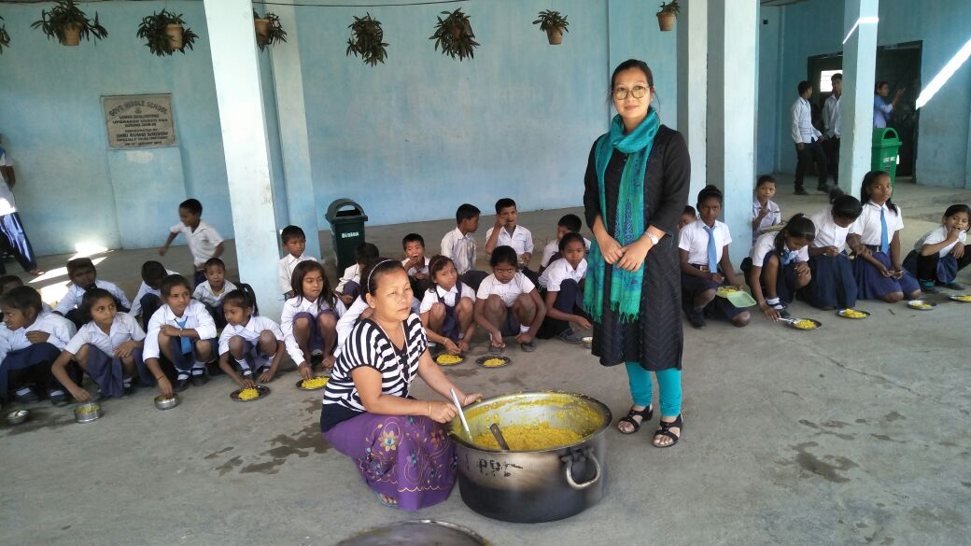
MDM being served…
GMS, Balukpong, West kameng District

Slide 9
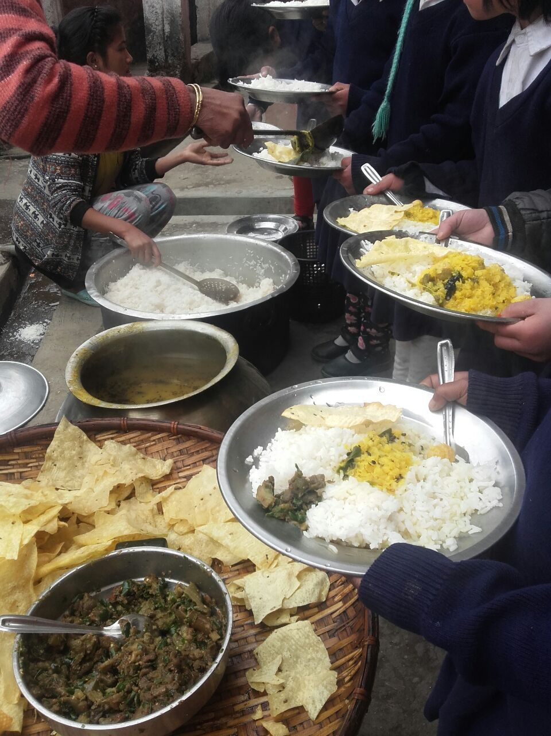
MDM being served…
GMS, Bomdila, West Kameng District

Slide 10
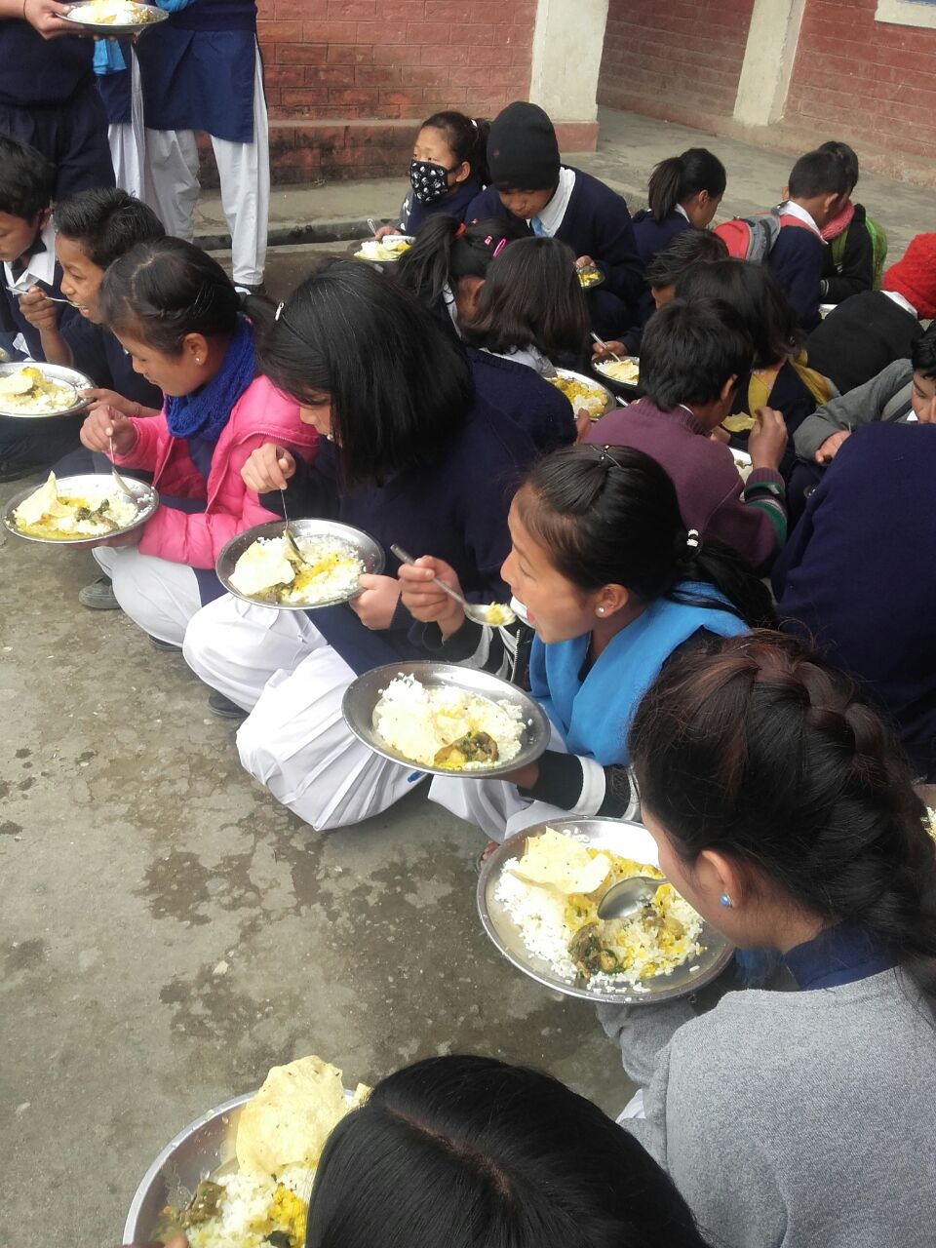
MDM being served…
GMS, Bomdila, West Kameng District

Slide 11
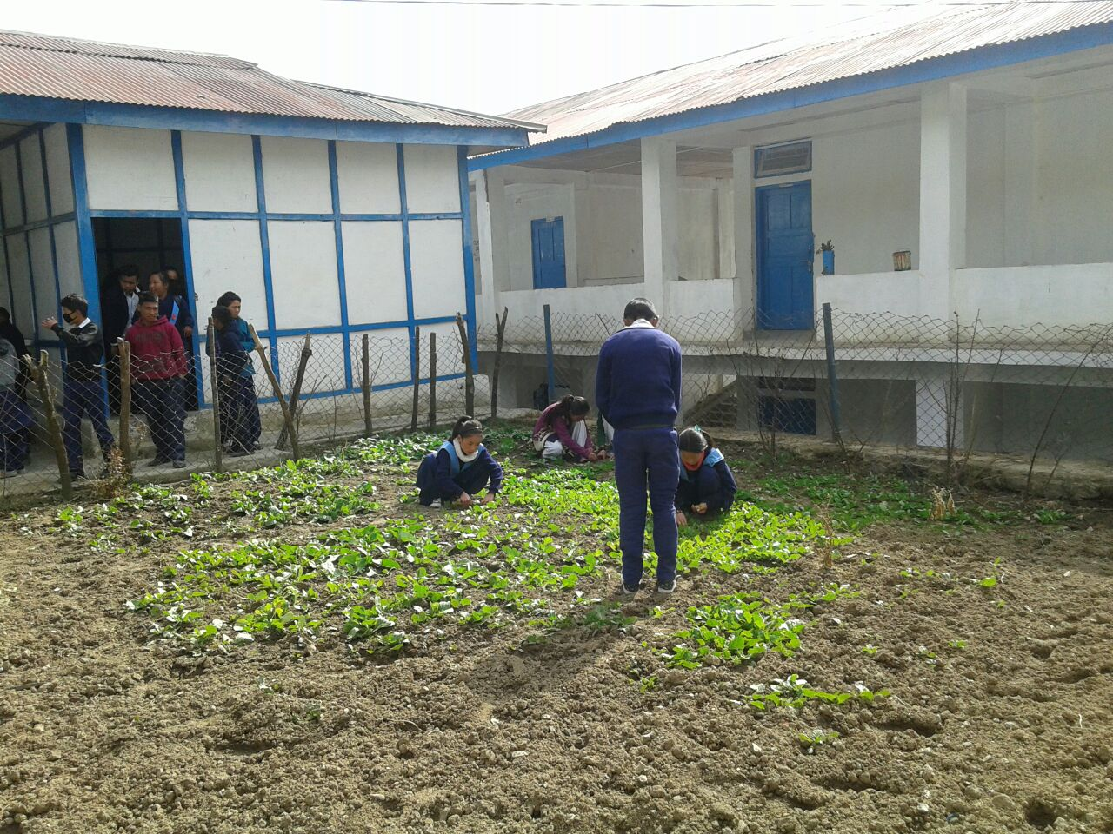
BEST PRACTICES
Kitchen Garden to supplement MDM
Kitchen garden preparation in GMS, Lumla, Tawang District

Slide 12
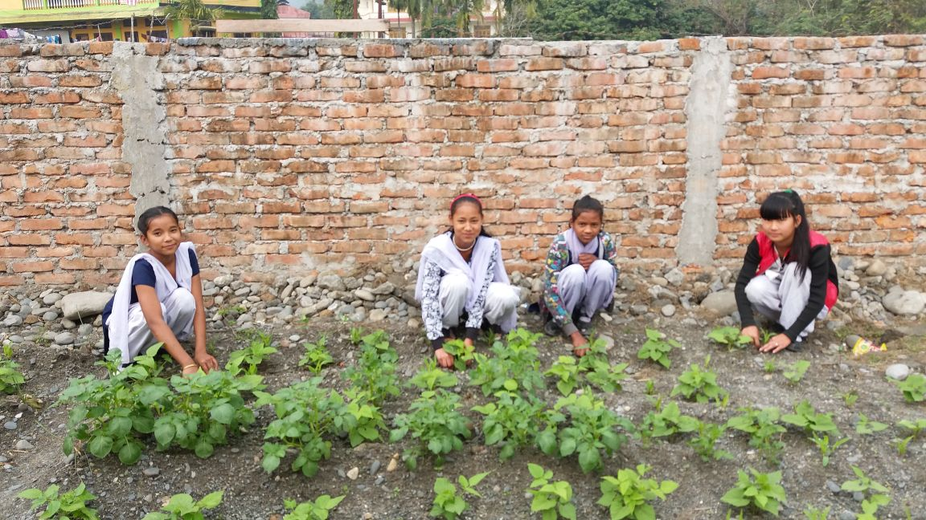
BEST PRACTICES….
Kitchen Garden to supplement MDM
Kitchen garden preparation in GSS, Balukpong, West Kameng District

Slide 13
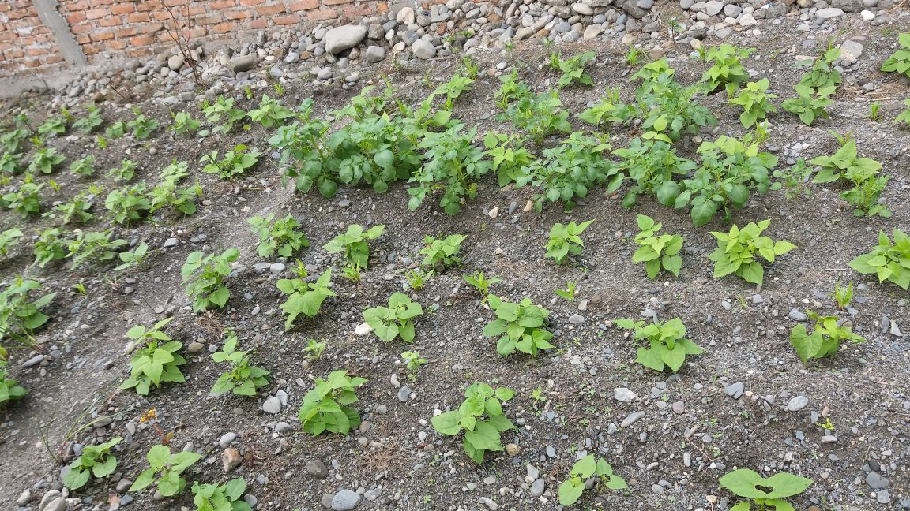
BEST PRACTICES….
Kitchen Garden to supplement MDM
Kitchen garden in GSS, Balukpong, West Kameng District

Slide 14
OTHER ISSUES….
1. Enhancement of Fund under MME Component
The present MME rate of 1.8% of total Central Share is insufficient to meet all the items under MME component. State has engaged 24 (23+1) Data Entry Operators (DEO) at monthly remuneration of Rs.10000/- per month. More that 50% of the fund under MME component is used up for remunerations to this DEOs. To strengthen and improve the monitoring and evaluation system at State, District, Block and School levels, MME rate needs to be enhanced.

Slide 15
ISSUES ……
2. Procurement of pulses from Central Buffer Stock through NAFED
As per SSMC meeting held on 06.03.2018, it was decided that the transportation cost of the pulses cannot be borne by the State Government and therefore, the same should be borne by GoI if the State has to procure the pulses from Central Buffer Stock . In view of extra cost of transportation of pulses, the State would like to defer the procurement of pulses from Central Buffer Stock through NAFED for CFY. This has been resolved in SSMC meeting held on 14.05.2018

Slide 16
ISSUES ……
3. Testing of food samples by accredited laboratories
Due to absence of reputed /accredited laboratory in the State of Arunachal Pradesh, testing of food samples served under Mid Day Meal scheme has not been conducted. The Department is awaiting the setting up of accredited laboratory for food testing in the State.

Slide 17
Thank You

