Slide 1
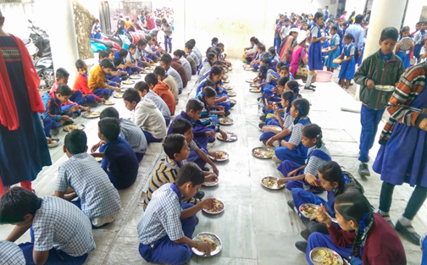


Mid Day Meal Scheme
PAB-MDM Meeting
Daman & Diu
on
09-05-2018

Slide 2
Best Practices
Additional contribution in cooking cost of Rs.7.99 for Primary and Rs. 8.20 for Upper Primary per child per day from UT budget.
Additional Honorarium has been paid to Cook cum Helper Rs.2642/-p.m. from UT fund plus Rs.1000/- from central share (Total Rs.3642/- Per cook/month for 11 months).
Tithi bhojan introduced in which additional food items biscuits, chocolate, fruity, amul cool milk samosa, pavbhaji, sweets etc. are being provided to all school children from UT.
Additional food items e.g. Boiled Eggs, Bananas, Salad, Sukdi are being provided to the children share thrice a week through their UT fund.
Emergency Contact Numbers (i.e. Primary Health Centre, Fire Department of Fire, Police Station, and Officials of MDM) have been displayed in all schools’ kitchen.
Contd..

Slide 3
Best Practices
Community participation in MDMS: Panchayats/Donors under CSR have donated Refrigerator and Storage Facility etc. in some schools.
All Schools have Gas based cooking. Separate toilets for Girls available in all schools of UT.
R.O. plant for safe drinking water available in all schools.

Slide 4
Issues
Delay in fund transfer from UT finance department to districts head quarter :- Adhoc funds transfer from UT Authority to District almost in 81 days . Similarly 1st instalment funds reached to district in 75 days. 2nd Instalment received by district in 46 day.

Slide 5
Innovations etc.
It is proposed that UTs may also be given flexibility to utilize, with prior approval of MHRD, 5% of their Annual Work Plan & Budget for new interventions provided they are not included under any of the Central or State Schemes and there is no overlapping of activities. This is subject to CCEA approval.
Some of the suggested innovation may be in the field of Water filters, kitchen gardens, provision of LPG connections, use of millets etc. These are only illustrative and not exhaustive.
Community participation.
Meetings of District committee headed by Dist. Collector.

Slide 6
Coverage of children (Primary)
(No. of children in thousand)
78%
81%
80%

Slide 7
Coverage of children (U. Primary)
(No. of children in thousand)
78%
88%
84%

Slide 8
Working days coverage

Slide 9
Food grain: allocation vs utilization (in MTs)

Slide 10
Payment of cost of Food grain to FCI
100%
(Rs.. In Lakh)

Slide 11
COOKING COST: ALLOCATION vs UTILISATION
Figure in Lakh

Slide 12
Honorarium to Cooks-cum-Helpers
99%
(Rs. in Lakh)
Payment of honorarium to CCH through e-transfer 100%

Slide 13
Transportation : Allocation vs Utilization
(Rs.. In Lakh)

Slide 14
MME : Allocation vs Utilization
(Rs.. In Lakh)

Slide 15
Achievement up to 2016-18 Kitchen cum Stores

Slide 16
Coverage : Rashtriya Bal Swasthya Karykram
Details | Institutions | Children
Total | 96 | 16636
Health Check UP | 96 | 16636
IFA Distribution | 84 | 12095
Deworming Tablets | 96 | 14347
Spectacles | 47 | 70

Slide 17
Elements of Ayushman Bharat
Electronic Health Records
Electronic health record for each child
Upgrading skills of emergency care
Training on basic first aid for the teachers
School Health Promotion Activities
Provision of Services
Health Screening
Age appropriate learning for promotion of healthy behavior and prevention of various diseases
Delivered through school teachers trained as Health Ambassadors in coordination with health department staff.
Screening of children 30 identified health conditions for early detection, free treatment and management through dedicated RBSK mobile health teams
Iron Folic Acid (IFA) tablets, Albendazole administration will be provided by teachers through WIFS and National Deworming Day (NDD) programme respectively.
Provision of Sanitary Napkins.
Identification of malnourished and anemic children and appropriate referrals to PHCs and hospitals. The periodicity of such checkups may be increased.
Age appropriate vaccination.
Availability of potable drinking water
Yoga and Meditation

Slide 18
Drinking water facilities
Total Schools | 96
Schools having drinking water facilities | 96
Safe drinking water facilities | 96
Water filtration | 96
RO/UF | 96
UV purification or e-boiling | Nil
Candle filter purifier | Nil
Activated carbon filter purifier | Nil

Slide 19
AMS (Real time data)
On 28th April, 2018
In 4 Schools meal not served

Slide 20
Automated Monitoring System
Month | Avg. No. of schools Reported |  |  | % School Reported
 | Daman | Diu | Total
Apr-17 | 53 | 18 | 71 | 74%
May-17 | 0 | 0 | 0 | --
Jun-17 | 43 | 23 | 66 | 69%
Jul-17 | 47 | 23 | 70 | 73%
Aug-17 | 58 | 30 | 88 | 92%
Sep-17 | 56 | 30 | 86 | 90%
Oct-17 | 60 | 30 | 90 | 94%
Nov-17 | 61 | 30 | 91 | 95%
Dec-17 | 61 | 30 | 91 | 95%
Jan-18 | 61 | 30 | 91 | 95%
Feb-18 | 58 | 31 | 89 | 93%
Mar-18 | 58 | 29 | 87 | 91%

Slide 21
Comparison : Meal served (Plan vs. AMS)
(in Lank)

Slide 22
Comparison of AWP&B and MIS Data

Slide 23
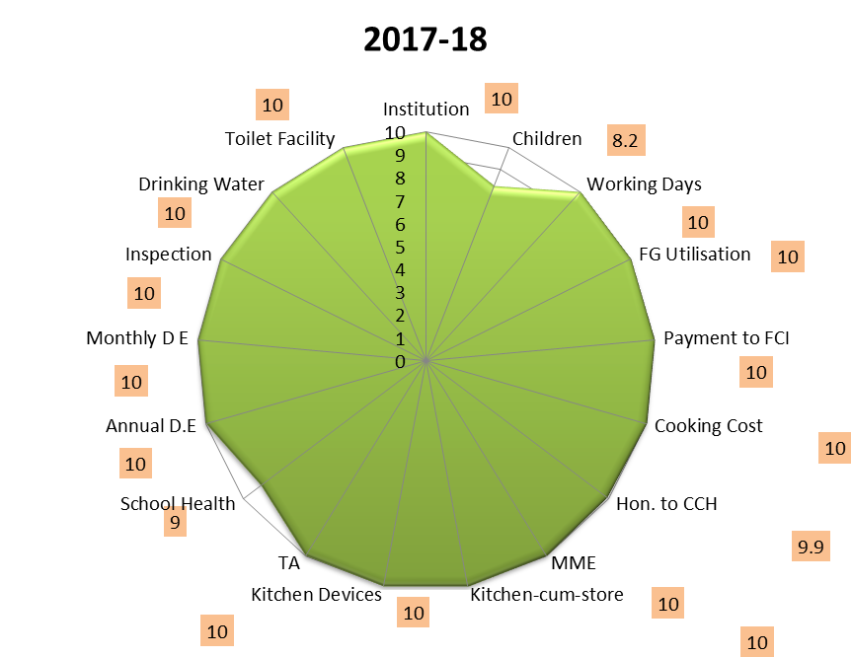
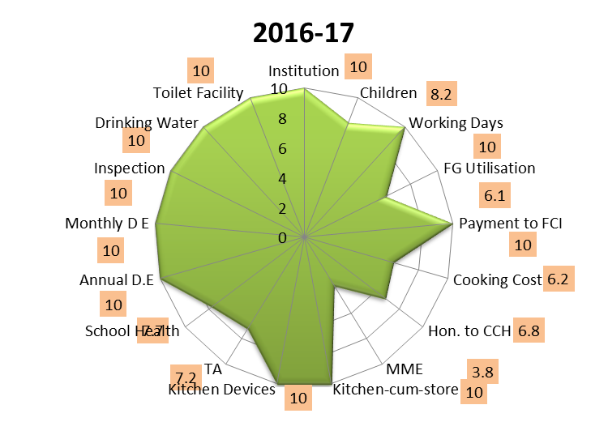
Score Card all components : 3 years

Slide 24
Part-II
Analysis of UT’s Proposal for
2018-19

Slide 25
Proposal for 2018-19 : Children (PRIMARY)
(Thousand)
Q-1
Q-2
Q-3
Q-4
Average
UT’s Proposal
Recommendation

Slide 26
Proposal for 2018-19 : Children (U. PRIMARY)
Recommendation
Q-1
Q-2
Q-3
Q-4
Average
UT’s Proposal
(Thousand)

Slide 27
Proposals and Recommendations
S. No | Component | PAB Approval 2017-18 | Proposal for AWP&B 2018-19 | Recommendation by Appraisal Team
1 | Children (Pry) | 8900 | 9400 | 8942
2 | Children (U Pry) | 6200 | 6600 | 6496
3 | Working Day (Pry and U Pry) | 220 (Pry & U Pry) | 233 (Pry & U Pry) | 233 (Pry & U Pry)
4 | Kitchen cum Store | Nil | Nil | Nil
5 | Cook cum Helper | 320 | 320 | 320
6 | Kitchen Devices | Nil | Nil | Nil
7 | Kitchen Devices (Replacement/Repair) | Nil | Nil | Nil
8 | MME Plan | Rs 60 lakh | Rs 60 lakh | Rs 60 lakh
9 | Notional Requirement of Central Assistance | Rs. 270.68 Lakh | Rs. 294.49 Lakh | Rs.288.04 Lakh

Slide 28
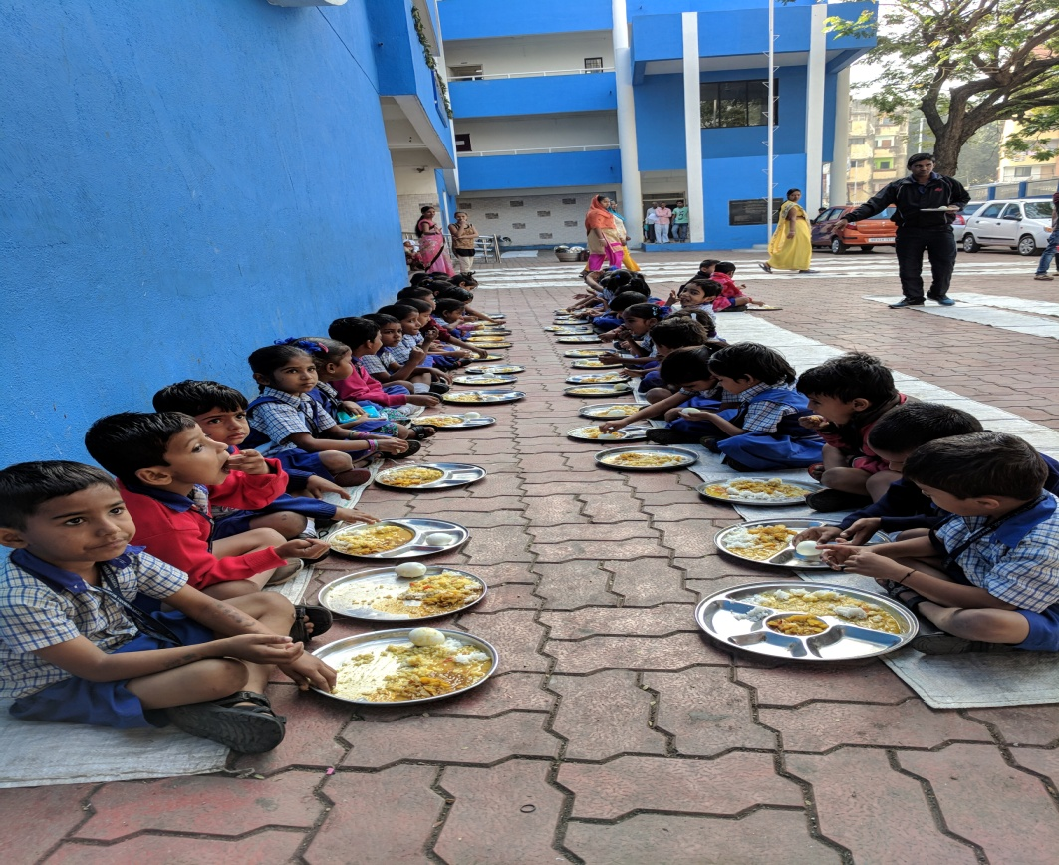
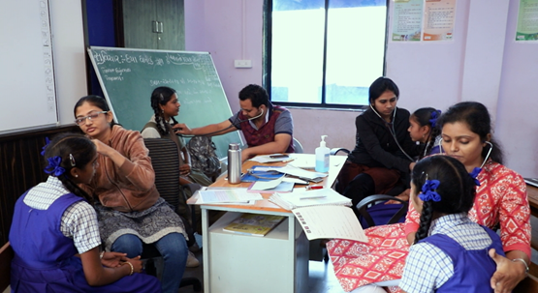
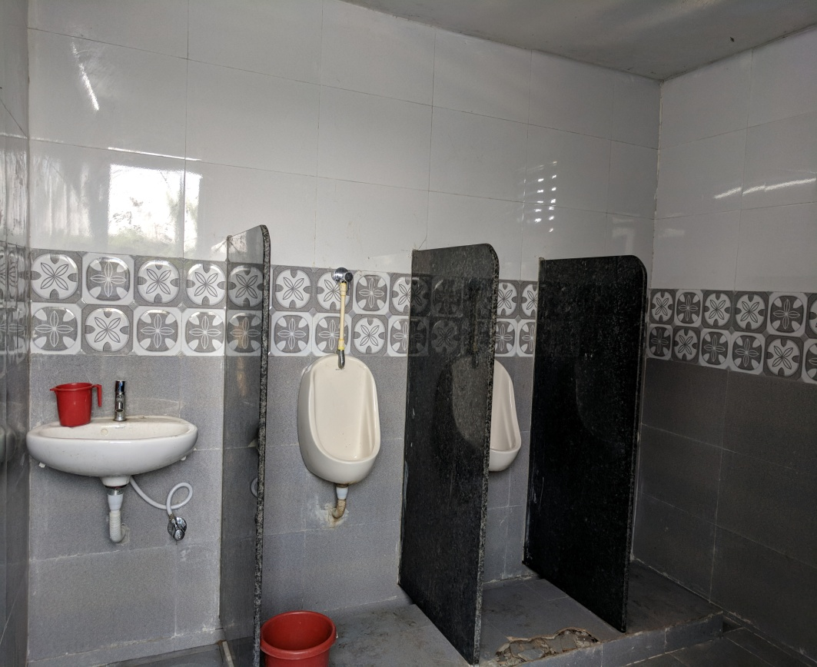
Thank you

