Slide 1

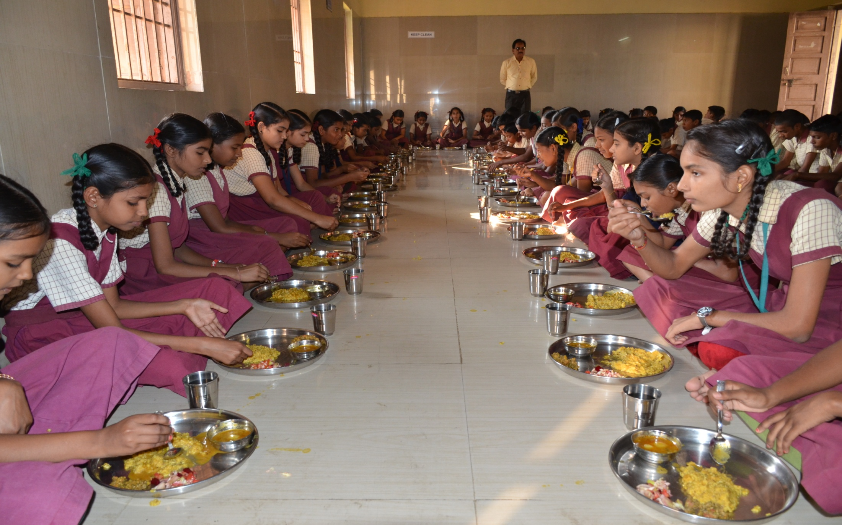

Mid Day Meal Scheme
PAB-MDM-2018-19
Meeting
Dadra & Nagar Haveli
on
09-05-2018

Slide 2
Best Practices
Additional of contribution Rs 9.37 in Primary and Rs. 10.11 in upper primary in cooking cost from their own UT funds.
Additional honorarium of Rs. 2831/- per cook-cum-helpers per month is being paid by UT from their own resources through e-transfer to their bank accounts.
Seasonal fruits, Sukhadi, Lapsi, Sheera served thrice a week.
LPG (100%) in all schools.
Health checkup of all children.
All cook-cum-helpers wear apron and head gear during preparation of meal.
Constructed dining hall on the roof of many schools as a pilot basis.
ROs provided by the UT Administration for 79 Schools (35%) as pilot basis.

Slide 3
Issues
Almost 4 months delay in the fund release of central assistance from Finance Department of UT to the Directorate of Panchyat Department.

Slide 4
Innovations etc.
It is proposed that the States and UTs may also be given flexibility to utilize, with prior approval of MHRD, 5% of their Annual Work Plan & Budget for new interventions provided they are not included under any of the Central or State Schemes and there is no overlapping of activities. This is subject to CCEA approval.
Some of the suggested innovation may be in the field of Water filters, kitchen gardens, provision of LPG connections, use of millets etc. These are only illustrative and not exhaustive.
Community participation.
Meetings of District committee headed by Dist. Collector.

Slide 5
Coverage of children (Primary)
(No. of children in thousand)
90%
80%
78%

Slide 6
Coverage of children (U. Primary)
79%
78%
74%
(No. of children in thousand)

Slide 7
Working days coverage

Slide 8
Food grain: allocation vs utilization (in MTs)

Slide 9
Payment of cost of Food grain to FCI
100%
(Rs.. In Lakh)

Slide 10
COOKING COST: ALLOCATION vs UTILISATION
Figure in Lakh

Slide 11
Honorarium to Cooks-cum-Helpers
91%
(Rs. in Lakh)
Payment of honorarium to CCH through e-transfer 100%

Slide 12
Transportation : Allocation vs Utilization
(Rs.. In Lakh)

Slide 13
MME : Allocation vs Utilization
(Rs.. In Lakh)

Slide 14
Achievement up to 2016-18 Kitchen cum Stores

Slide 15
Coverage : Rashtriya Bal Swasthya Karykram
Details | Institutions | Children
Total | 280 | 42338
Health Check UP | 280 | 42338
IFA Distribution | 271 | 40338
Deworming Tablets | 280 | 42338
Spectacles | 280 | 438

Slide 16
Elements of Ayushman Bharat
Electronic Health Records
Electronic health record for each child
Upgrading skills of emergency care
Training on basic first aid for the teachers
School Health Promotion Activities
Provision of Services
Health Screening
Age appropriate learning for promotion of healthy behavior and prevention of various diseases
Delivered through school teachers trained as Health Ambassadors in coordination with health department staff.
Screening of children 30 identified health conditions for early detection, free treatment and management through dedicated RBSK mobile health teams
Iron Folic Acid (IFA) tablets, Albendazole administration will be provided by teachers through WIFS and National Deworming Day (NDD) programme respectively.
Provision of Sanitary Napkins.
Identification of malnourished and anemic children and appropriate referrals to PHCs and hospitals. The periodicity of such checkups may be increased.
Age appropriate vaccination.
Availability of potable drinking water
Yoga and Meditation

Slide 17
Drinking water facilites
Total Schools | 280
Drinking water facilities | 280
Safe drinking water | 280
Water filtration | 280
RO/UF | 79 (28%)
UV purification or e-boiling | Nil
Candle filter purifier | Nil
Activated carbon filter purifier | Nil

Slide 18
Comparison of data: MIS vs AWP&B

Slide 19
AMS (Real time data)

Slide 20
Automated Monitoring System
Month | No of schools Reported | Meal Served Days | Meal Served | Avg No. of Chidren
Apr-17 | 14 | 25 | 30930 | 1237
May-17 | 0 | 0 | 0 | 0
Jun-17 | 11 | 16 | 18386 | 1149
Jul-17 | 9 | 26 | 26733 | 1028
Aug-17 | 34 | 23 | 78751 | 3424
Sep-17 | 50 | 23 | 108252 | 4707
Oct-17 | 40 | 10 | 38534 | 3853
Nov-17 | 36 | 22 | 73181 | 3326
Dec-17 | 69 | 24 | 215534 | 8981
Jan-18 | 124 | 25 | 407018 | 16281
Feb-18 | 140 | 23 | 412457 | 17933
Mar-18 | 201 | 23 | 512948 | 22302

Slide 21
Automated Monitoring System

Slide 22
Score Card all components : 3 years

Slide 23
Part-II
Analysis of UT’s Proposal for
2018-19

Slide 24
Proposal for 2018-19 : Children (PRIMARY)
Average
UT’s Proposal
Recommendation
Q-1
Q-2
Q-3
Q-4

Slide 25
Proposal for 2018-19 : Children (U. PRIMARY)
Q-1
Q-2
Q-3
Q-4
Average
UT’s Proposal
Recommendation

Slide 26
Proposals and Recommendations
S. No | Component | PAB Approval 2017-18 | Proposal for AWP&B 18-19 | Recommendation by Appraisal Team
1 | Children (Pry) | 19500 | 24280 | 23018
2 | Children (U Pry) | 13900 | 11500 | 10871
3 | Working Day (Pry and U Pry) | 231 (Pry & U Pry) | 244 (Pry & U Pry) | 244 (Pry & U Pry)
4 | Kitchen cum Store | Nil | Nil | Nil
5 | Cook cum Helper | 925 | 926 (925 +1) 1 (Additional) | 926 (925 +1)
6 | Kitchen Devices | Nil | Nil | Nil
7 | Kitchen Devices (Replacement/Repair) | Nil | 280 | 280 Units
8 | MME Plan | Rs 30 lakh | Rs 30 lakh | Rs 30 lakh
9 | Notional Requirement of Central Assistance | Rs. 549.63 Lakh | Rs. 592.99 | Rs. 568.75 Lakh
 | Pending liability of Rs.318.03 lakh which was sanctioned on 31-March-2017 |  |  | Rs. 886.78 Lakh

Slide 27
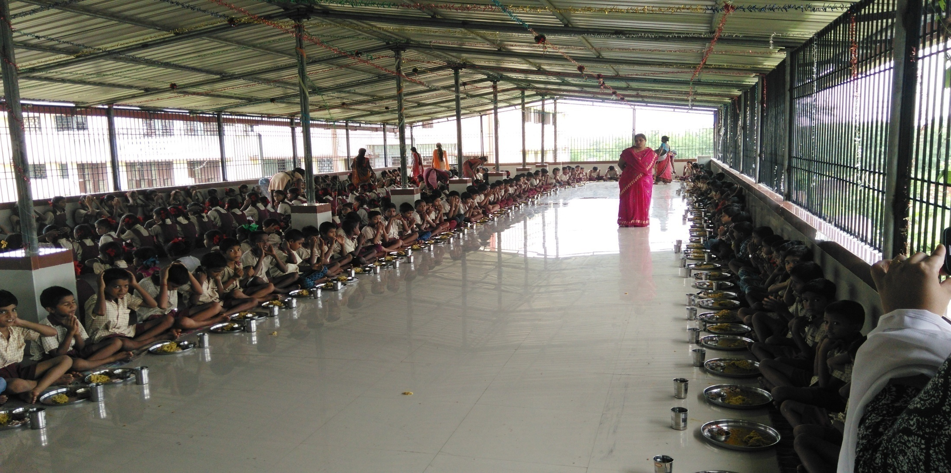
Thank you
Dining hall on roof of CPS, Khardpada,Dadra & Nagar Haveli

