Slide 1
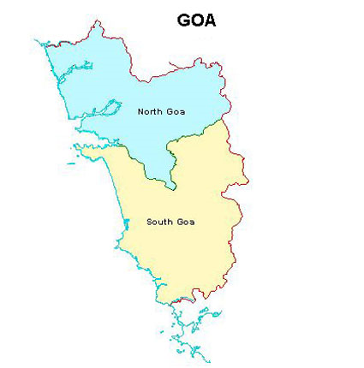
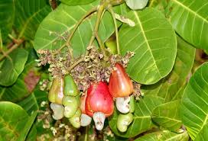
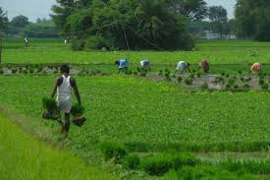
Directorate of Education Government of Goa MID DAY MEAL SCHEME

Slide 2
Brief History
Prior to 2003, in the State of Goa, 3 kgs of rice was distributed to primary students under Mid Day Meal Scheme.
In 2003-04, Kachori, Ladoos, Chakli, Shankar Pali, Biscuits, etc. were distributed.
In 2005-06, items such as Bhaji Pao, Vegetable Pulao, Shira, Pohe, Upama & Moong Bhaji Pao were served .
Tenders were invited Taluka-wise from local Self Help Groups to serve hot cooked food to the children of schools from the year 2005
At present there are 106 Self Help Groups/Mahila Madals and six P.T.A’s supplying Mid Day Meals in all the 12 Talukas of the State.

Slide 3
MENU FOR MID-DAY MEAL
Earlier Menu | Existing Menu
Bhaji Pav/Puri/Chapati Vegetable Pulao | Chole Bhaji & Pav/Poli Masoor Bhaji & Chapati 3. Red chowli Bhaji & Chapati 4. Chana Bhaji & Pav/Poli 5. Chana-Kuleeth Mix Bhaji & Pav/Poli 6. Chowli-Paute Mix Bahaji & Chapati

Slide 4
INSTITUTIONS
STAGE | PAB APPROVAL 2017-18 | COVERAGE | REMARKS
PRIMARY | 1068 | 1041 | 27 Govt. Primary Schools are closed/amalgamated in neighboring Schools.
UPPER PRIMARY | 433 | 438 | Newly opened 5 Upper Primary Schools are added in the year 2017-18

Slide 5
APPROVAL V/S ACHIEVEMENT FOR THE YEAR 2017 – 18.
NO. OF CHILDREN
 | ENROLLMENT | AVERAGE | PAB APPROVAL
PRIMARY | 95,279 | 86,010 | 87,534
UPPER PRIMARY | 65,735 | 56,143 | 56,234

Slide 6
WORKING DAYS
PAB APPROVAL FOR 2017-18 | COVERAGE FOR 2017-18
220 days | 222 days

Slide 7
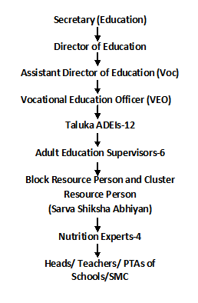
MDMS Administrative Setup
(State Nodal Officer)

Slide 8
Flow of Funds
CENTRAL GOVT RELEASES FUNDS AS PER ALLOCATION
BILLS OF SELF HELP GROUPS ARE SUBMITTED BY THE TALUKA ADEIs
STATE TREASURY RELEASES STATE SHARE FUND
DIRECTORATE OF EDUCATION SCRUTINIZES AND SUBMITS THE BILLS TO THE DIRECTORATE OF ACCOUNTS FOR FINAL PAYMENT TO SHG,FCI, TRANSPORTER
HELPERS – Rs.1000 per month
PAYMENTS IS DONE THROUGH ECS TO THE SELF HELP GROUPS, FCI, TRANSPORTER ON MONTHLY BASIS

Slide 9
Supply of Meals
106 Self Help Groups/Mahila Mandals and Six P.T.As supply meals to the schools.
Selected after inviting applications from eligible Self Help Groups fulfilling following conditions:-
License from Directorate of Food and Drugs Administration.
Group registered with Registrar of Society Act under Societies Act 1860.
Taluka wise Residence Certificate of the Self Help Group is obtained.
Meals are supplied to children during the interval/recess period.

Slide 10
Checking Quantity and Quality
F.C.I. Depot (Food grain)
Quality Control Officer of FCI and Vocational Education Officer (VEO)
Samples are stored in the Directorate of Education.
Self Help Groups are provided with the samples to cross check the quality at the time of receiving the food grains from the civil supply godown/s.
Kitchen (Preparation)
Inspected by:
Officials from the Directorate of Food and Drug Administration.
Vocational Education Officer (VEO)
Heads of the Schools
A.D.E.I.s of respective Taluka.
Health Officer.
Block Resource Person/Cluster Resource Person of Sarva Shiksha Abhiyan.
Nutrition experts

Slide 11
Checking Quantity and Quality (Contd..)
School Level (Hot Cooked Food)
Head of the school checks for Quantity and Quality of the food received for the day from the Self Help Group.
One member of the P.T.A. and Class Teacher test and tastes the meal before serving to students.
Taluka A.D.E.I.s visit one school per day of their jurisdiction.
Nutrition Experts
Education Officers who are on tour.

Slide 12
Grievance Redressal System
D.E.O. FOR NORTH ZONE
D.E.O. FOR SOUTH ZONE
D.E.O. FOR CENTRAL ZONE
TALUKA ADEI FOR TALUKA

Slide 13
School Health Programme
The Programme is carried out by Directorate of Health Services and submit the report to the Directorate of Education on quarterly basis.
Some schools are visited more than once.
The information for the year 2017-18.
Students of std IX to X are also supplied de worming tablets.
 | 2016-17 | 2017-18
 | School/Students Covered | Schools covered | No of Students
No of schools covered | 1,390 | 1,390 | 3,09,187
No of students covered | 273323 | 1,390 | 3,09,187
Iron , folic Acid | 1,92,436 | 527 | 90,663
De worming Tablets | 2,60,479 | 1,750 | 2,74,679
Dist of Spectacles | 159 | 357 | 482

Slide 14
Budget Provisions for the year 2017-18 ( ` in Lakhs)
Schools | Budget Provision 2017-18
Primary | 1115.33
Upper Primary | 1371.03
Grand Total | 2486.36

Slide 15
Details of the food grains Released / Utilised for Primary & Upper Primary stage upto Mar. 18 (In metric tonnes)
 | Allocated | Lifted (upto 31-03-2018) | Utilised (upto 31-03-2018) | % Utilization (upto 31-03-2018)
 | Wheat | Wheat | Wheat | Wheat
Primary Stage | 1895.44 | 1895.44 | 1895.44 | 100 %
Upper Primary Stage | 1822.85 | 1809.13 | 1822.85 | 100 %

Slide 16
Central Assistance for 2017-18 for MDMS (Pry & Upp. Pry) ( ` in lakhs)
Component | PAB Allocation | Released | Expenditure | % Utilization (upto 31-03-2018)
Cost of Food Grains | 76.22 | 76.22 | 74.09 | 97.20%
Cooking Cost | 936.57 | 936.57 | 935.93 | 99.93%
Transport Assistance | 28.59 | 28.59 | 28.59 | 100%
MME | 60 | 60 | 40.98 | 68.30%
Honorarium to cook cum helper | 166.62 | 166.62 | 162.36 | 97.44%
Total | 1268.00 | 1268.00 | 1241.95 | 97.94%
Opening Balance of MME was 37.07 Lakhs
MME Released during 2017-18 is 22.93

Slide 17
MIS Annual and Monthly Status Report
100% Annual Data Entries of schools are completed.
Monthly Data Report
Note: Out of 1479 schools 11 schools could not be entered in MIS Portal because of U- DISE Code problem.
Total No. of Schools | Monthly Data Progress
 | April | May | June | July | August | September | October | November | December | January | February | March
1468 | 100% | 100% | 100% | 100% | 100% | 100% | 100% | 100& | 100% | 100% | 100% | 100%

Slide 18
Proposal for the Year 2018-19

Slide 19
Total Requirement of Food Grains for 2018-19 for Primary Stage (Classes I-V)
Name of the District | Number of Students | Requirement of Food Grains (In MTs) @ 0.0001 MT
 |  | Wheat | Rice | Total
1 | 2 | 3 | 4 | 5
North | 48,653 | 1070.37 | 0 | 1070.37
South | 38,347 | 843.63 | 0 | 843.63
Total | 87,000 | 1914.00 | 0 | 1914.00

Slide 20
Total Requirement of Food Grains for 2018-19 for Upper- Primary Stage (Classes VI-VIII)
Name of the District | Number of Students | Requirement of Food Grains (In MTs) @ 0.00015 MT
 |  | Wheat | Rice | Total
1 | 2 | 3 | 4 | 5
North | 32,937 | 1086.92 | 0 | 1086.92
South | 25,563 | 843.58 | 0 | 843.58
Total | 58,500 | 1930.50 | 0 | 1930.50

Slide 21
Requirement of Pulses (in MTs)
 | Average No of Students | Pulses 1 Kabuli chana | Pulses 2 Masoor | Pulses 3 Red Chawali | Pulses 4 Chana White | Pulses 5 Kuleeth | Pulses 6 Paute | Pulses 7 White Chawali | Total
Primary | 87000 | 63.80 | 63.80 | 63.80 | 95.70 | 31.90 | 31.90 | 31.90 | 382.80
Upper Primary | 58500 | 64.35 | 64.35 | 64.35 | 96.51 | 32.18 | 32.18 | 32.18 | 386.10
Total | 145500 | 128.15 | 128.15 | 128.15 | 192.21 | 64.08 | 64.08 | 64.08 | 768.90

Slide 22
Requirement of Central & State Funds for 2018-19 for MDMS (Pry & Upp. Pry) ( ` in lakhs)
Component | Primary |  | Upper Primary |  | Total |  | Grand Total
 | Centre | State | Centre | State | Centre | State
Cost of Food Grains | 38.28 | - | 38.61 | - | 76.89 | - | 76.89
Cooking Cost | 474.67 | 694.78 | 477.48 | 456.89 | 952.15 | 1151.67 | 2103.82
Transport Assistance | 14.36 | - | 14.48 | - | 28.84 | - | 28.84
MME | 60.00 |  |  |  | 60.00 |  | 60.00
Honorarium to cook cum helper | 93.12 | 62.08 | 73.50 | 49.00 | 166.62 | 111.08 | 277.70
Kitchen Devices | - | - |  |  |  |  | -
Total | 650.00 | 756.86 | 634.07 | 505.89 | 1284.50 | 1262.75 | 2547.25

Slide 23
Best Practices
* All cook cum helpers have Bank Accounts.
* State Government is providing more funds than its mandatory share in cooking cost (i.e. Rs. 1.98 more in Primary and 1.08 more in U.P.).
*All payments of cook cum helpers, SHGs /MMs/ PTAs, Food Corporation of India and Transport contractor has been done through ECS.
* Master training given by Directorate of Food & Drugs Administration, Goa in collaboration with FSSAI and Directorate of Education, Goa to 100 Teachers from each District namely North and South Goa in order to Sensitize children on Safe and Nutritious Food at Schools.

Slide 24
Proposal for Management monitoring and evaluation for the year 2018-19
Sr. No. | Name of the items | Amount in Rs. In Lakhs.
 | STATE LEVEL
1. | Office Expenses | 1.15
2. | TA/DA/ Hiring of Vehicle | 2.00
3. | MIS Coordinator | 2.16
4. | Data Entry Operators | 4.68
 | BLOCK LEVEL
5 | Nutrition Experts | 5.40
6 | Data Entry Operators | 18.72
7 | Social Audit | 2.72

Slide 25
Proposal for Management monitoring and evaluation for the year 2018-19 (Continued)
Sr. No. | Name of the items | Amount in Rs. In Lakhs.
 | SCHOOL LEVEL
8. | Forms and Stationary | 8.28
9. | Smart Phone | 0.32
10. | Testing of Food Samples | 3.43
11. | Training to Cook cum Helpers | 2.00
12. | Training on Health and Hygiene | 1.00
13. | IVRS Project | 8.14
 | TOTAL | 60.00

Slide 26
THANK YOU

