Slide 1
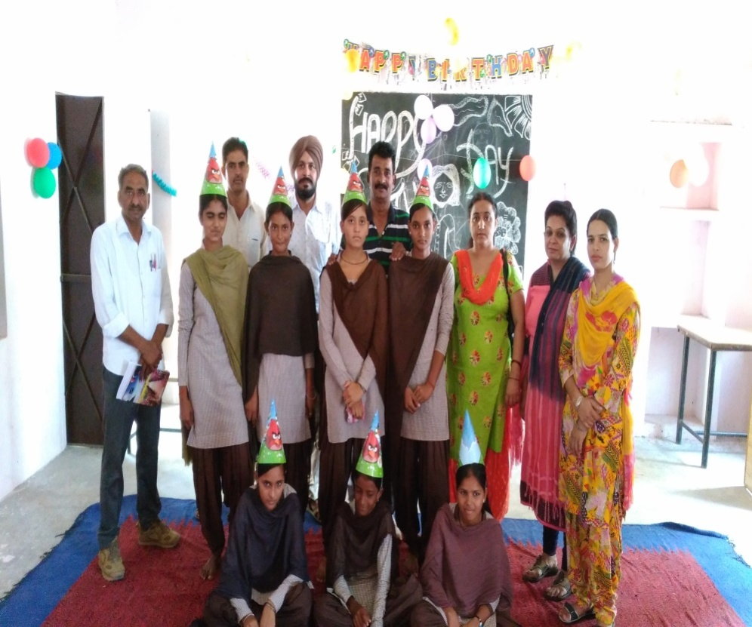
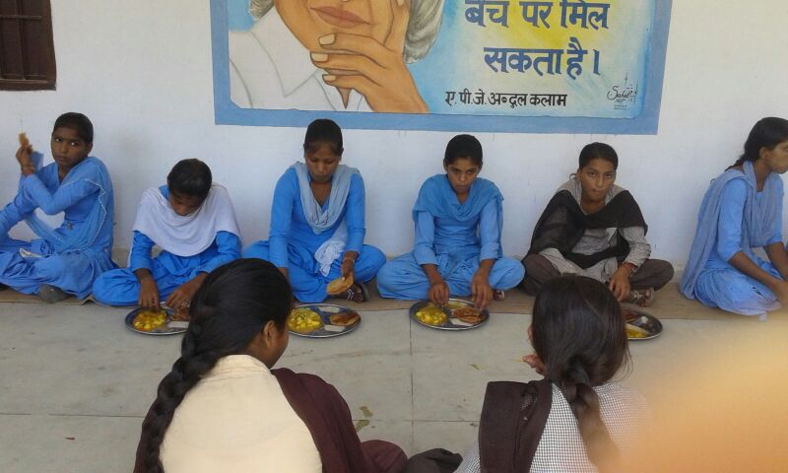
Mid Day Meal Scheme PAB-MDM – HARYANA 13.06.2018

Slide 2
Review of Implementation of MDMS HARYANA (1.4.2017 to 31.03.2018)
Ministry of HRD, Govt. of India

Slide 3
Best Practices
Additional Contribution of Rs.1500 for Honorarium to cook cum helper.
LPG facility in all schools.
Double Fortified Salt is used for cooking MDM in all the districts.
Storage bins provided in all the schools.
Celebration of Beti ka Janamdin; School me Abhinandan.
Free home base education, meals and medical facility to children with special needs through mobile van named KALAM EXPRESS in district Jind.
Stainless steel eating plates and spoons in all schools for MDM.
Medical check up of CCH twice a year.

Slide 4
ISSUES
Delay (2- 3 months) in release of funds to the implementation agencies
Less food grain used in cooking of MDM in primary (72 gms) and Upper primary (106 gms) per child per day.
Rs.3.68 and Rs.5.16 provided for cooking cost per child per day in primary and upper primary respectively.
No Meetings of District committee headed by Dist. Collector in 4 Districts
Delay in submission of information to GOI
Mismatch between AWP&B data and MIS data.

Slide 5
Innovations etc.
It is proposed that the States and UTs may also be given flexibility to utilize, with prior approval of MHRD, 5% of their Annual Work Plan & Budget for new interventions provided they are not included under any of the Central or State Schemes and there is no overlapping of activities. This is subject to CCEA approval.
Some of the suggested innovation may be in the field of Water filters, kitchen gardens, provision of LPG connections, use of millets etc. These are only illustrative and not exhaustive.
Community participation.
Meetings of District committee headed by Dist. Collector. (55)

Slide 6
Coverage : Children Enrolment Vs Achievement (PRY)
Coverage : Children Enrolment Vs Achievement (PRY)
No. of Children(in Lakhs)
National Avg.76%
95%
92%
96%
Ministry of HRD, Govt. of India

Slide 7
Coverage : Children Enrolment Vs Achievement (UPY)
No. of Children(in Lakhs)
National Avg.76%
95%
90%
98%
Ministry of HRD, Govt. of India

Slide 8
FOOD GRAIN : ALLOCATION Vs UTILISATION
Foodgrains (in MTs)
65%
63%
72%

Slide 9
Payment to FCI (Rs. in lakhs.)
Cost of Food Grain (Rs. In Lakh )
99%
Rs. 25.92 Lakh is due as on 31.03.18 as per FCI Statement
Ministry of HRD, Govt. of India

Slide 10
COOKING COST: ALLOCATION vs UTILISATION
Rs in Crore
85%
77%
87%
Ministry of HRD, Govt. of India

Slide 11
MME : ALLOCATION vs UTILISATION
Rs in Lakhs
77%
53%
33%
Ministry of HRD, Govt. of India

Slide 12
Transportation Assistance : Allocation vs Utilization
Rs in Lakhs
67%
57%
69%
Ministry of HRD, Govt. of India

Slide 13
Achievement up to 2017-18 (Kitchen cum Stores)
Total Allocation : 11,483 Kitchen Cum Stores
9250 KS
Progress (in %)
1246 KS
987 KS
Ministry of HRD, Govt. of India

Slide 14
COVERAGE : RASHTRIYA BAL SWASTHYA KARYKRAM
Details | Institutions | Children
Total in State | 14990 | 1601082
Health Check UP | 13334 | 1394448 (87%)
IFA Distribution | 13334 | 1394448 (87%)
Deworming Tablets | 13334 | 2788896 (174%)
Ministry of HRD, Govt. of India

Slide 15
Elements of Ayushman Bharat
Electronic Health Records
Electronic health record for each child
Upgrading skills of emergency care
Training on basic first aid for the teachers
School Health Promotion Activities
Provision of Services
Health Screening
Age appropriate learning for promotion of healthy behavior and prevention of various diseases
Delivered through school teachers trained as Health Ambassadors in coordination with health department staff.
Screening of children 30 identified health conditions for early detection, free treatment and management through dedicated RBSK mobile health teams
Iron Folic Acid (IFA) tablets, Albendazole administration will be provided by teachers through WIFS and National Deworming Day (NDD) programme respectively.
Provision of Sanitary Napkins.
Identification of malnourished and anemic children and appropriate referrals to PHCs and hospitals. The periodicity of such checkups may be increased.
Age appropriate vaccination.
Availability of potable drinking water.
Yoga and Meditation.

Slide 16
Availability of safe drinking water
Schools | No. of schools
Total Schools | 14990
Schools having drinking water facility | 14990
Schools having safe drinking water facility | 12892
Having water filtration facility | 684
Membrane (UV + RO) | 567
UV purification | 21
Candle filter purifier | 76
Activated carbon filter purifier | 20
Ministry of HRD, Govt. of India

Slide 17
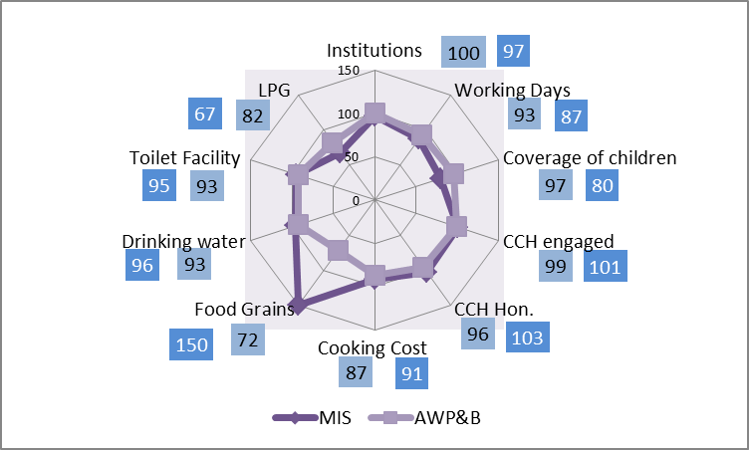
Comparison Data : MIS and AWP&B -2018-19
Ministry of HRD, Govt. of India

Slide 18
PERFORMANCE OVER 3 YEARS
2017-18
2016-17
2015-16

Slide 19
analysis of state’s proposal for 2018-19

Slide 20
Proposal for 2018-19 (Primary)
No. of Children (in lakh)
Q-1
Q-2
Q-3
PAB Approval
Q-4
Enrolment
Average availed
Proposed
Recommend
Ministry of HRD, Govt. of India

Slide 21
Proposal for 2018-19 (Upper Primary)
No. of Children (in lakh)
Q-3
Q-4
Q-1
Q-2
Proposed
PAB Approval
Recommend
Enrolment
Average availed
Ministry of HRD, Govt. of India

Slide 22
Proposals and Recommendations
S. N | Component | PAB Approval 2017-18 | Proposal for 2018-19 | Recommendation 2018-19
1 | Children (Pry) | 841135 | 952828 | 924812
2 | Children (U Pry) | 579943 | 636205 | 628880
3 | NCLP | 5415 | 2553 | 2553
4 | Working Days – Pry & Upy | 242 | 232 | 232
5 | Working Days – NCLP | 302 | 293 | 293
6 | Cook cum Helper | 30423 | 30423 | 30423
7 | Drought - Children (Pry) | Nil | Nil | Nil
8 | Drought - Children (U Pry) | Nil | Nil | Nil
9 | Drought - Working days | Nil | Nil | Nil
10 | Drought - Cook-cum-helpers | Nil | Nil | Nil
11 | Kitchen cum Store | Nil | Nil | Nil
12 | Kitchen Devices (New) | Nil | Nil | Nil
13 | Kitchen Devices (Rep.) | Nil | Nil | Nil
14 | Central Assistance (Rs in Lakh) | Rs. 138.79 Cr. | Rs. 146.01 Cr. | Rs. 143.41 Cr.

Slide 23
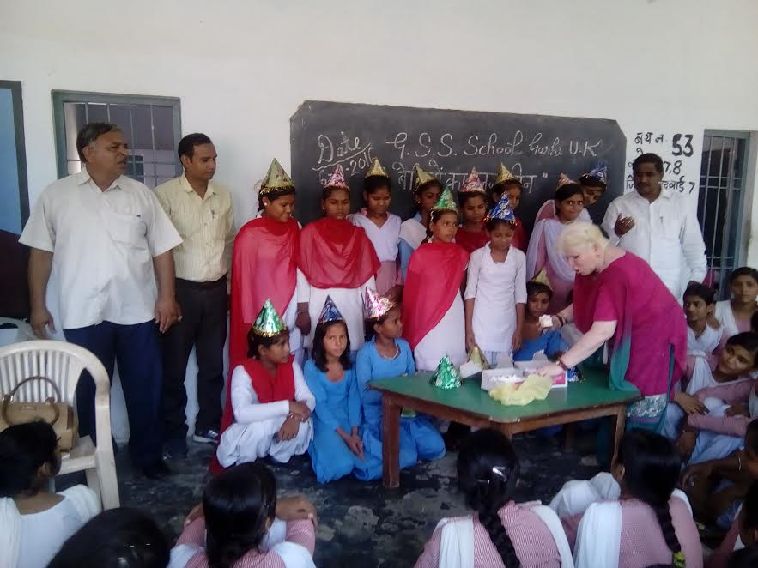
Thank You
BETI KA JANAMDIN SCHOOL ME ABHINANDAN

