Slide 1
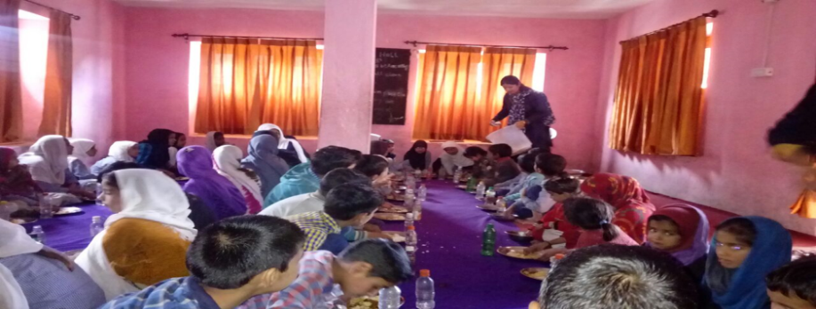
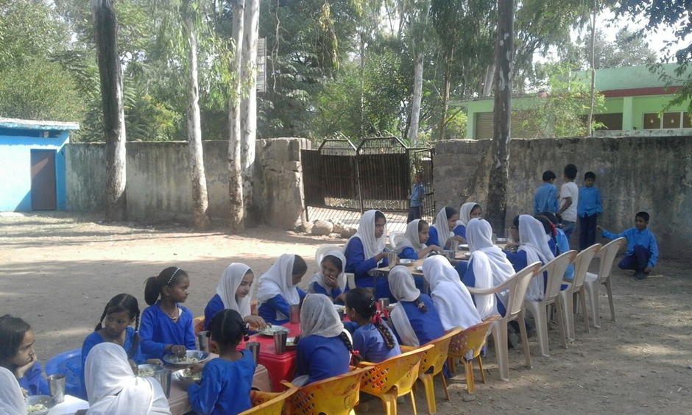
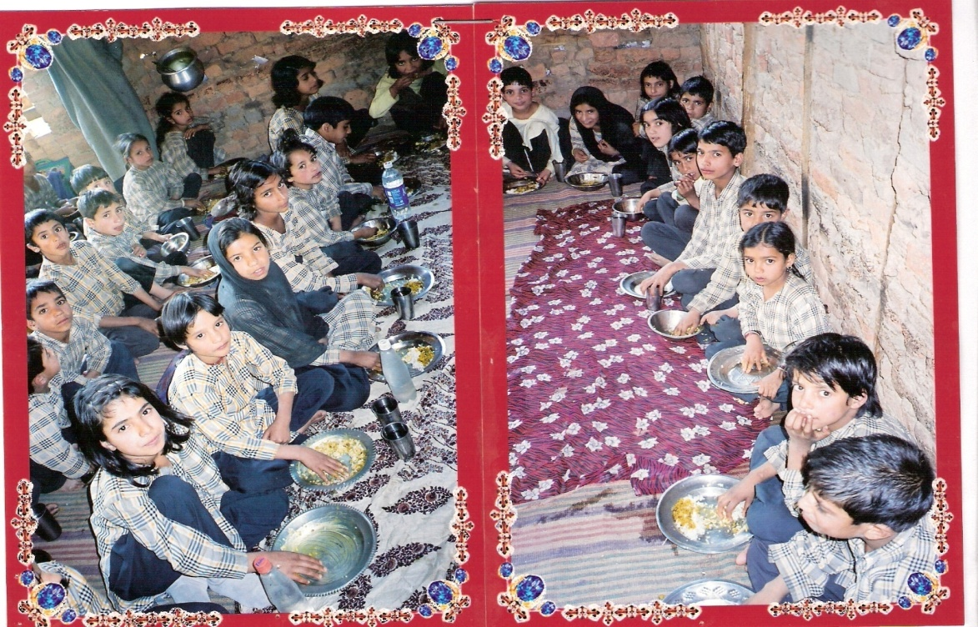
Government of Jammu & Kashmir
Review of National Programme of Mid Day Meal Scheme 2017-18
&
Proposals Annual Work Plan & Budget 2018-19

Slide 2
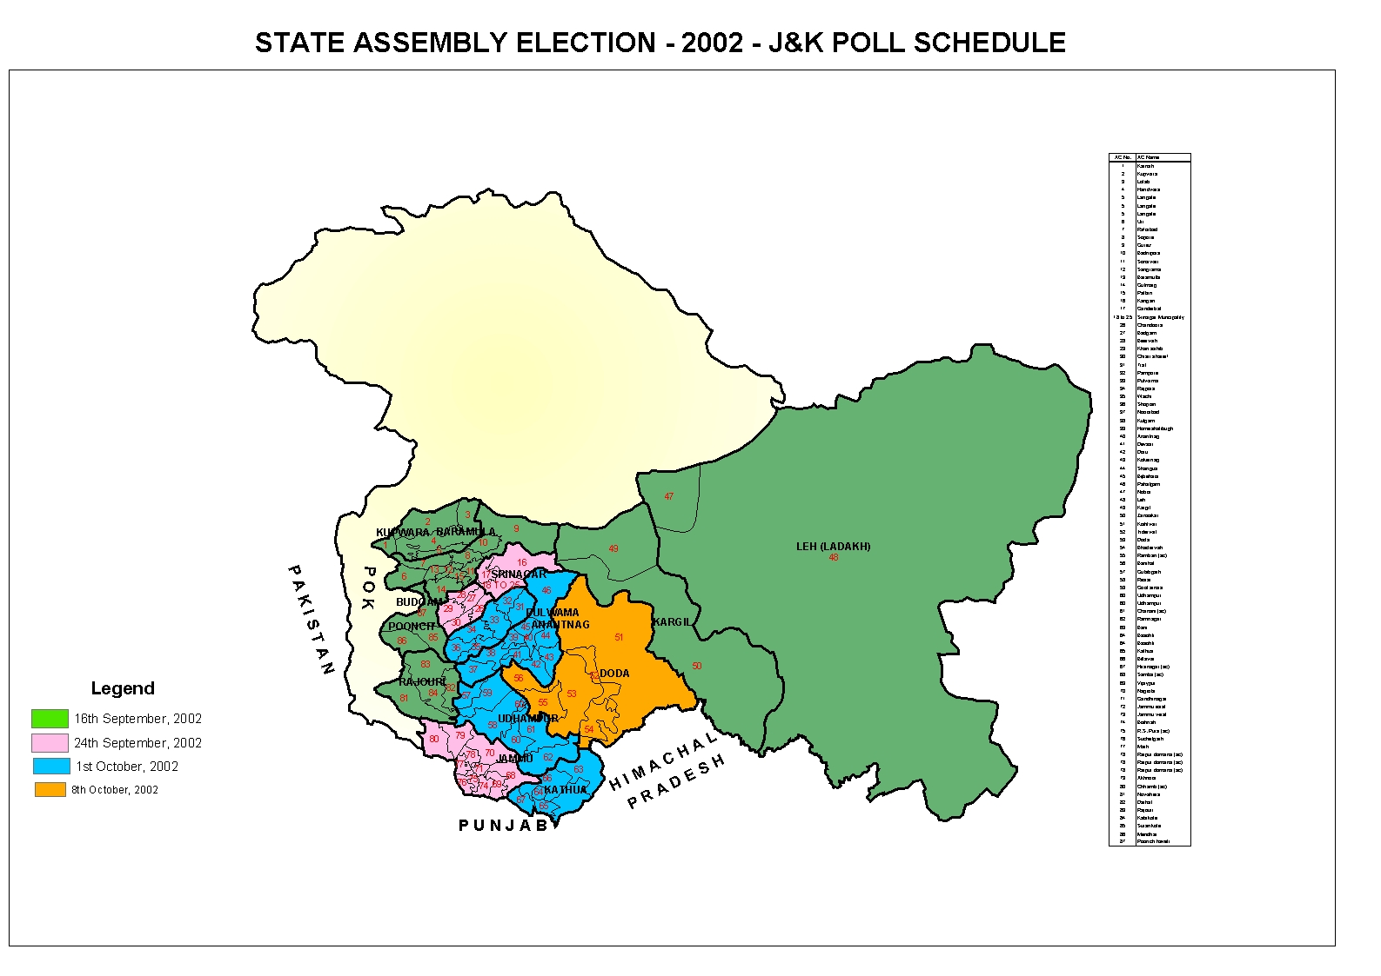
Jammu & Kashmir
Districts – 22 CD Blocks – 143 Educational Zones–201
Total Population = 1,25,48,926
Literacy rate as per census 2011 = 67.16 %

Slide 3
Over view
Mid Day Meal Scheme
National Programme of Nutritional Support to Education (Mid Day Meal a flagship programme) was launched in Sept. 2004.
The Mid-Day Meal has a sharing pattern of 90:10.
At the gross root level, the scheme is being implemented under the supervision of School Management Committees (SMCs) and Village Education Committees (VECs).
The food grains are lifted from the FCI by the CAPD Deptt. and distributed through the nearest Public Distribution Centers.

Slide 4
Main Objectives
To boost Universalization of Elementary Education by improving;
Enrolment
Attendance
Retention
Learning levels of children.
Nutritional status of students.

Slide 5
Salient Feature
S. No | Components | Sharing Pattern
 |  | Centre | State
1 | Foodgrains (Rice) per child per School Day: 100 gms for Primary Stage (Class I to V) 150 gms for Upper Primary Stage (Class VI to VIII) | 100 | --
2 | Cost of Food Grains @ Rs. 3000/- per MTs. | 100 | --
3 | Transportation Cost @ 1350/- per MTs. | 100 | --
4 | Cooking cost per child per School Day: Rs. 4.13 for Primary Stage Rs.6.18 for Upper Primary Stage. | 90 | 10
5 | Honorarium to Cooks @Rs. 1000/- for 10 months | 90 | 10
6 | Management, Monitoring & Evaluation (MME) | 100 | --

Slide 6
Weekly Menu – Day wise
S. No | Day | Name of the Commodity/Item to be served
1 | Monday | a. Pulses ( e.g Arhar Dal,) b. Potato, Tomato, Onion (Mixed)
2 | Tuesday | a. Pulses ( e.g. Rajma Dal /Masoor Dal) b. Seasonal Vegetables (Combined at least three)
3 | Wednesday | a. Pulses (e.g. Rajma Dal /Channa Dal) b. Nutri and Tomatos( Mixed)
4 | Thursday | a. Pulses (e.g. Moong Dal) b. Potato, Onion, Tomato (Mixed)
5 | Friday | a. Meat/Cheese b. Seasonal Leafy Vegetables (Mixed)
6 | Saturday | a. Pulses (e.g. Beans/ Channa dal) b. Mixed leafy vegetables (Combination of three)

Slide 7
Management Structure
State Government vide order No: 305-Edu of 2017 dated: 14-06-2017 has created Management / Monitoring Structure at different level separately for Jammu & Kashmir Divisions as under:
Joint Director (KAS) as Ex-officio, Jt. Dir. (MDM)
Principal DIET as Ex-officio, Dy. Dir. (MDM)
Assistant Director (Plg),CEO Office as Ex-officio, Asstt. Dir. (MDM)
Principal, Model Schools as Ex-officio, Cluster Head (MDM)
Head of Institution as In charge, MDM.
Director (Planning), School Education Department is the Nodal Officer at State Level.

Slide 8
MONITORING INSTITUTIONS
Following Committees have been constituted by the State Government for monitoring purposes;
Divisional Level Committee headed by one Joint Director from the respective Directorate of School Education.
District Level Committee headed by Principal DIET of the respective District.
Zonal Level Committee headed by one Principal of +2 institution of the respective zone to be nominated by the Chief Education Officer of the concerned District.

Slide 9
Review of Implementation of MDMS
(Primary + Upper Primary) (1.4.2017 to 31.03.2018)

Slide 10
Coverage 2017-18
(Physical)
Stage | No. of Schools |  | Enrollment |  | No. of Cook-cum-Helpers
 | PAB approved | Existing (Actual) | PAB approved | Existing (Actual) | PAB approved | Existing (Actual)
PRIMARY | 13431 | 13360 | 362869 | 648366 | 17772 | 16806
UPPER PRIMARY | 9779 | 9770 | 194892 | 322876 | 15496 | 14135
NCLP | 15 | -- | 635 | -- | -- | --
Total | 23225 | 23130 | 558396 | 971242 | 33268 | 30941

Slide 11
Achievement
(Beneficiaries & Working days)
Item | Stage | 2017-18
 |  | Coverage | %age Coverage against PAB Approval | %age Coverage against actual
Children | PS | 420104 | 116 | 65
 | UPS | 216843 | 111 | 67
 | PS + UPS | 636947 | 114 | 66
Working days | PS | 189 | 86 | --
 | UPS | 187 | 85 | --
 | PS + UPS | 188 | 86 | --

Slide 12
FINANCIAL PROGRESS
Fig; Rs. in lakh
Received/Released
Expenditure
CS
TOTAL
CS
TOTAL
SS
SS
9652.40
969.15
10622.75
8478.65
866.07
9344.71
88%
89%
88%
Note: Rs. 9652.40 lacs includes Rs.649.90 lacs received as additional allocation at fag end of the Financial Year 2017-18 and could not be utilized.

Slide 13
Utilization of food grains 2017-18
(Figs. in MTs)
Total Allocation | Foodgrains available (O.B+ Lifted) | Consumed during the year | Balance Stock / Un-utilized | % age Utilization
15982.56 | 14190.81 | 13663.17 | 527.64 | 96
Note: Total allocation of 15982.56 MTs includes 1538.30 MTs received as additional allocation at fag end of the Financial Year 2017-18 and lifted in the first quarter of 2018-19.

Slide 14
Payment of Cost of Food grains to FCI
(Rs In lacs)
C.A available | Bills raised by FCI | Payment to FCI | Unspent Balance | Pending bills of previous year | Payment of pending bills of previous year
387.60 | 371.57 | 385.83 (99%) | 1.77 | 113.10 | 92.10

Slide 15
Utilization of Cooking Cost
(Fig; Rs. in lacs)
Component | Funds received/released during 2017-18 |  |  | Expenditure incurred during 2017-18 |  |  | %age
 | Centre Share | State Share | Total | Centre Share | State Share | Total
Cooking Cost | 5840.64 | 695.07 | 6535.71 | 5074.83 | 562.42 | 5637.25 | 86
Utilization of Honorarium to Cooks
(Fig; Rs. in lacs)
Component | Funds received/released during 2017-18 |  |  | Expenditure incurred during 2017-18 |  |  | %age
 | Centre Share | State Share | Total | Centre Share | State Share | Total
Honorarium to Cooks | 2766.36 | 274.68 | 3041.04 | 2720.35 | 303.65 | 3024.00 | 99

Slide 16
Utilization of Transportation Cost
(Fig; Rs. in lacs)
Component | Allocation | Expenditure | %age
Transportation Cost | 215.75 | 146.95 | 68
Utilization of MME funds
(Fig; Rs. in lacs)
Component | Allocation | Expenditure | %age
MME | 173.26 | 150.68 | 87

Slide 17
School Health Programme (Rashtriya Bal Swasthya Karykram)
Quarter | Health check up carried out |  | Distribution of Iron Folic Acid Tablets |  | Distribution of De-worming Tablets
 | No. of schools | No. of Children | No. of schools | No. of Children | No. of Schools | No. of Children
I | 1127 | 30982 | 768 | 5068 | 793 | 26932
II | 5292 | 96354 | 3832 | 32938 | 3802 | 34071
III | 8315 | 175130 | 7122 | 95702 | 7422 | 108910
IV | 4913 | 70354 | 5273 | 27868 | 5337 | 29668
Total | 19647 | 372820 | 16995 | 161576 | 17354 | 199581
Existing No. of Schools and Children | 23130 | 971242 | 23130 | 971251 | 23130 | 971251
Coverage (%age) | 84.94 % | 38.38 % | 73.48 % | 16.64 % | 75.02 % | 20.55 %

Slide 18
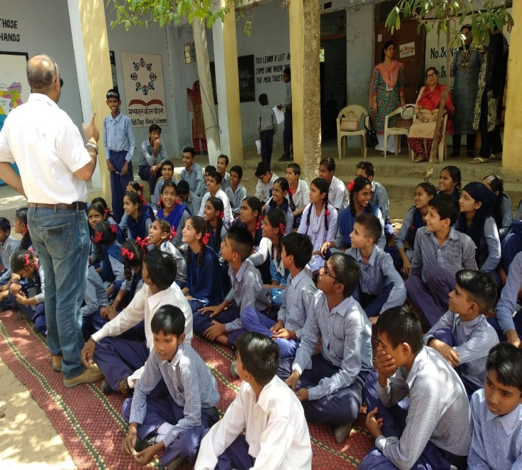
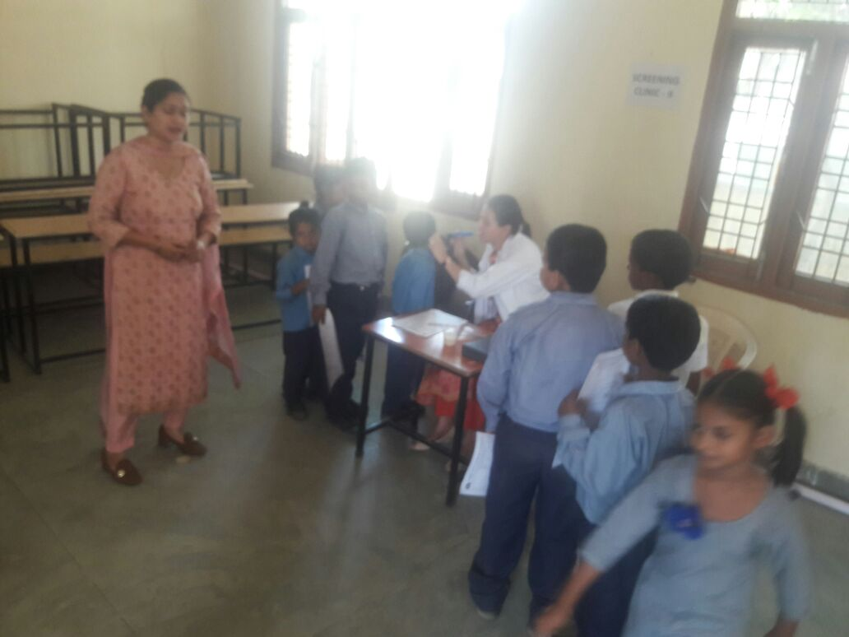
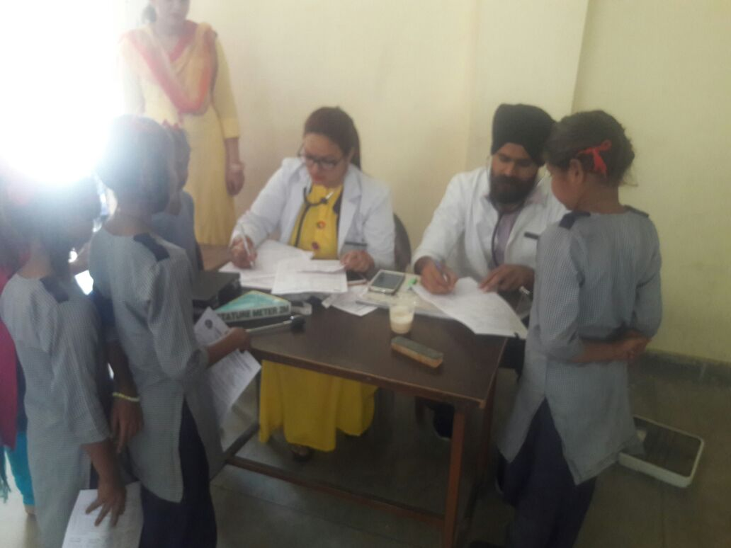
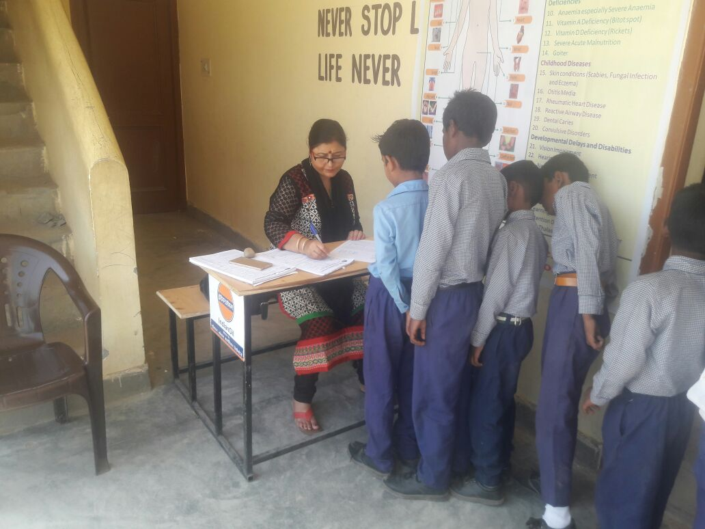
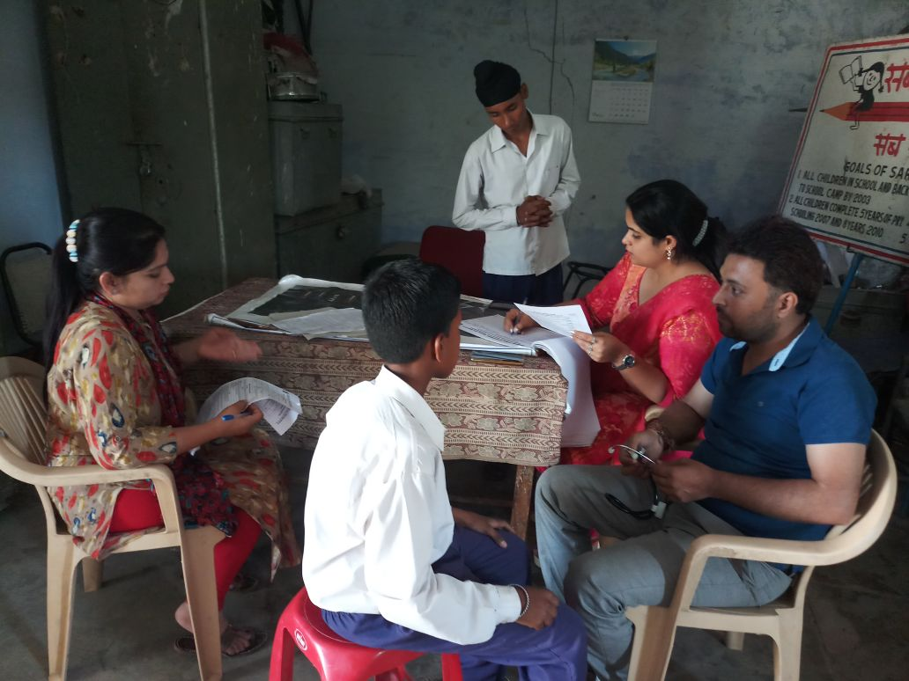
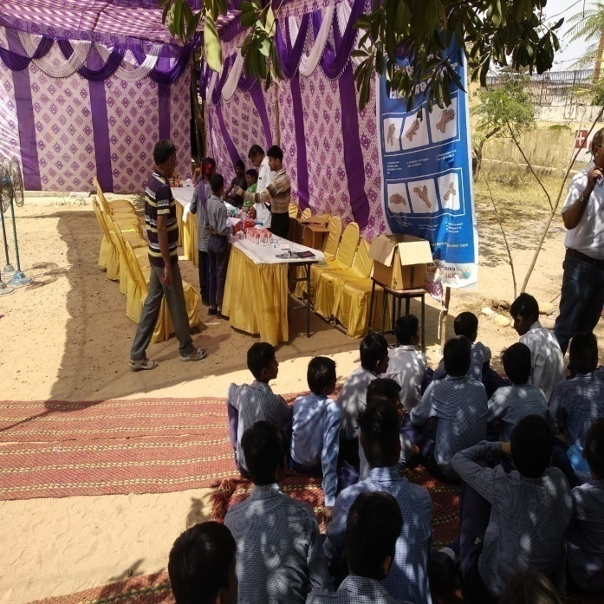
School Health Programme (Rashtriya Bal Swasthya Karykram)

Slide 19
Training of Cook Cum Helpers
Division | Master Trainer trained during 2017-18 | CCH Trained by Master Trainer during 2017-18 | Proposed for 2018-19
 |  |  | Master Trainer | CCH to be Trained by Master Trainer
Jammu | 79 | 1378 | 90 | 4000
Kashmir | 49 | -- | 50 | 3000
Total | 128 | 1378 | 140 | 7000

Slide 20
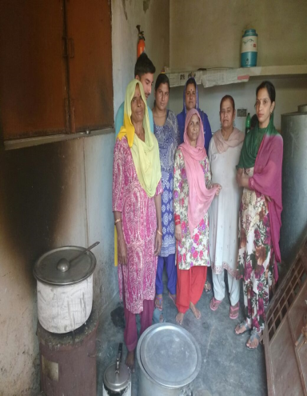
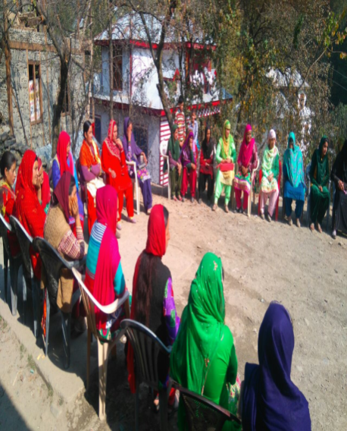
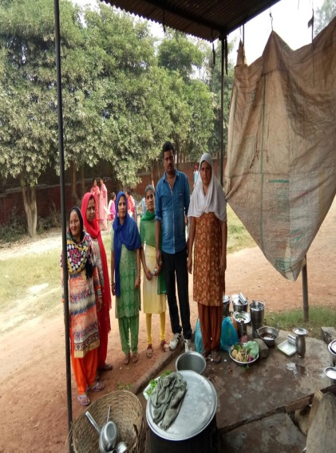
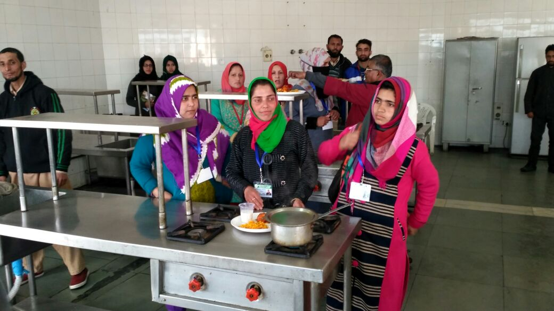
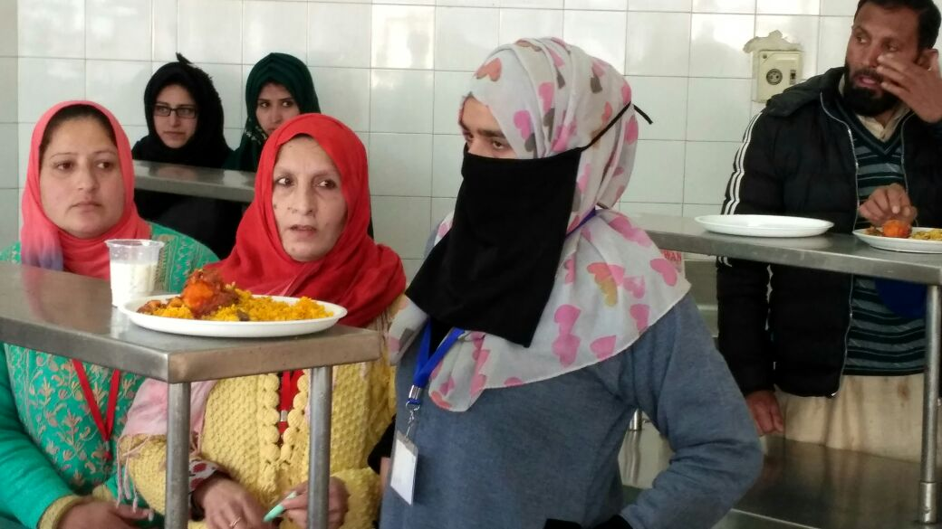
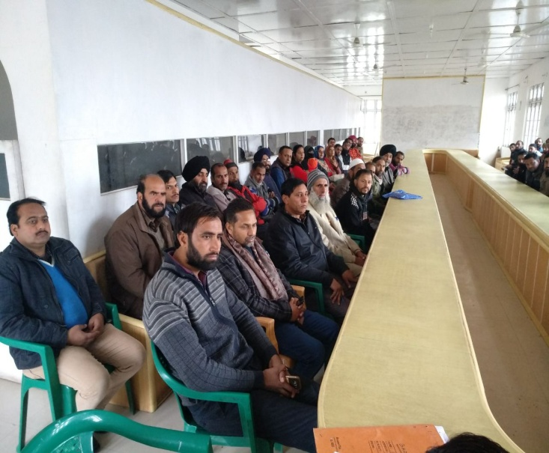
Training of Cook Cum Helpers

Slide 21
Availability of Infrastructure
Indicator | No. of Schools / Centers
 | Jammu | Kashmir | Total
No. of Schools covered under MDM Scheme | 12006 | 11124 | 23130
No. of Schools with gas based cooking | 6404 | 8136 | 14540
No. of Schools having toilet facility | 11254 | 10057 | 21311
No. of Schools with drinking water facility | 9930 | 10591 | 20521

Slide 22
CONSTRUCTION OF KITCHEN CUM STORES
CONSTRUCTION OF KCSs (Central Assistance)
11815 Kitchen-cum-Stores with the financial implication of Rs. 8393.63 lacs sanctioned by MHRD from the year 2006-07 to 2011-12.
7118 Kitchen-cum-Stores with Rs. 4578.30 lacs (Central Assistance) have been constructed thereby leaving a balance of 4697 Kitchen-cum-Stores with the financial involvement of Rs.3815.33 lacs.
The State is in process to surrender Kitchen-cum-Stores having low per unit cost i.e. Rs. 0.60 lacs.
The State Finance Department has desired to provide Utilization Certificate, Copy of authorization letters and audited figures from Accountant General’s Office for the purpose.
Director, School Education Jammu/Kashmir were asked to submit Utilization Certificate and audited certificate/figures from Accountant General’s Office duly signed by the competent authority for its submission to the State Finance Department.
CONSTRUCTION OF KCSs (Convergence)
6685 Kitchen-cum-Stores have been constructed through convergence upto march 2018.

Slide 23
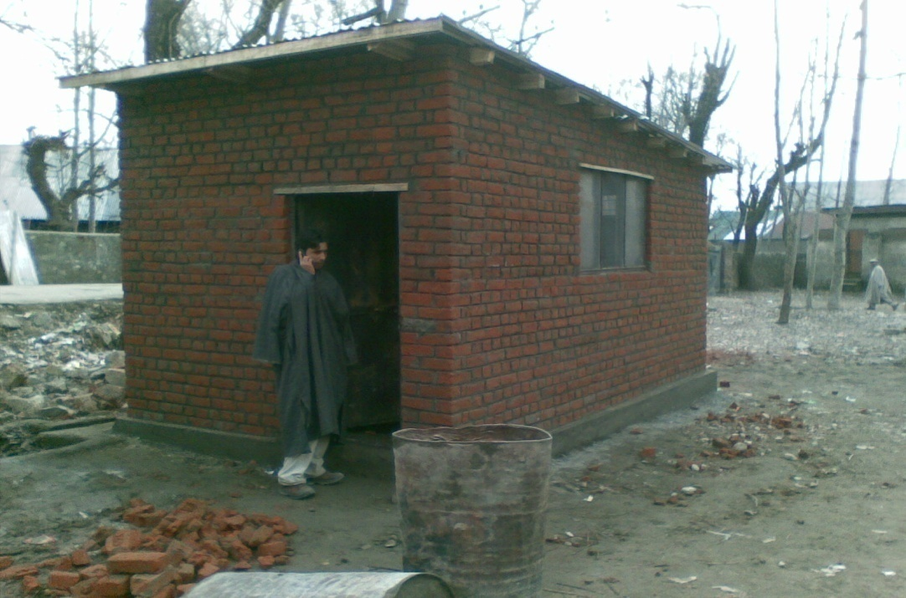
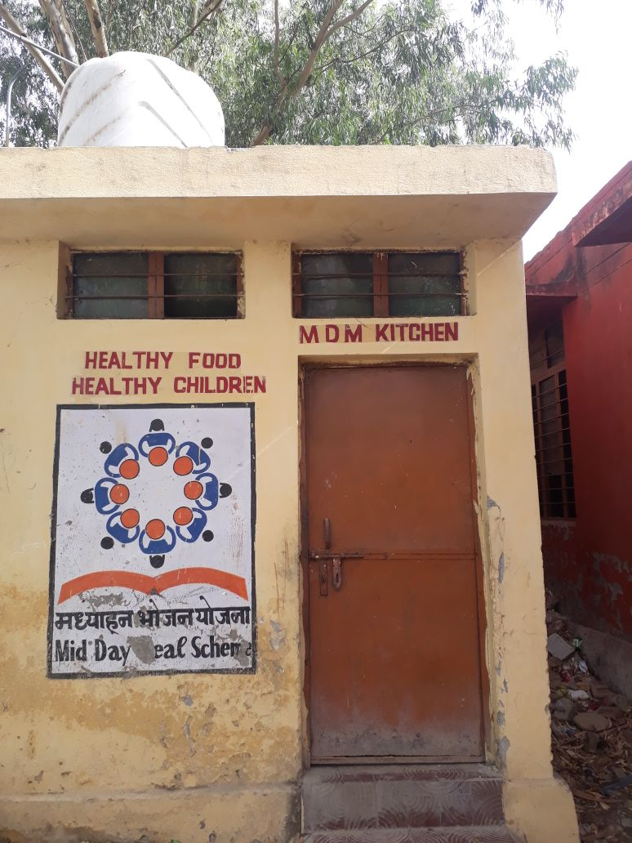
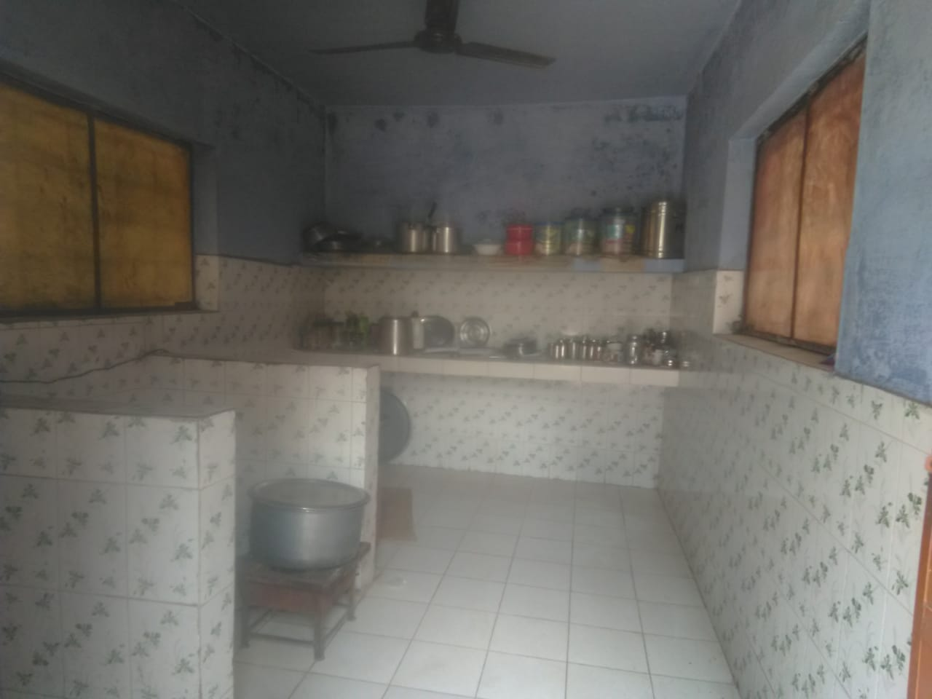
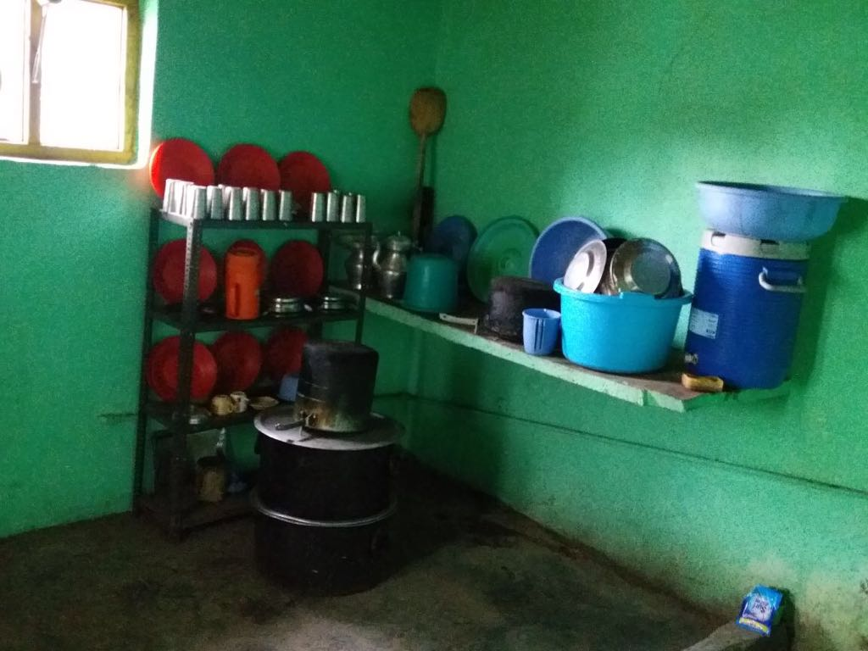
CONSTRUCTION OF KITCHEN CUM STORES

Slide 24
PROCUREMENT OF KITCHEN DEVICES
KITCHEN DEVICES
Against 23623 No. of Kitchen Devices sanctioned by the MHRD, GoI, 22312 No. of Kitchen Devices have been procured, thereby leaving 1311 Kitchen Devices with the financial involvement of Rs. 65.55 lacs still to be procured.
The School Education Department is in touch with the State Finance Department for revalidation of unspent balance of Rs 65.55. lacs needed for the procurement of 1311 KDs.
MHRD has sanctioned Central Assistance of Rs. 1048.45 lacs for the procurement of 20969 No. of Kitchen Devices in the PAB-MDM 2015-16 (201 new and 8885 replacements) and PAB-MDM 2017-18 (44 new and 11839 replacements).

Slide 25
Best Practices
Äkshay Patra (NGO)
The department initiated process to provide meals to the beneficiaries (Students) at school level through NGOs named as “Äkshay Patra” on pilot basis in the District of Jammu and Samba. MOU has been drafted and sent to the Revenue Department for their concurrence.
Automated Reporting & Monitoring System (ARMS)
On line daily Automated Reporting & Monitoring System (ARMS) developed by NIC-HP (www.mdmhp.nic,in) under MDM has been rolled out since Dec. 2017.
Social Audit
Social Audit of the MDM scheme in four Districts (Budgam, Ganderbal, Kathua and Ramban) through Department of Social Action/Sociology, University of Jammu/Kashmir has been taken up.

Slide 26
Best Practices
Sample Analysis
National Accredited Lab. has been approached for sample analysis of meals served to the children.
Department is in touch with Drugs & Food Control Organization for testing of food samples and process of lifting of samples shall start shortly.
Training of Cook Cum Helpers
For quality and hygiene, training of Cook-cum-Helpers has been started through Institute of Hotel Management, Rajbagh, Srinagar and Food Craft Institute, Nagrota, Jammu.
Kitchen Garden
137 schools have established Kitchen Gardens and 4408 schools have been targeted where the land is available for setting up of Kitchen Gardens during 2018-19. The fresh vegetables so produced is used in preparing Mid-Day Meals.

Slide 27
Best Practices
Honorarium to Cook-cum-Helpers
E-transfer of Honorarium in the bank accounts of cook cum helpers
District level meetings
9 meetings of District level committee headed by the senior most MP held during 2017-18.
362 Meetings of District Steering cum Monitoring committee headed by Deputy Commissioner held during 2017-18.
School Inspections
19919 Schools have been inspected by the Government officials during 2017-18
Water purifier in Schools
1302 schools have facilities of water filtration.

Slide 28
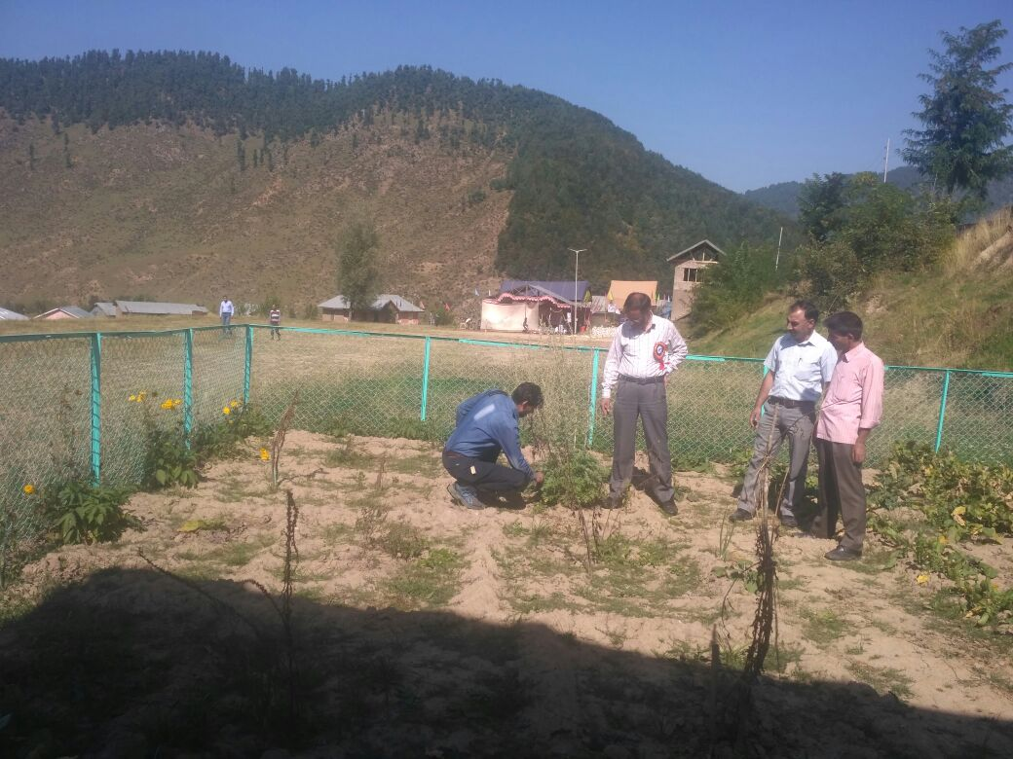
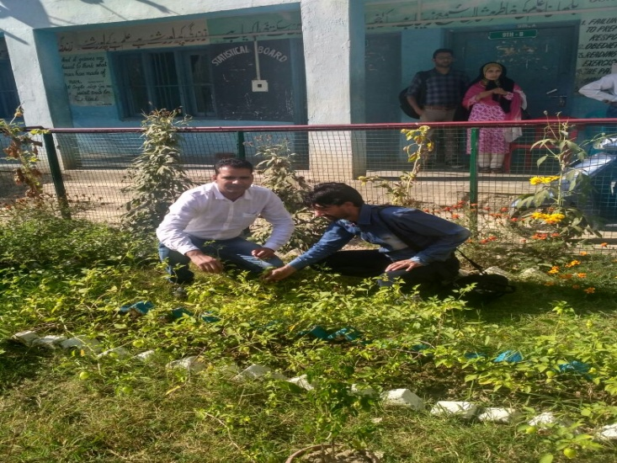
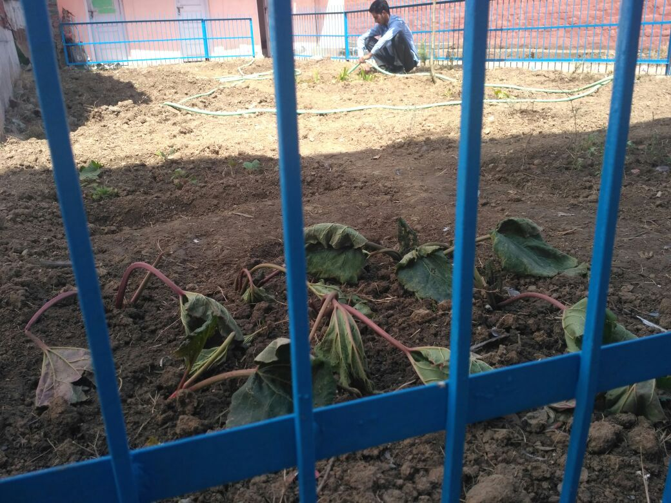
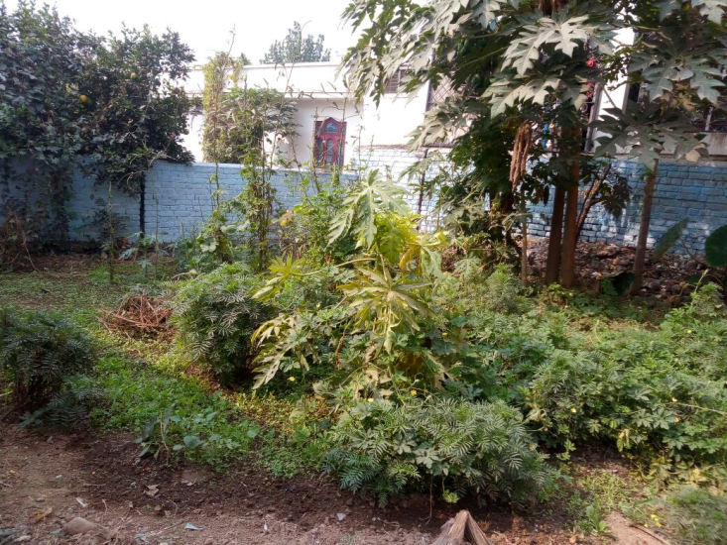
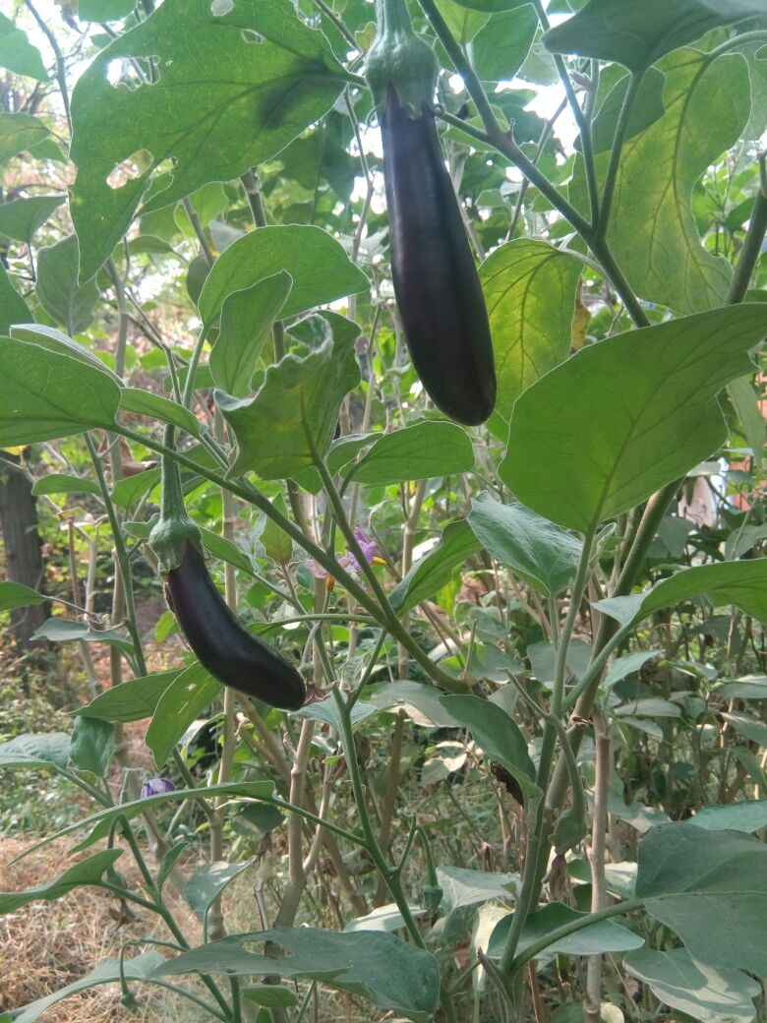
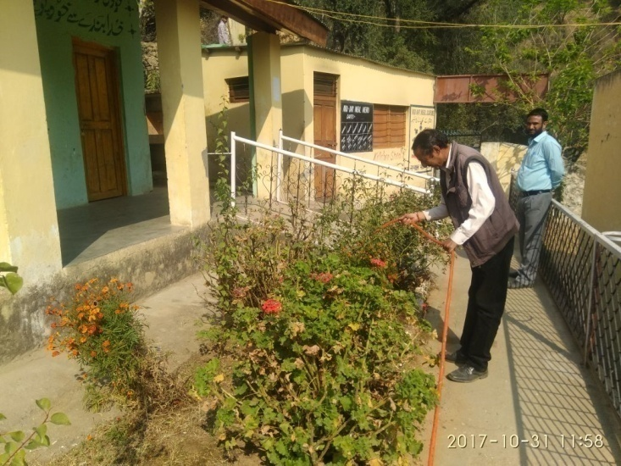
Kitchen Garden
137 schools have established Kitchen Gardens
GHSS Kulgam
HSS Beerwah Badgam
HSS Malvan
SS
MS Baryal Udhampur
MS Baranpata Jammu
HS Jodhpur Doda

Slide 29
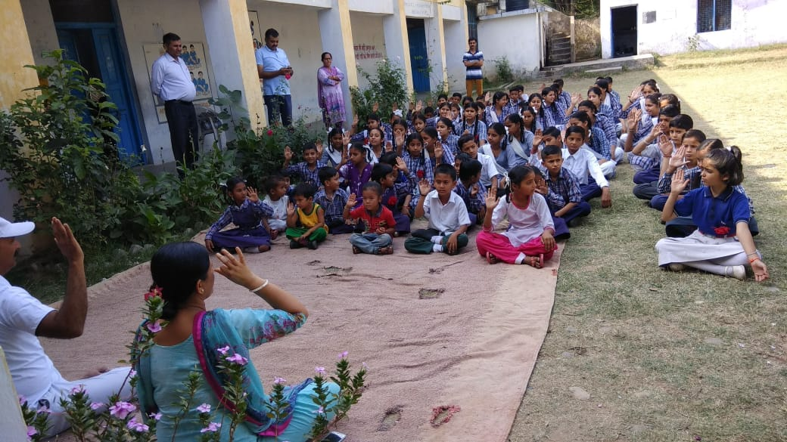
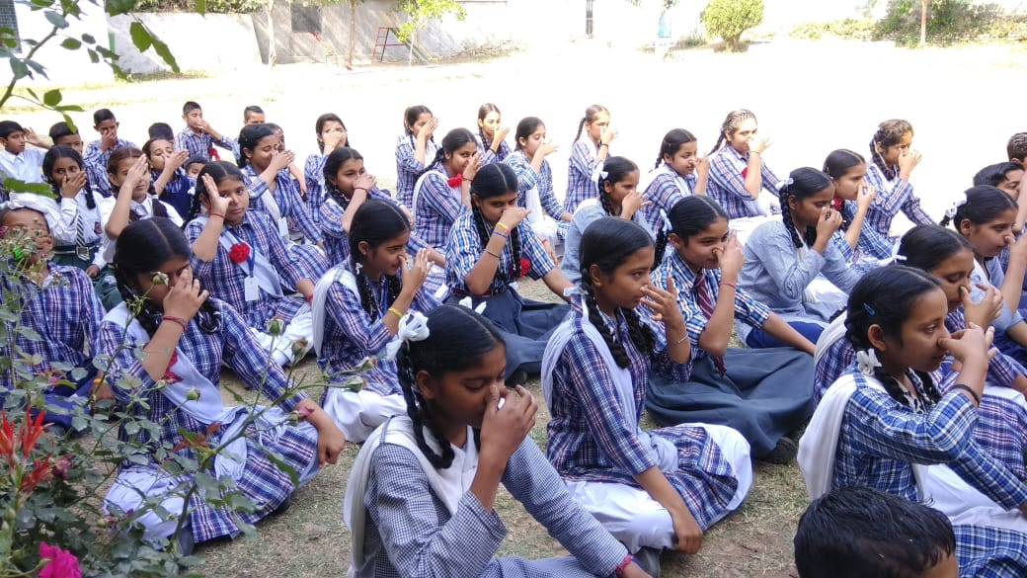
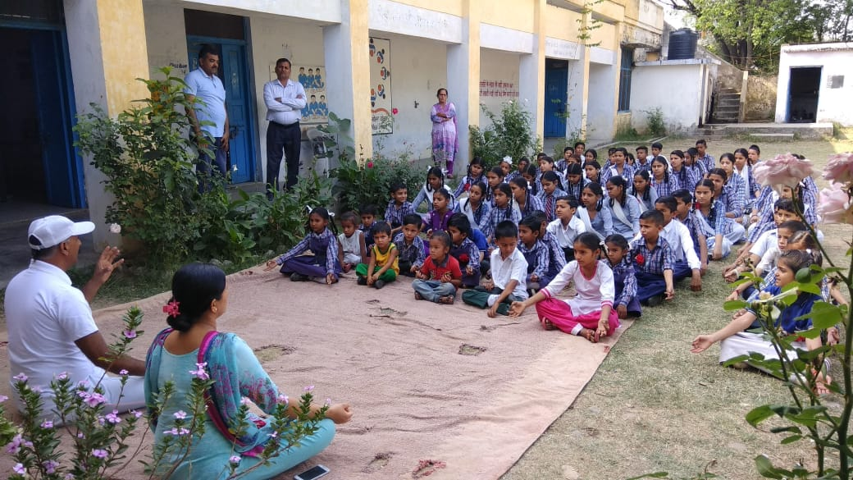
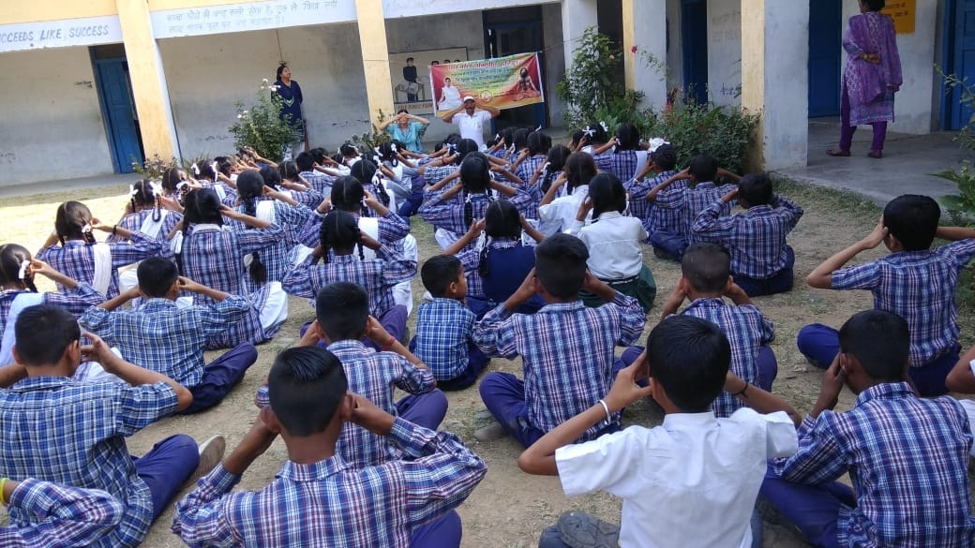
Yoga in Schools

Slide 30
AWP&B 2018-19 Proposals
in the
Implementation of MDMS
(Primary + Upper Primary)

Slide 31
AWP&B 2018-19 (Proposal)
Physical
PAB approved enrolment for the year 2016-17 | 7,17,627 Children
PAB approved enrolment for the year 2017-18 | 5,58,396 Children
Proposal for the year 2018-19 | 7,76,998 Children
Item | Unit | PS | UPS | Total
Schools | Number | 13,360 | 9,770 | 23,130
Children | Number | 5,18,694 | 2,58,304 | 7,76,998
Working Days | Number | 220 | 220 | 220
Cook-cum-Helpers | Number | 17,772 | 15,496 | 33,268
Foodgrains (Rice) | MTs | 11,411 | 8,524 | 19,935

Slide 32
AWP&B 2018-19 (Proposal)
Financial (Rs. in lakh)
Component | PS |  | UPS |  | PS + UPS
 | CS | SS | CS | SS | CS | SS | Total
Cost of foodgrains | 342.34 | 0.00 | 255.72 | 0.00 | 598.06 | 0.00 | 598.06
Transportation Cost | 154.05 | 0.00 | 115.07 | 0.00 | 269.12 | 0.00 | 269.12
Cooking Cost | 4245.04 | 467.87 | 3159.53 | 352.32 | 7404.57 | 820.19 | 8224.76
Honorarium to Cooks | 1599.48 | 177.72 | 1394.64 | 154.96 | 2994.12 | 332.68 | 3326.80
MME | 114.14 | 0.00 | 88.62 | 0.00 | 202.76 | 0.00 | 202.76
Total | 6455.05 | 645.59 | 5013.58 | 507.28 | 11468.63 | 1152.87 | 12621.50

Slide 33
Issues
Increase in Honorarium to Cook-cum-Helpers from existing Rs. 1000/- per month for 10 months to Rs 2000/- per month for 12 months.
Increase in Cooking cost rates (@ 7.5%) which has become due w.e.f July 2017.
Transportation Cost be increased from existing Rs. 1350/- per MT.
The rate of MME component be increased from existing 1.8%.

Slide 34
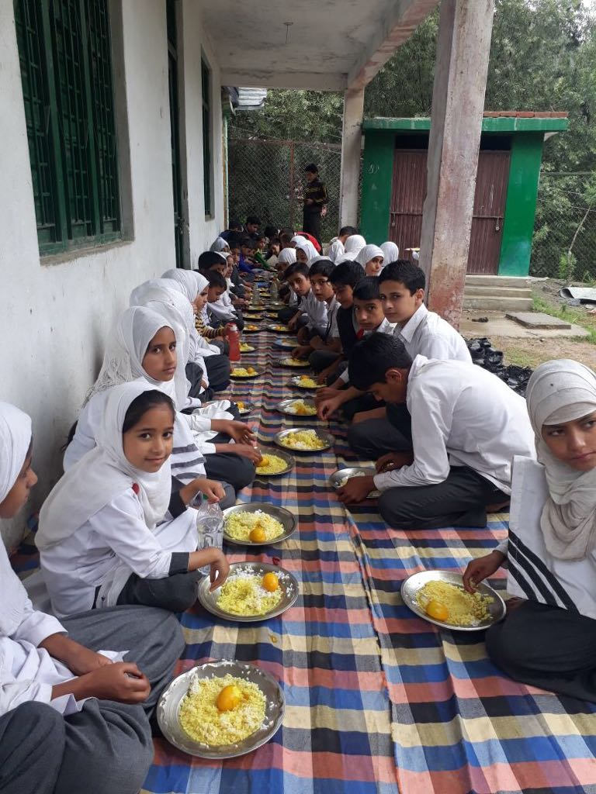
Thanks

