Slide 1
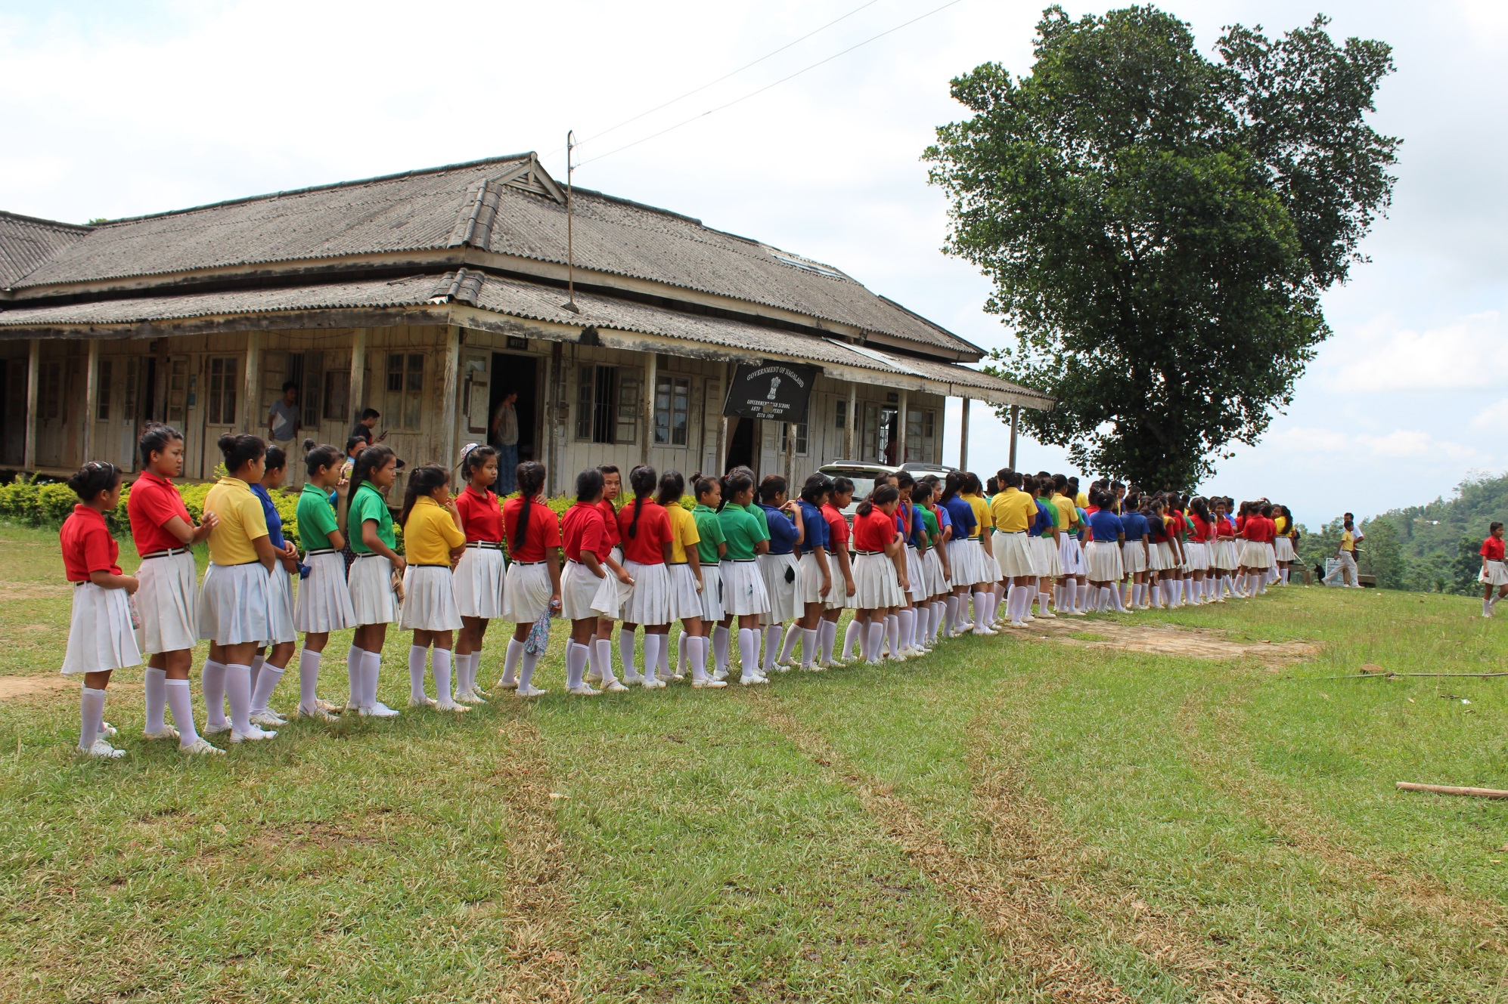
Mid Day Meal Scheme
MDM-PAB Meeting- Nagaland
17.05.2018
Ministry of HRD, Govt. of India

Slide 2
Review of Implementation of MDMS in NAGALAND (Primary + Upper Primary) (1.4.2017 to 31.03.2018)
Ministry of HRD, Govt. of India

Slide 3
Good practices in Implementation
Community contributes seasonal fruits, vegetables as a supplement to the meals served to children.
Community is providing dining tables for serving MDM in some of the schools.
Kitchen garden in schools for giving the children more nutritious food.(358 kitchen garden in schools)
To strengthen monitoring of MDM scheme in the blocks, 134 officers have been designated as Area Education Officers for effective inspection & monitoring of the scheme
Sense of ownership has come up among the community for implementation
Church gives loans in form of fund & food grain from its resources when there are delays.
Ministry of HRD, Govt. of India

Slide 4
Issues
Insufficient provision of safe drinking water (54%) only.
Very poor reporting under AMS (1.14%) only.
Mismatch in data of MDM-MIS and AWP&B.
Delay in submission of required information by State Govt. (viz. QPRs, information of unspent balance etc.)
Social audit not yet conducted as per MHRD Guide line.
CCH are being paid in cash by SMC (55%) & E-Transfer in bank account ( 45%)
Ministry of HRD, Govt. of India

Slide 5
Innovations etc.
It is proposed that the States and UTs may also be given flexibility to utilize, with prior approval of MHRD, 5% of their Annual Work Plan & Budget for new interventions provided they are not included under any of the Central or State Schemes and there is no overlapping of activities. This is subject to CCEA approval.
Some of the suggested innovation may be in the field of Water filters, kitchen gardens, provision of LPG connections, use of millets etc. These are only illustrative and not exhaustive.
Community participation.
Meetings of District committee headed by Dist. Collector.

Slide 6
Coverage : Children (Pry) during last 3 yrs
National Avg – 76%
No. of Children (in lakh)
91%
98%
98%
Ministry of HRD, Govt. of India

Slide 7
Coverage : Children (Up. Pry) during last 3 yrs
National Avg – 76%
No. of Children (in lakh)
78%
95%
93%
Ministry of HRD, Govt. of India

Slide 8
Aadhaar Enrollment as on 31.03.18
Details | Children
Total Enrolment | 163502
Number of children Aadhaar | 63286 (39%)
Number of Children without Aadhaar | 100216(61%)
Ministry of HRD, Govt. of India

Slide 9
FOOD GRAIN : ALLOCATION vs UTILISATION
Quantity in Hundred MTs
72%
74%
100%
Ministry of HRD, Govt. of India

Slide 10
Payment of cost of Food grains to FCI
Cost of Food Grain (Rs. In Lakh )
100%
Ministry of HRD, Govt. of India

Slide 11
COOKING COST: ALLOCATION vs UTILISATION
Rs in Crore
51%
61%
100%
Ministry of HRD, Govt. of India

Slide 12
Transportation Assistance : Allocation vs Utilisation
Rs in Crore
41%
64%
100%
Ministry of HRD, Govt. of India

Slide 13
MME : ALLOCATION vs UTILISATION
Rs in Lakh
96%
20%
59%
.
Ministry of HRD, Govt. of India

Slide 14
Construction of Kitchen cum Stores
Total Sanctioned : 2223 Kitchen Cum Stores
Progress (in %)
2223
Ministry of HRD, Govt. of India

Slide 15
Coverage : RBSK
Details | Total Institutions | Children
Total in State | 2059 | 163701
Health Check-up | 2059 | 103007 (63%)
IFA Distribution | 2059 | 24525 (15%)
Deworming Tablets | 2059 | 37605 (23%)
Spectacles | 2059 | 0
Ministry of HRD, Govt. of India

Slide 16
Elements of Ayushman Bharat
Electronic Health Records
Electronic health record for each child
Upgrading skills of emergency care
Training on basic first aid for the teachers
School Health Promotion Activities
Provision of Services
Health Screening
Age appropriate learning for promotion of healthy behavior and prevention of various diseases
Delivered through school teachers trained as Health Ambassadors in coordination with health department staff.
Screening of children 30 identified health conditions for early detection, free treatment and management through dedicated RBSK mobile health teams
Iron Folic Acid (IFA) tablets, Albendazole administration will be provided by teachers through WIFS and National Deworming Day (NDD) programme respectively.
Provision of Sanitary Napkins.
Identification of malnourished and anemic children and appropriate referrals to PHCs and hospitals. The periodicity of such checkups may be increased.
Age appropriate vaccination.
Availability of potable drinking water
Yoga Meditation

Slide 17
Availability of safe drinking water
Schools | No of Schools
Total Schools | 2059
Schools having drinking water facility | 1118 (55%)
Schools having Safe drinking water facility
Having water filtrations facility
Membrane (UV+RO)
UV purification
Candle filter purifier | 1118
Activated carbon purifier
Ministry of HRD, Govt. of India

Slide 18
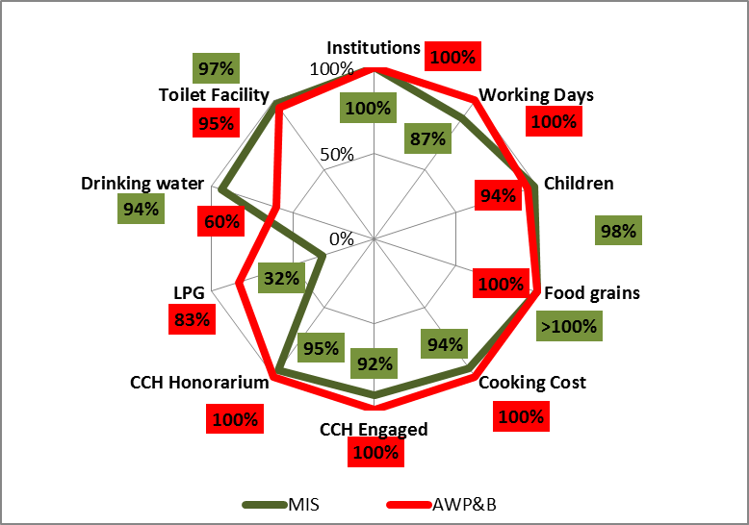
Comparison of data: MIS vs AWP&B
Ministry of HRD, Govt. of India

Slide 19
Three Year scorecard at a glance
FY : 2017-18
FY-2016-17
FY-2014-15

Slide 20
Analysis of State’s Proposal for 2018-19
Ministry of HRD, Govt. of India

Slide 21
Proposal for 2018-19 : Children (Primary)
No. of children (in lakhs)
Availed MDM in Q-1
Proposal for 2018-19
PAB Approval 17-18
Availed MDM in Q-3
Proposed by State
Availed
Availed MDM in Q-2
Availed MDM in Q-4
Enrolment
Ministry of HRD, Govt. of India

Slide 22
Proposal for 2018-19: Children (Upper Primary)
No. of children (in Lakhs)
0.41
Proposal for 2018-19
Enrolment
Availed MDN in Q-1
Proposed by State
Availed
Availed MDM in Q-2
PAB Approval for 17-18
Availed MDM in Q-3
Availed MDM in Q-4
Ministry of HRD, Govt. of India

Slide 23
Proposals and Recommendations
S. No | Component | PAB Approval 2017-18 | Proposal for 2018-19 | Recommendation
1 | Children (Pry) | 121634 | 123391 | 122117
2 | Children (U Pry) | 36858 | 40111 | 39603
3 | Children (STC) | 957 | 2200 | 1981
4 | Working Days | Pry_220 Upry_220 NCLP_312 | Pry_220 Upry_220 NCLP_312 | Pry_220 Upry_220 NCLP_312
5 | Kitchen cum Store | 0 | 845
6 | Cook cum Helpers | 4643 (Reduction of 414) | 4695 (Additional Pry-48+U.Pry5=52) | 4695 (Additional Pry-48+U.Pry5=52)
7 | Kitchen Devices (New) | Nil | Nil | Nil
8 | Kitchen Devices (Replacement) | 541 | 1044 | 1000
9 | MME (Rs. In lakh) | 37.21 | 39.40 | 38.97
10 | Kitchen –cum-Store | Nil | 845
11 | Notional Requirement of Central Assistance (Rs. In Crore) | 21.88 | 22.27 | 22.04

Slide 24
Thank You
Ministry of HRD, Govt. of India

