Slide 1
Annual Work Plan & Budget, 2019-20
[Mid Day Meal Scheme]
MDM - PAB Meeting
07.05.2019
Arunachal Pradesh

Slide 2
OVERVIEW
Initiatives taken up by State Government. Other Issues.

Slide 3
INITIATIVES OF STATE GOVERNMENT
1. Centralized Kitchen
Rs.200.00 lakh has been sanctioned for starting centralized kitchen in Itanagar. Another Rs.100.00 lakh has been sanctioned for starting centralized kitchen in Pasighat. Namsai District has also started centralized kitchen from CMSSY grant of Rs.30.40 lakh for construction of kitchen-cum-store in 19 schools/clusters. Funds have been transferred to Districts through PFMS.
2. Top-up additional Honorarium to Cook-cum-Helper from State Government
An amount of Rs.652.50 lakh has been sanctioned during 2018-19 as a Top-up additional honorarium to CcH @Rs.1000/- per month for 10 months in a year. Payment is being made through DBT mode under PFMS.

Slide 4
INITIATIVES….
3. Constitution of Central Inspection Team (CIT)
Central Inspection Team has been constituted comprising of 4 members in each Team vide order No.SEDN/179/2019 dated, 26/03/2019. Each Team has been assigned a group of Districts divided into Centre Zone, East Zone, West Zone, North Zone and South Zone. Motive of inspection of schools is to wipe out short falls & take corrective measure in implementation of various schemes including MDM scheme.
4. Orientation Training Program for Head Teachers
State level Orientation Training Program for Head Teachers has been conducted from 6th to 9th August, 2018 at Itanagar. Head Teachers were trained in maintaining academic calendar activities, account maintenance, record keepings, cooking & serving uninterrupted quality MDM, contingency plan of MDM scheme, importance of kitchen garden in schools, MDM entitlement, etc. Funds are being placed to the districts to conduct similar training programs.

Slide 5
INITIATIVES….
5. Decentralized Planning Process
Planning process under Education Department has been decentralized through Chief Minister’s Samast Shiksha Yojana. Fund is placed to the Deputy Commissioners of the Districts through PFMS. District Executive Committee under the chairpersonship of Deputy Commissioner of the districts have been empowered to implement various schemes under Education Department. Better maintenance of school infrastructures including construction of new Kitchen-cum-Stores for MDM scheme are being taken up in phase manner. An amount of Rs.233.80 lakh has been placed to Deputy Commissioners of 9 Districts during 2018-19 for construction of 74 kitchen-cum-store. Under this Yojana, there are provisions for the districts to submit their proposal for LPG connection in the schools, procurement of eating plates, tumbler & spoon and drinking water supply in schools.

Slide 6
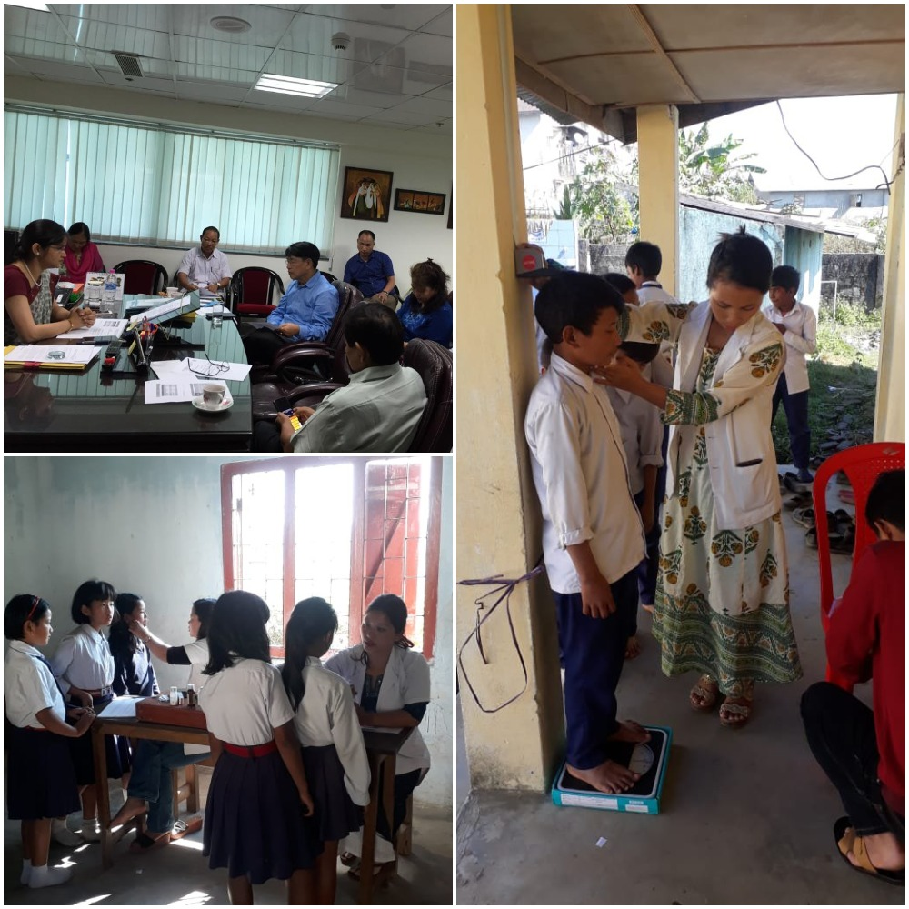
INITIATIVES….
6. Rashtriya Bal Swasthya Karykram (School Health Programme)
 | Coordination meetings between Education Department and Health Department have been conducted on 12.06.2018 & 27.07.2018. Rashtriya Bal Swasthya Karykram (SHP) screening are being conducted in schools periodically. Both Departments are monitoring and sharing information & data through whatsapp group ‘SCHOOL HEALTH PROGRAMME’. Health Checkup coverage is 63.52% (33.34% in 2017-18). Administration of de-worming tablet is 61.31% (34.22% in 2017-18). Iron folic tablet is 25.45%(17.02% in 2017-18).

Slide 7
INITIATIVES….
7. Standard Operating Procedure (SOP)
Standard Operating Procedure (SOP) for effective implementation of MDM scheme has been issued vide letter No.EED9/MDM/25/2014-15 dated, 2/11/2018. Development of kitchen gardens given top priority in schools where land is available to supplement the implementation of Mid Day Meal scheme. Total schools with kitchen garden are 221. Strengthening of Student Database MIS (SDMIS) at District level to check duplicity in enrolment. Strict action to be initiated against Head of schools if wrong enrolment data is submitted. District Level Steering cum Monitoring Committee (DLSMC) of MDM scheme along with other convergent Departments to be conducted at least once a month under chairpersonship of Deputy Commissioner. DDSEs to explore the possibility of introducing locally available nutritional grains like, millet in mid day meal. Cost to be borne from existing cooking cost norms.

Slide 8
INITIATIVES….
8. Other activities being taken up or to be taken up within this year.
Enrolment Drive is being conducted at district/block/village level w.e.f. 15/04/2019 to 15/05/2019 to check decline in enrolment. Training of Cook-cum-Helper on MDM entitlement norms, personal hygiene, washing & cleaning, garbage disposal, etc. will be conducted in every districts during 2019. Cooking competition of cook-cum-helpers to be conducted. 1st Working day of each month : Tithi Bhojan to be conducted wherein all Administrative Officers/Line Department officers would visit one school at 11.00 Hrs. to taste the MDM with students. 5% flexi fund – Tiffin box, water bottle, Dinning Hall for Govt. UPS with Dining tables & chair, LPG connection will be taken.

Slide 9
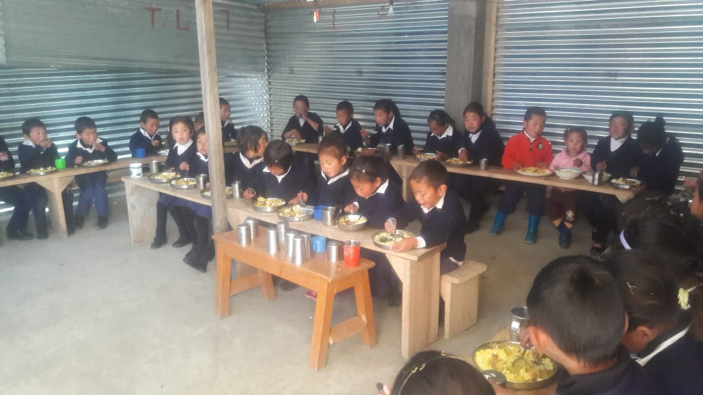
MDM being served…
Upper Primary School, Shyaro, Tawang District

Slide 10
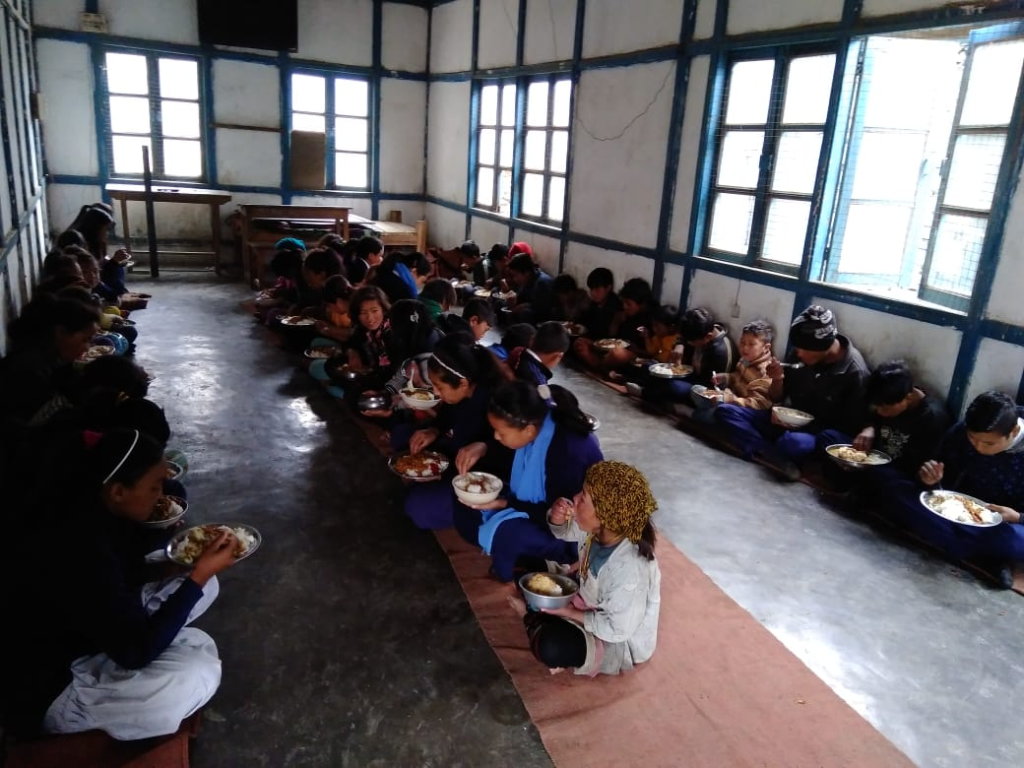
MDM being served…
GMS, Thembang (West Kameng District)

Slide 11
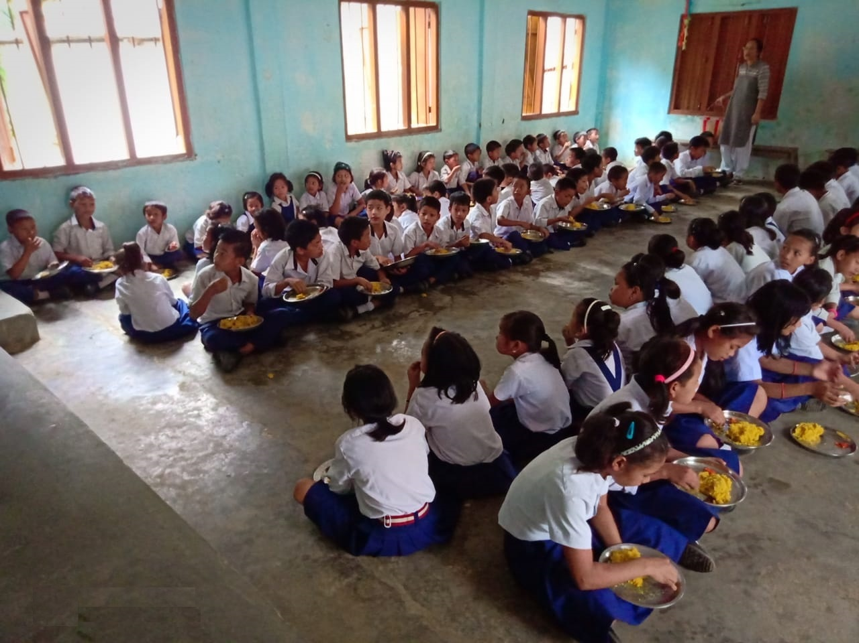
MDM being served…
Govt. Upper Primary School, Bank Colony, Khonsa

Slide 12
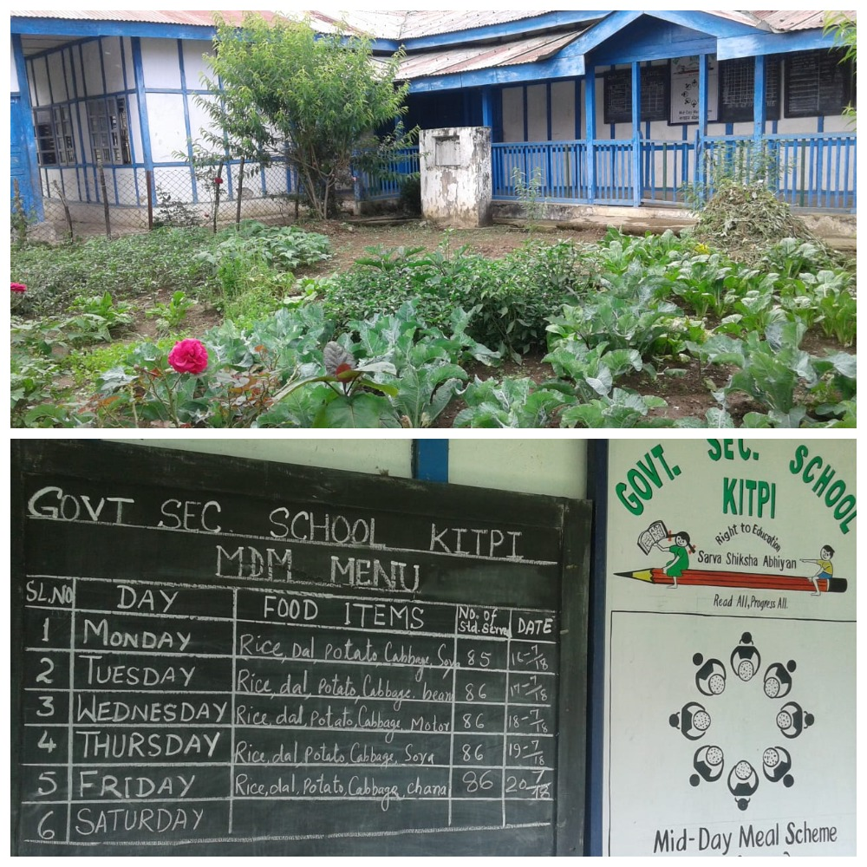
Display of Menu, MDM Logo & Kitchen Garden

Slide 13
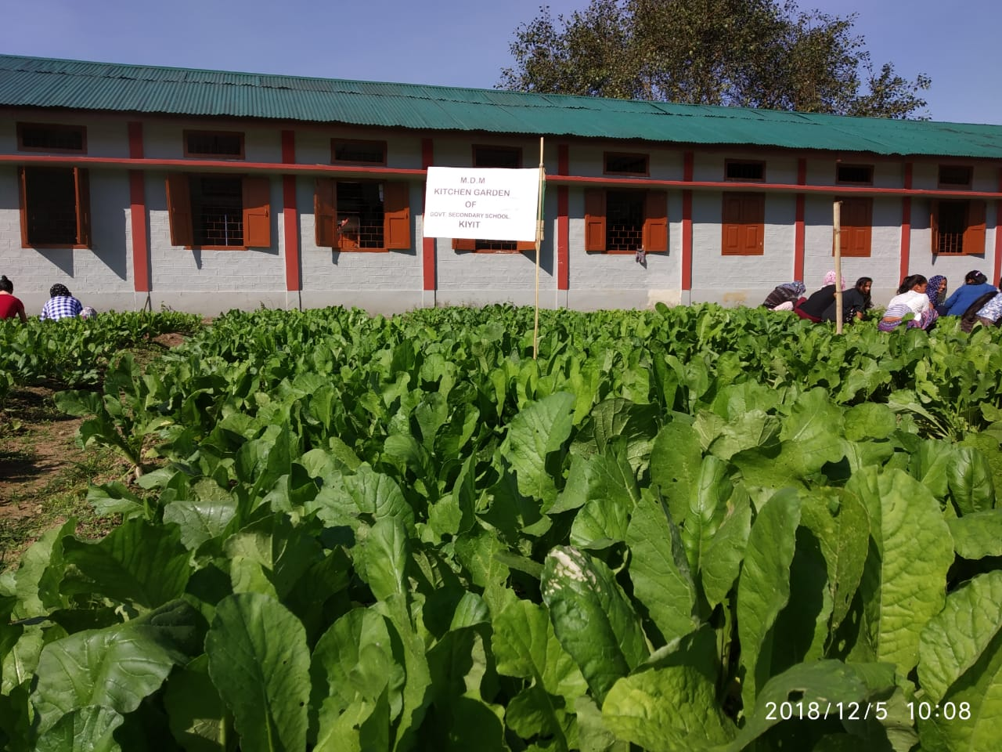
BEST PRACTICES
Kitchen Garden to supplement MDM
Govt. Secondary School, Kiyit (East Siang District)

Slide 14
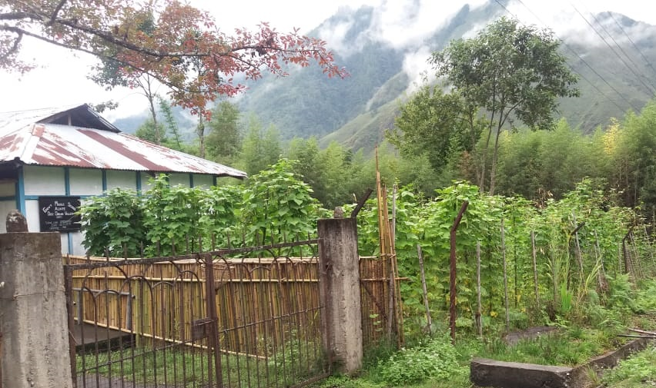
BEST PRACTICES….
Kitchen Garden to supplement MDM
GMS, Alinye (Dibang Valley District)

Slide 15
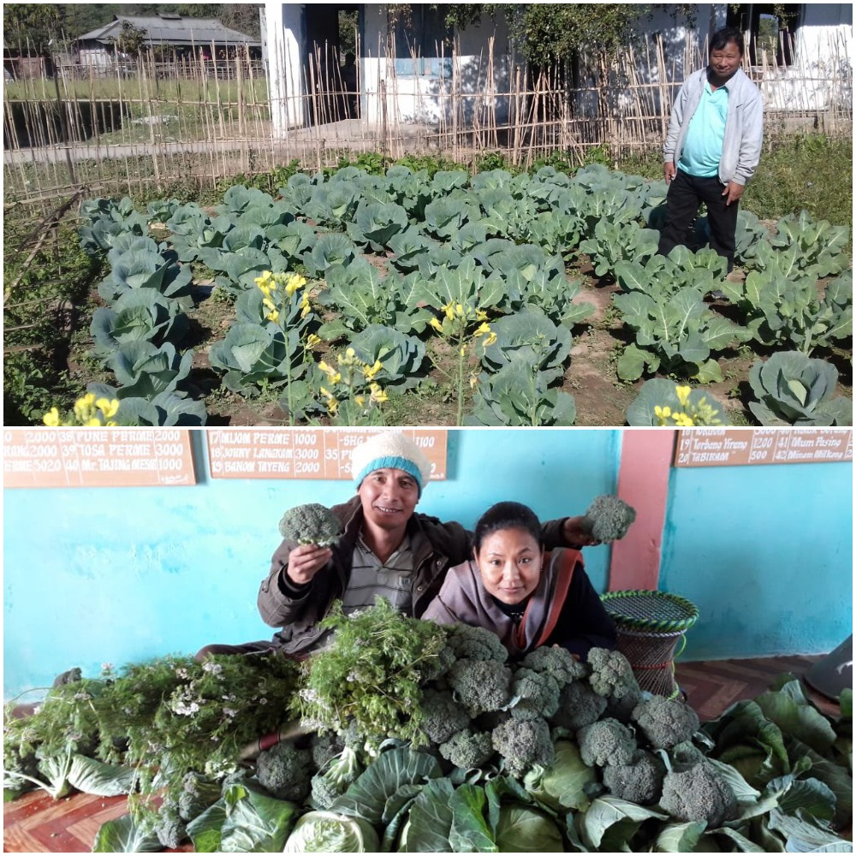
BEST PRACTICES….
Kitchen Garden to supplement MDM
Govt. UPS, Ngupak (East Siang District)

Slide 16
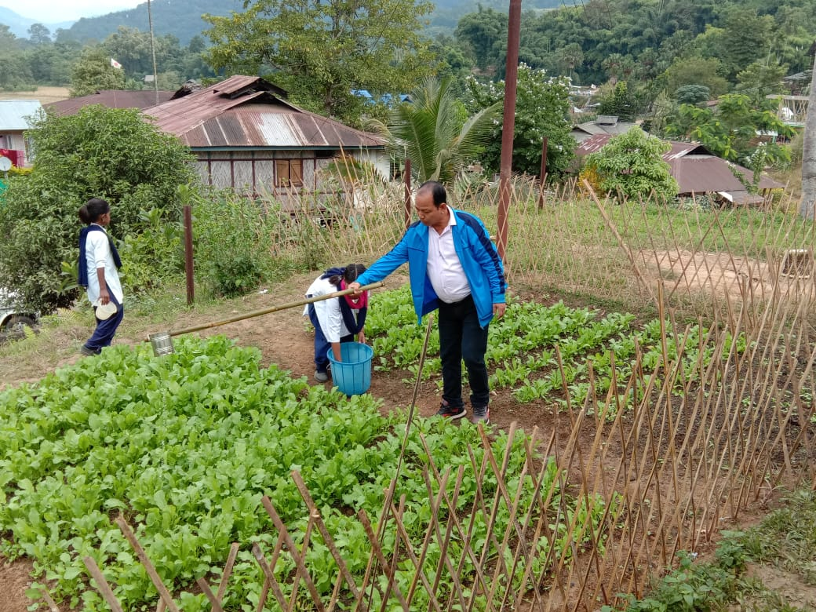
BEST PRACTICES….
Kitchen Garden to supplement MDM
Govt. UPS, Panya (West Siang District)

Slide 17
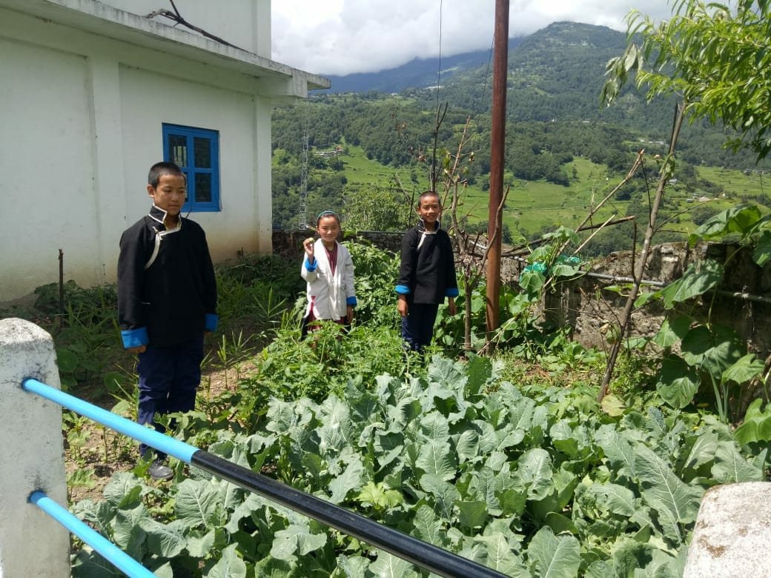
BEST PRACTICES….
Kitchen Garden to supplement MDM
Govt. ME, Gongkhar (Tawang District)

Slide 18
OTHER ISSUES….
1. Automated Monitoring System (AMS) through SMS
Like other States, Arunachal Pradesh also registered for Automated Monitoring System of MDM scheme by onboarding with Himachal Pradesh AMS system. Daily reporting from schools through SMS is very poor at maximum 3-4%. Reasons for poor reporting are precarious mobile network connectivity at block level & frequent change of mobile numbers of teacher in charge of MDM. For Automated Monitoring System (AMS), SIM card to be ensured in school name from MME component. This was resolved in SSMC meeting held on 30.04.2019.

Slide 19
OTHER ISSUES….
2. Testing of food samples by accredited laboratories
Due to absence of reputed /accredited laboratory in the State of Arunachal Pradesh, testing of food samples served under Mid Day Meal scheme has not been conducted. Testing of food samples served under Mid Day Meal scheme will become more necessary with setting up of Centralized Kitchens in districts. This issue was also placed before the SSMC, and it was observed by the house that setting up accredited food testing laboratories in the State would be possible only if the Centre gives financial assistance for setting up such accredited food testing laboratories in the State..

Slide 20
OTHER ISSUES….
3. Central Assistance for repairing of Kitchen-cum-Store
All the kitchen-cum-store of MDM scheme in the State were built at a cost of Rs.60,000/- per kitchen-cum-store during 2006-07 & 2007-08. Almost all the kitchen-cum-stores are in dilapidated condition. As per AWP&B 2019-20, table-AT28B, State has submitting the proposal for repairing of 2934 kitchen-cum-Store @Rs.10000/- per kitchen-cum-store. The proposal is made for only those schools where MDM is being served. The total proposal amount is Rs.293.40 lakh. Out of which, Central share is Rs.264.06 lakh and State share is Rs.29.34 lakh. This may be approved in this PAB meeting irrespective of submission of SOR.

Slide 21
Thank You

