Slide 1
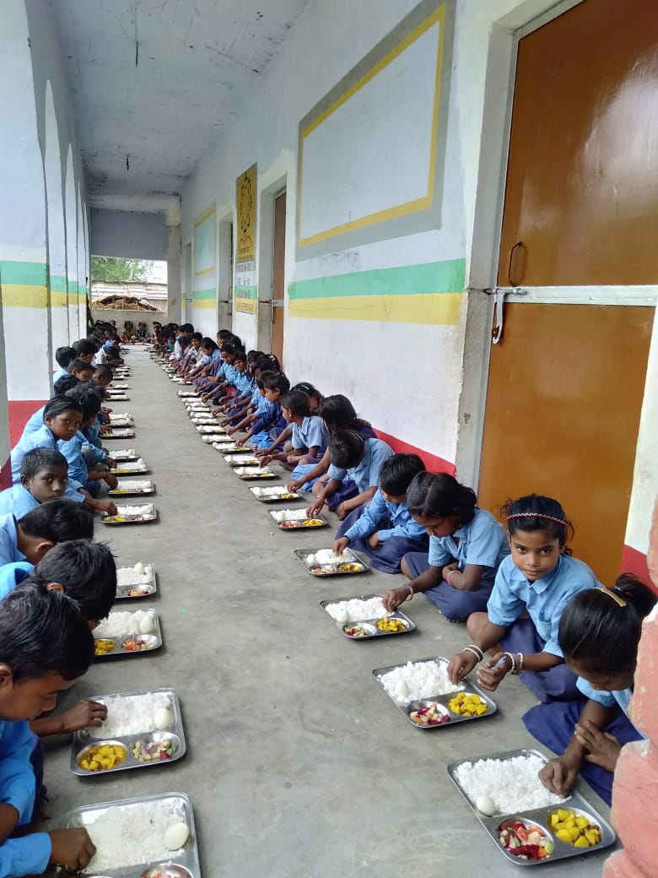
ANNUAL WORK PLAN & BUDGET-2019-20 PAB MEETING 29.05.19 Directorate of MDM EDUCATION DEPARTMENT GOVT. OF BIHAR

Slide 2
GOAL
100% coverage of school attending children
Ensuring quantity, quality, hygiene and timeliness in food served
Timely payments – salary, honorarium to cook cum helper, vendor payments, etc.
Timely and accurate reporting

Slide 3
STEPS TAKEN TO ENRICH THE SCHEME
State has provided fund for LPG connection with stove and fire extinguisher to all school.
90 percent school are using LPG for cooking MDM.
State is providing Egg/Fruit once in a week.
District MDM office directly transfer monthly honorarium of Cook cum helper from district level to CCH account through RTGS on the basis of absentee entered by the concerned BRP in MIS per month.
Provision of compensation of Rs. 4 lakhs after demise of cook cum helper during work.
34.20 crores compensation given to kith and kin of 855 Cook cum helper who died during work from 31.8.15 to 31.03.19.

Slide 4
GRIEVANCE REDRESSAL
A toll free no 1800-345-6208 has been installed at directorate level for grievance related to mid-day meal scheme.
E.mail address and telephone numbers of all district level officers and state level officers have been posted on dopahar.org for the public view and for sending grievance regarding mid day meal scheme.
Every Friday Director Mid-day Meal meets people with complain regarding MDM.

Slide 5
Initiative
Mid-day meal Rule 2015 (Food security act)has been implemented in the state since 1st Feb 2019
State has again increased additional honorarium to CCH of Rs. 250/- per month (total Rs.1500/-per month) w.e.f 01.02.2019
State has scale up school kitchen garden “Ankuran “ with help of UNICEF in 4700 schools. And proposed 20000 school kitchen garden for 2019-20

Slide 6
VSS/ Cook cum helper training
One day training programme of vidyalaya shikha Samiti /HM and 220000 cook cum helpers was organized in all districts on a rotational basis from 25.4.18 to 30.5.18 for preparation of safe, hygienic and nutritious food in school

Slide 7
VSS/Cook cum helper training

Slide 8
Kitchen Garden-Ankuran Bihar

Slide 9
Kitchen Garden-State level Convergence meeting

Slide 10
Kitchen Garden-State level Convergence meeting

Slide 11
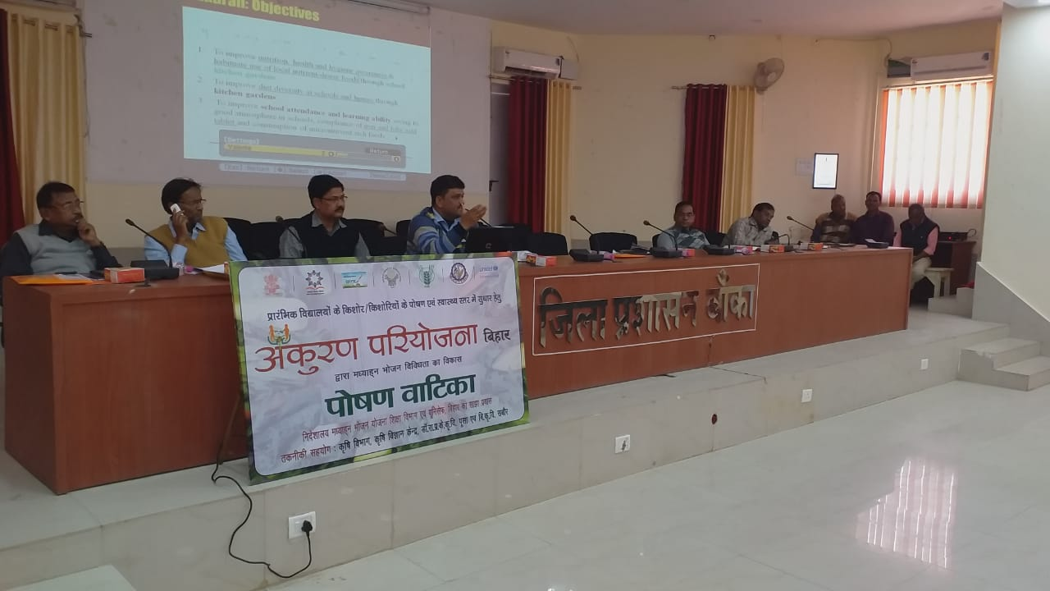
Kitchen Garden-District level Convergence meeting

Slide 12
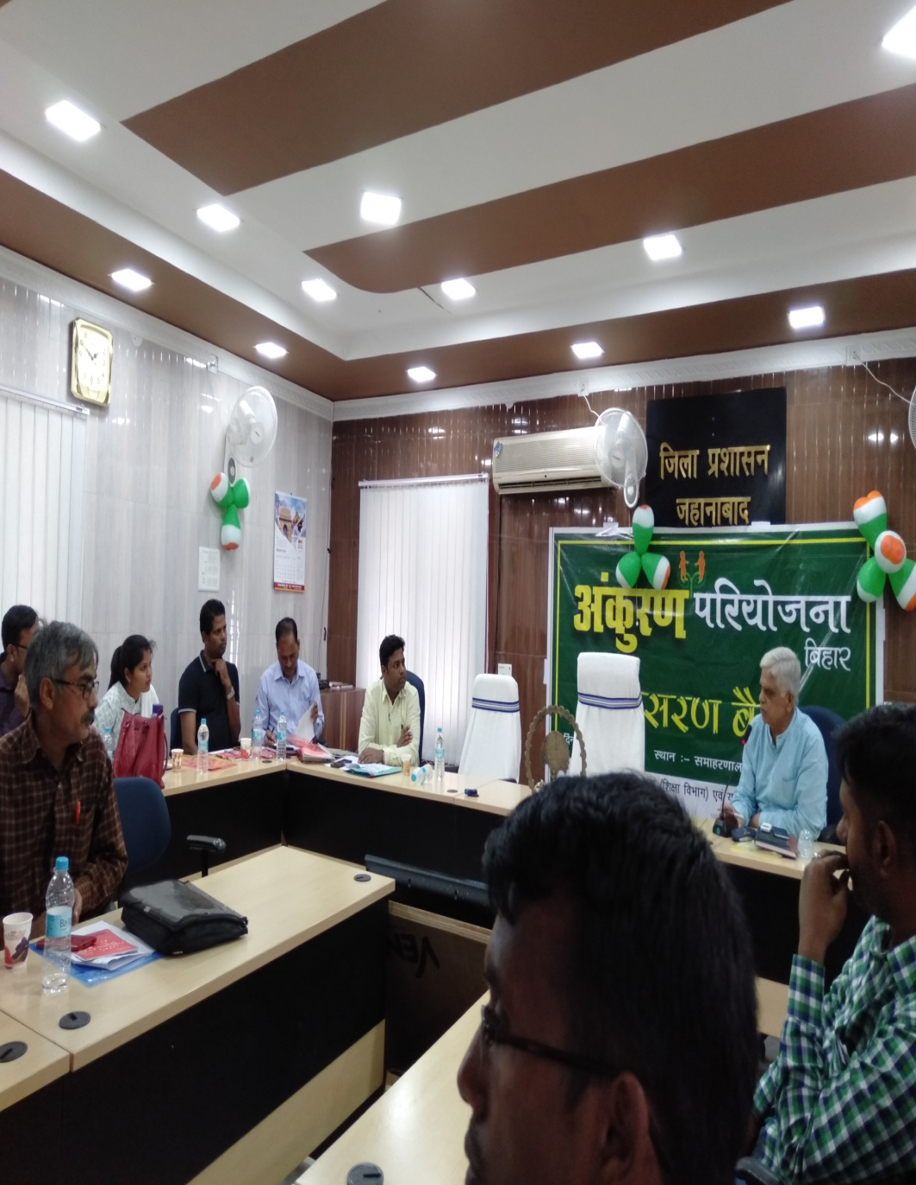
Kitchen Garden-District level Convergence meeting

Slide 14
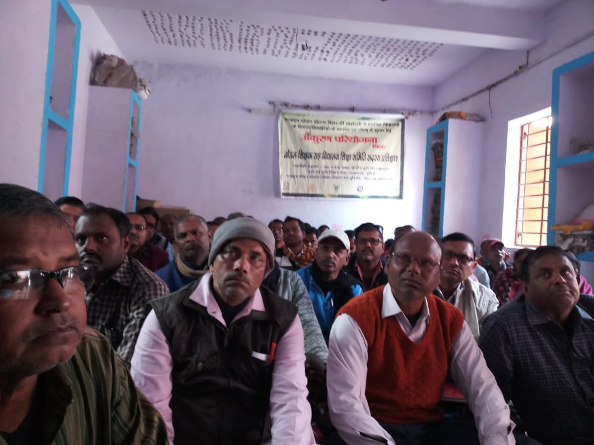
Kitchen Garden-Block level Convergence meeting

Slide 15
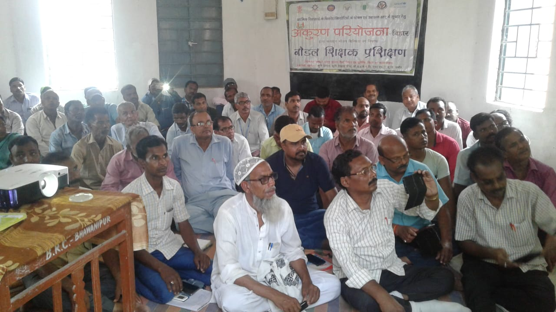
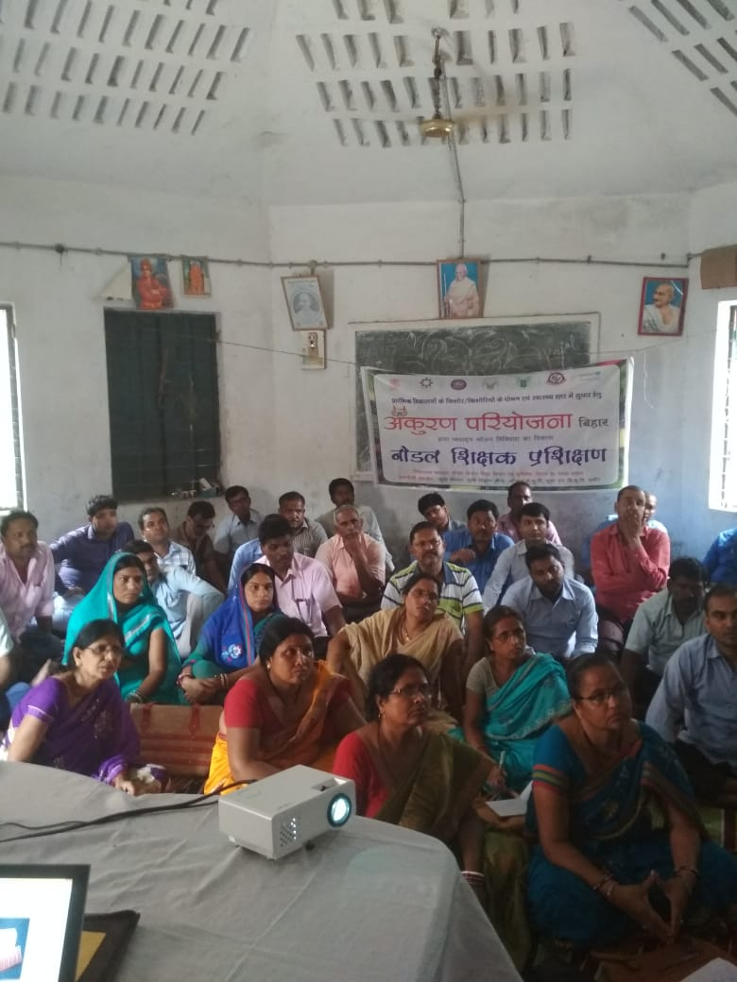
Kitchen Garden-Nodal Teacher Training

Slide 16
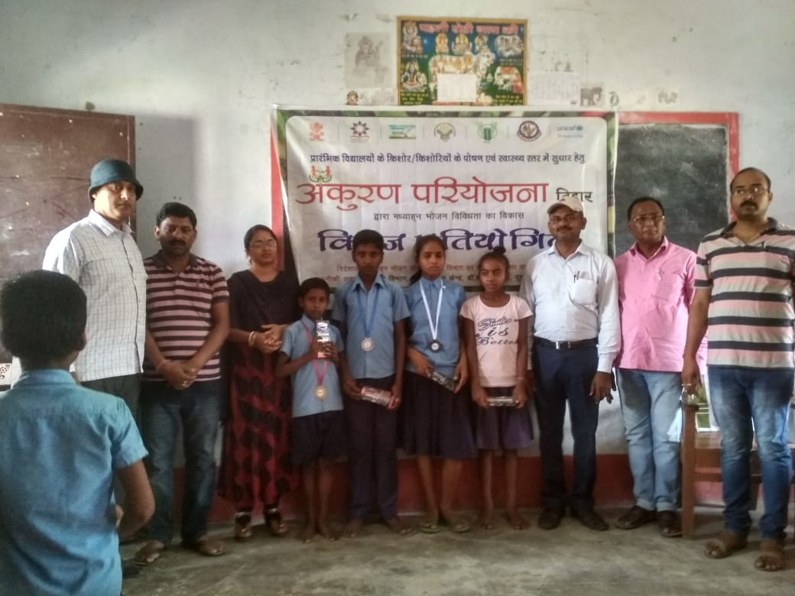

Slide 17
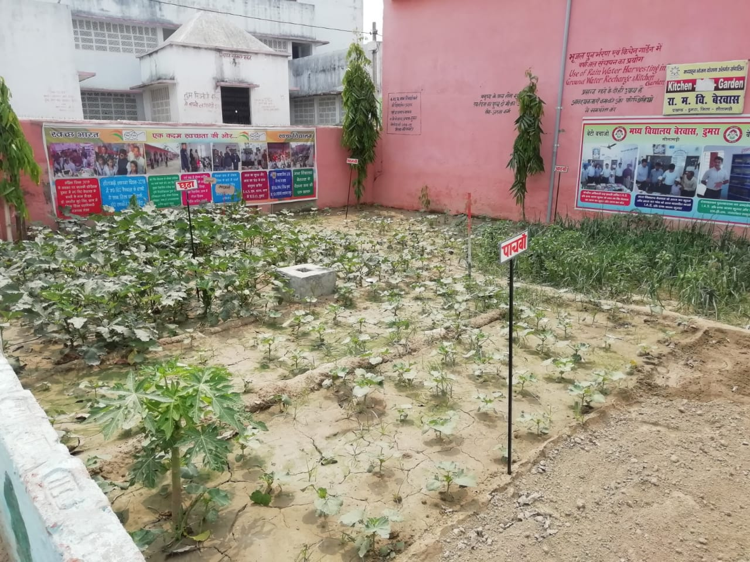
KITCHEN GARDEN - ANKURAN

Slide 18
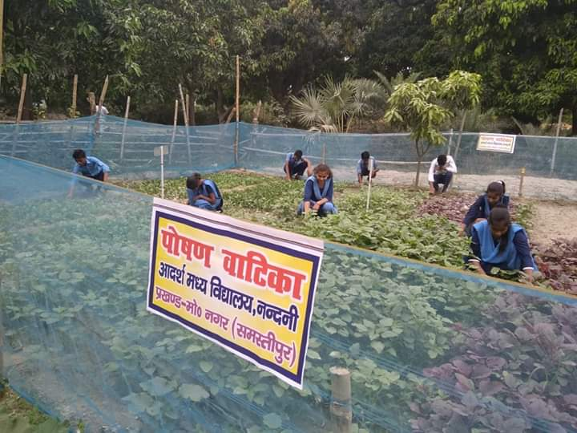

Slide 19
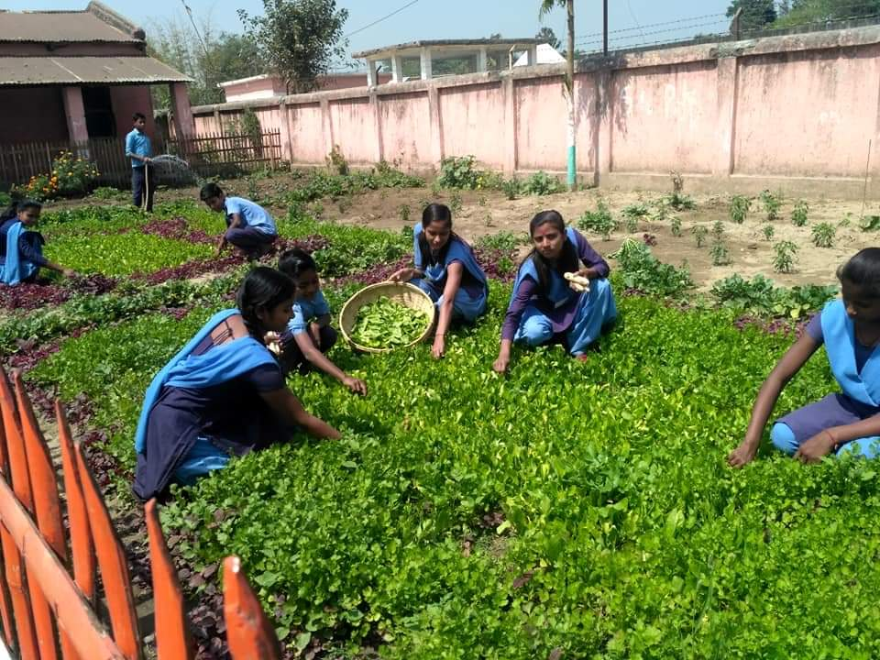
Proposal for 2019-20

Slide 20
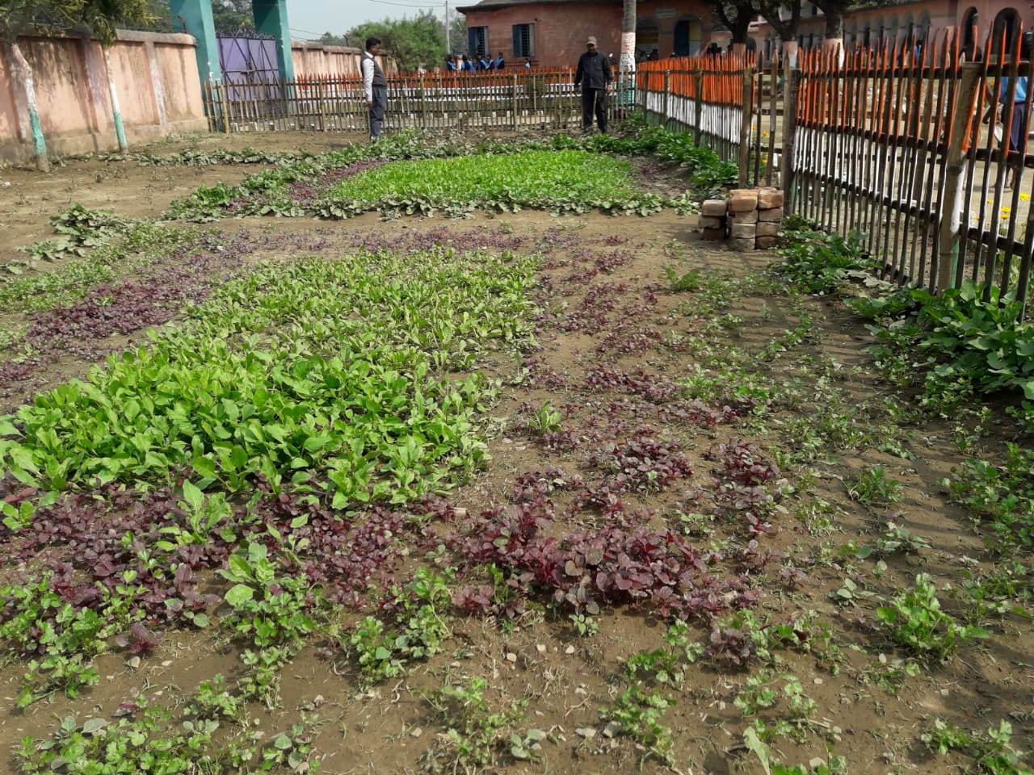

Slide 22
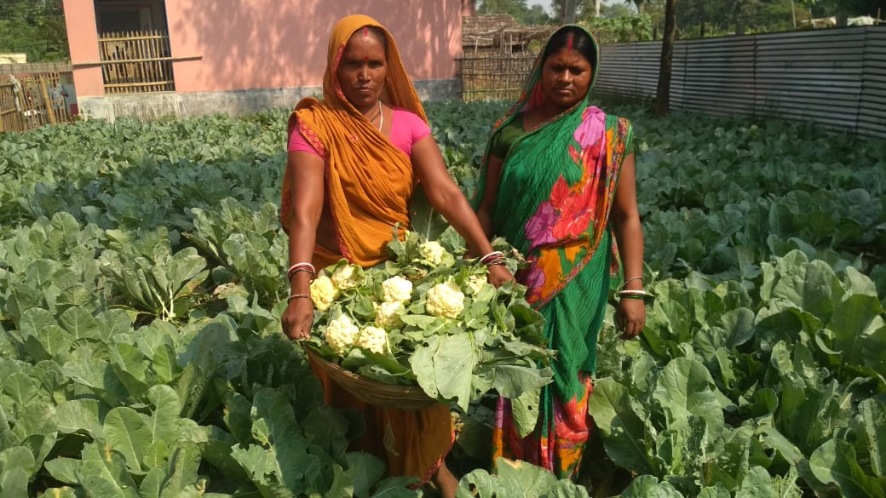

Slide 23
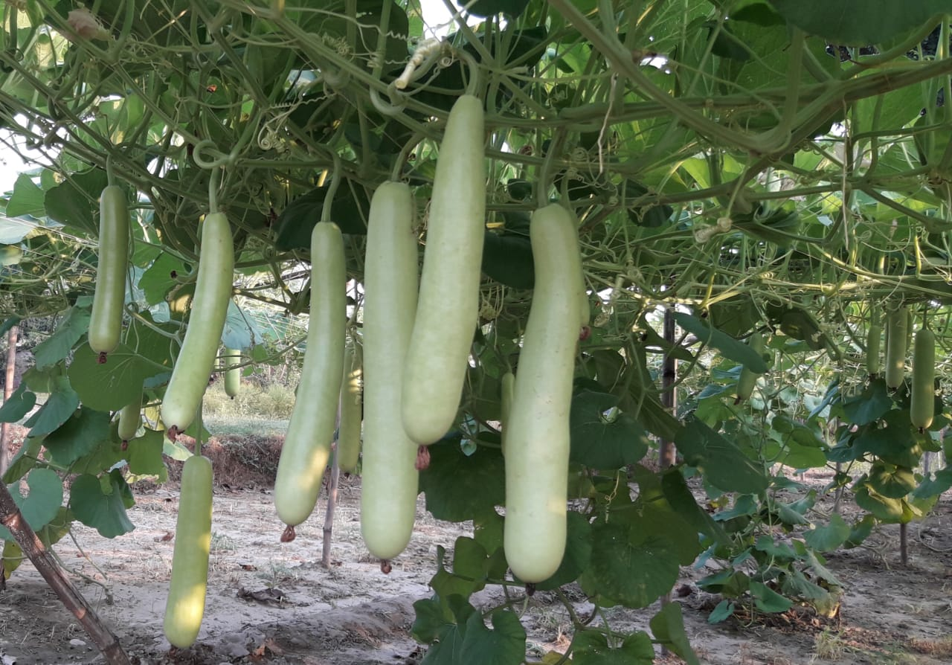

Slide 24
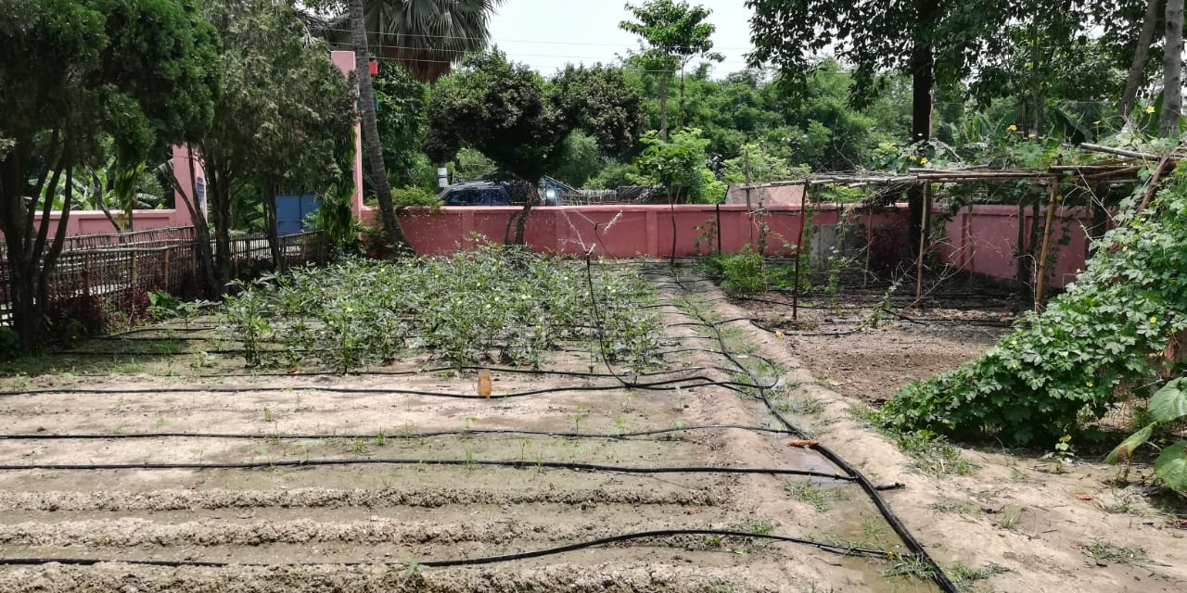

Slide 25
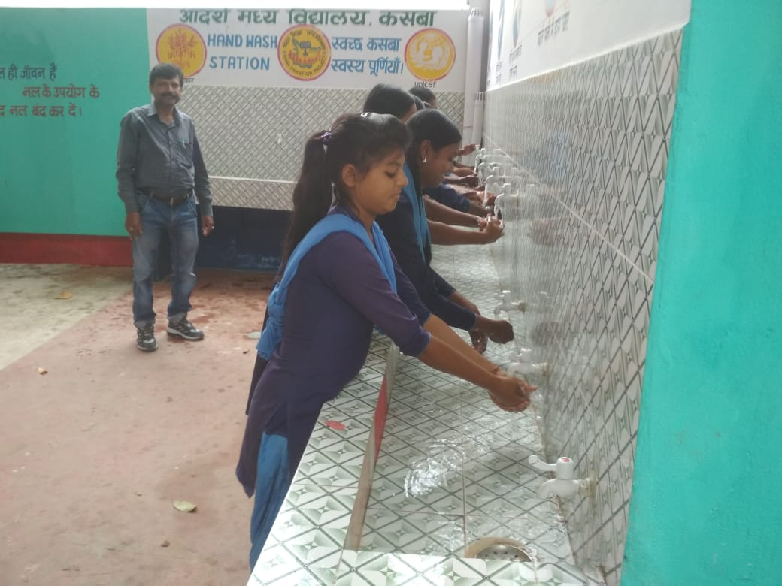

Slide 26
Proposed Provisions for 2019-20
Component | Budget provision in 2018-19 | Proposed Budget Provision in 2019-20 (Lakhs) |  | Total (In Lakhs)
 |  | Centre Share (60%) | State Share (40%)
Cost of foodgrains (100% centre) | 10017.52 | 10017.52 | 0.00 | 10017.52
Cooking Cost (60%:40%) | 137772.70 | 93721.75 | 62414.91 | 156136.70
Transportation Assistance (100% centre) @Rs 150 per quintal | 2504.38 | 5008.80 | 0.00 | 5008.80
Honorarium to Cook-cum-Helper (60%:40%) @Rs. 2000 per cook | 24531.60 | 29437.92 | 19625.28 | 49063.20
Management , monitoring and evaluation(MME) (100% centre) | 1979.22 | 3729.95 | 0.00 | 3729.95
Old Kitchen Devices Replacement (60:40)@Rs.10000/15000/20000/25000-per school on enrollment basis | 0.00 | 3955.02 | 2636.68 | 6591.70
Repair of kitchen-cum-stores @Rs 10000/- per school ( 60:40) | 0.00 | 2113.6 | 1409.0 | 3522.6
Flexi fund 5% of total annual work plan (60:40) for new intervention | 0.00 | 4144.38 | 2762.93 | 6907.31
TOTAL | 176805.40 | 152128.94 | 88848.80 | 240977.74

Slide 27
ISSUES / SUGGESTIONS
Increase in monthly honorarium of cook-cum-helper from Rs. 1000/- to Rs. 2000/-

Slide 28
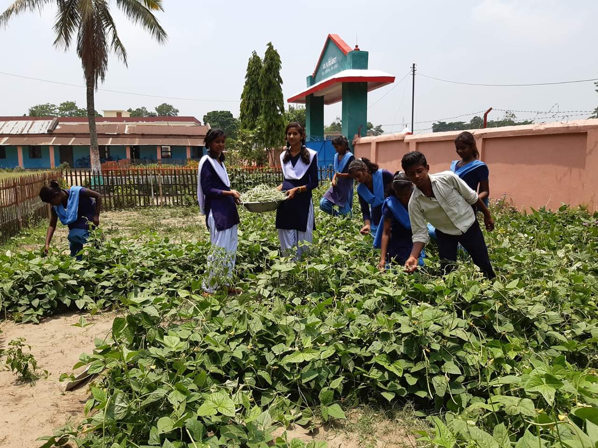
THANK YOU
Thank You

