Slide 1
Annual Work Plan & Budget Mid Day Meal Scheme 2019-20
Education Department
Government Of Gujarat

Slide 2
Index
Introduction
Status of MDM year 2018-19
State Government Initiative
Annual Work Plan & Budget year 2019-20
Proposals

Slide 3
Introduction
Gujarat introduced MDM scheme in 1984 and is pioneer state in providing fresh, hot and nutritious meal during the day to children between the age group of 6 to 14 years, i.e. standard 1 to 8.
All total 34307 Schools are Covered under MDM
Beneficiary Students: 42.99 lakh (2018-19)
Cook cum Helpers: 96,329 (2018-19)
Budget sanctioned for 2018-19 : Rs. 1095 Crores
Central Share : Rs. 446.05 Cr
State Provision : Rs. 649.34 Cr

Slide 4
Status of MDM year 2018-19

Slide 5
MDM Coverage
Standard | Coverage (2018-19)
 | Enrollment | Beneficiary | Coverage in %
Primary | 3336949 | 2605009 | 78.07
Upper Primary | 2151370 | 1694100 | 78.75
Total | 5488319 | 4299109 | 78.33
Approved days as per PAB Up to March-19 |  | Actual MDM given days Up to March-19
Primary | Upper Primary | Primary | Upper Primary
248 | 248 | 243 | 243

Slide 6
Details of Daily Materials and Nutrient
Sr. No. | Materials | Primary School |  |  | Upper Primary School
 |  | Requirement (in gram) | Calorie | Protein (in gram) | Requirement (in gram) | Calorie | Protein (in gram)
1 | Food Grain (Wheat/Rice) | 100 | 340 | 8 | 150 | 510 | 12
2 | Puls | 20 | 70 | 5 | 30 | 105 | 7.5
3 | Vegetable | 50 | 25 | 0 | 75 | 38 | 0
4 | Oil | 10 | 90 | 0 | 10 | 90 | 0
Total |  | 180 | 525 | 13 | 265 | 743 | 19.5

Slide 7
Last 5 years Student Detail (in lakh)
Sr. No. | YEAR | ENROLL STUDENT | BENEFICIARY
1 | 2014-15 | 64.88 | 42.29
2 | 2015-16 | 61.57 | 43.94
3 | 2016-17 | 59.73 | 43.66
4 | 2017-18 | 57.61 | 43.97
5 | 2018-19 | 54.88 | 42.99

Slide 9
Inspection of MDM Centres And Coverage of MDM
Inspection of MDM centers:
During current year 57197 MDM centers are inspected and 389 samples are taken for quality check. (GSCSC & FDC)
The Coverage:
In the year 2018-19,Over all four quarter Coverage against enrollments of MDM is 78.38%

Slide 10
Social Audit
Social Audit of Mid Day Meal was done as per the Government of India's Guidelines.
For the year 2018-19 Social Audit of Mid Day Meal was given to Mahatma Gandhi Labour Institute, Ahmedabad.
Two district - i.e. Mahesana and Mahisagar were selected for social audit.

Slide 11
Social Audit
- Key Recommendation
The performance indicators,
Nutritional Status,
attendance of students
availed MDM students
the evaluation based Grading should be introduced as per criteria mentioned in the MHRD guideline.
Evaluation based Grading
- A Grade: Performance matches entirely with the decided criteria.
- B Grade: Averagely performed based on the criteria.
- C Grade: Under Performing based on the criteria.
Incentive System for Best Performing School every month.

Slide 12
Social Audit
- Key Recommendation
Students committee should be formed comprising of std.7th and 8th to exchange idea and create innovative ways to enhance the scheme.
MDM menu should be regularly revised so that variety is maintained.
Kitchen garden should be promoted in the schools which can utilize the waste water of kitchen and hand wash.
MDM Suggestion Box should be introduced in each school.

Slide 13
MDM for Model School
Model School scheme has been launched from year 2014-15. Total 72 model schools are in different districts of the state.
In model School mid day meals and nutritious snacks is given to the children from std. 6 to 12.
Expenditure in 2018-19 - Rs. 5.17 Cr.

Slide 14
State Government Initiatives
Two Time Meal
Sukhadi Project
Dudh Sanjivani Yojana
Tithi bhojan
Anna Triveni Yojana
Centralized Modern Kitchen in MDM
Website /Mobile Application for AMS (Automated Monitoring System)
and Data collection
Monitoring of food grain distribution System (Proposed)

Slide 15
State Government Initiatives Two Time Meal
As per the guideline of Mid Day Meal to provide 450 calories and 700 calories we were giving 180 gram (primary) and 265 gram (upper primary) food grains.
When this food grain is cooked its weight becomes almost double of the food grain approximately 400 grams.
The students of Primary and Upper Primary could not take this much food intake at a time.
After care full consideration Government has decided to divide meal into two parts (1) Breakfast (2) Lunch
Now children take full daily intact and hence they have get more protein & calorie value.

Slide 16
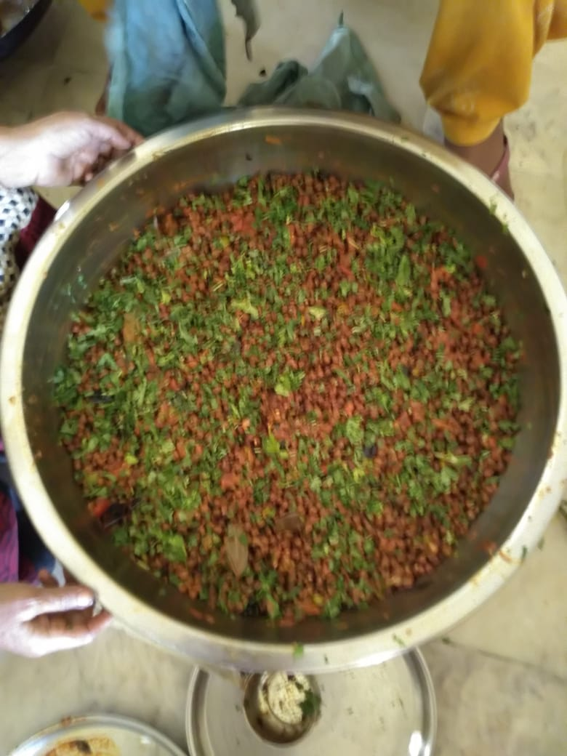
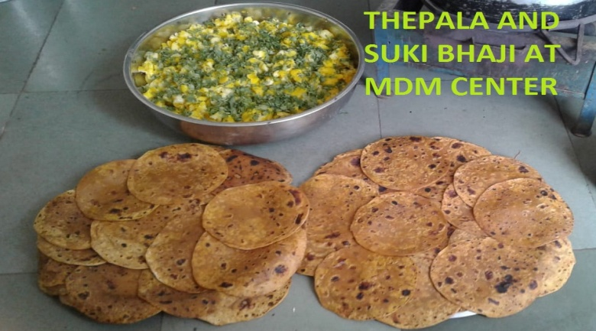
State Government Initiatives Weekly Menu
DAY | BREAK FAST | LUNCH
Monday | Sukhdi | Vegetable khichdi
Tuesday | Chana Chat | Thepala & Suki Bhaji
Wednesday | Mix Dal/ Usal | Vegetable Pulav
Thursday | Chana Chat | Dal Dhokli
Friday | Muthiya | Dal-Bhat
Saturday | Chana Chat | Vegetable Pulav
Chana Chaat
Thepla & Suki Bhaji

Slide 17
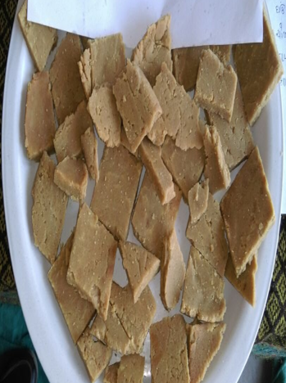
State Government Initiatives Sukhdi
It aims to enhance calorie and protein intake by students.
Sukhdi recipe is being served once a week and is approved by the CFTRI (Central Food Technological Research Institute) & nutrition experts
It is prepared using wheat, jaggery and oil.
Expenditure in 2018-19
Rs. 25.52 cr.

Slide 18
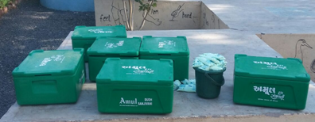
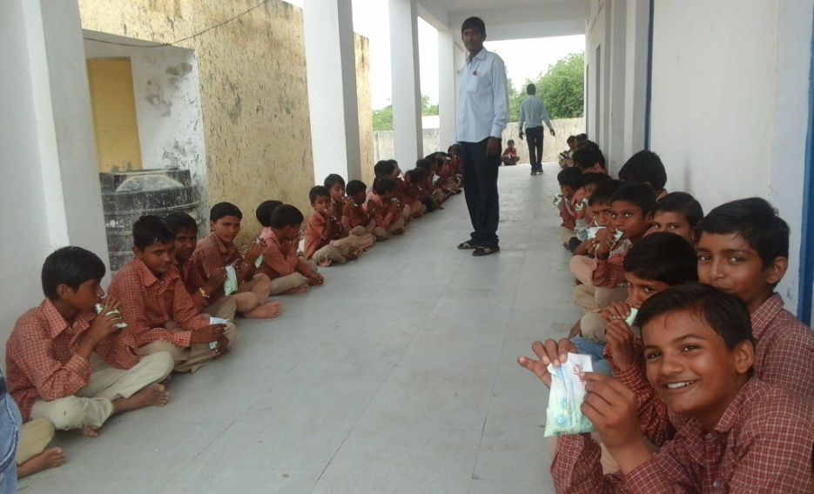
State Government Initiatives Dudh Sanjivani Yojana - Milk in MDM
In this scheme 200 ml. flavored milk is served 5 days in a week to primary school children.
Currently 26 Talukas of 12 Districts get the benefit of this scheme (In Developing Talukas)
Beneficiary MDM centers : 3748
Beneficiary Students : 4.75 lakh

Slide 19
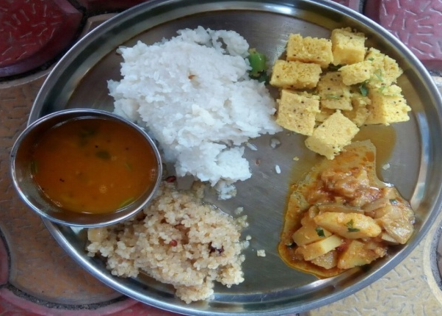
State Government Initiatives
Tithi Bhojan - An approach with Community participation
The State Government has initiated the concept of Public Participation in the scheme through the concept of “TithiBhojan”.
The Villagers sponsor the food with sweets, namkeen, farsan, fruits for children on various occasions and provide utensil for MDM centers.
It is customary in Gujarat to host public dinner on festival days or social occasions like
Marriage anniversary
Birth Anniversary
Death anniversary
Any special occasion like any educational or social achievement like ranking first in school, promotion etc.

Slide 20
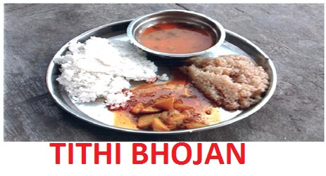
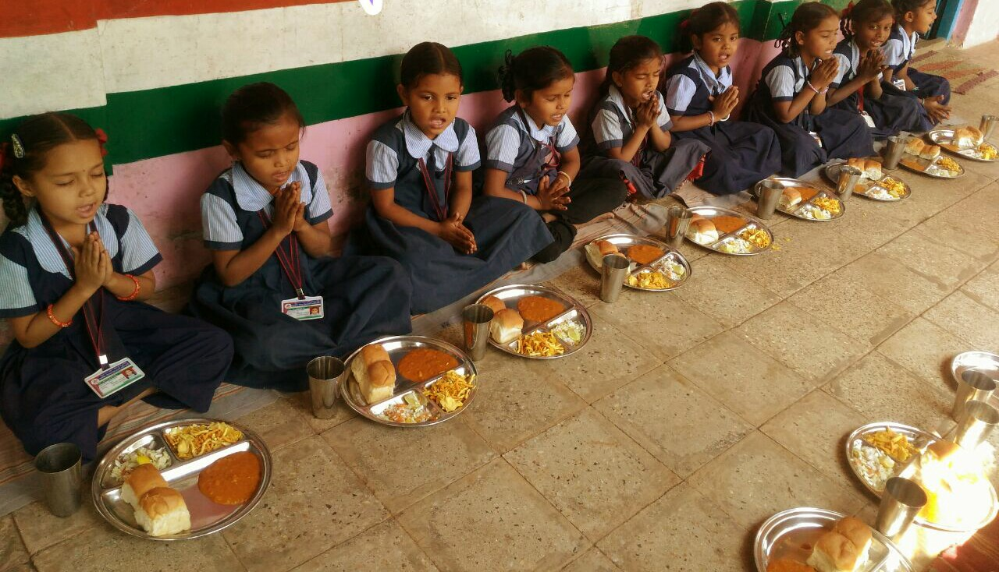
State Government Initiatives
- How Tithi Bhojan Yojana works
In each village people are educated for this Yojana. Sarpanch of gram panchayat, political leaders, social leaders, principal of the school, economically rich people in the community give contribution in Tithi Bhojan Yojana.
Per month average 5 Tithi Bhojan donors are listed in each village.

Slide 21
State Government Initiatives Tithi Bhojan Yojana - Impact
It reduces MDM cost.
Impact on social participation.
Supplementation of the nutritional value of MDM food.
Development of rapport with the local community.
Inculcating the feeling of equity and brotherhood among the children of all communities.
More cohesive relation between the school administration and the community.
This is also reflected in form of partial enhancement of the enrolment and regular attendance of the children at the school.

Slide 22
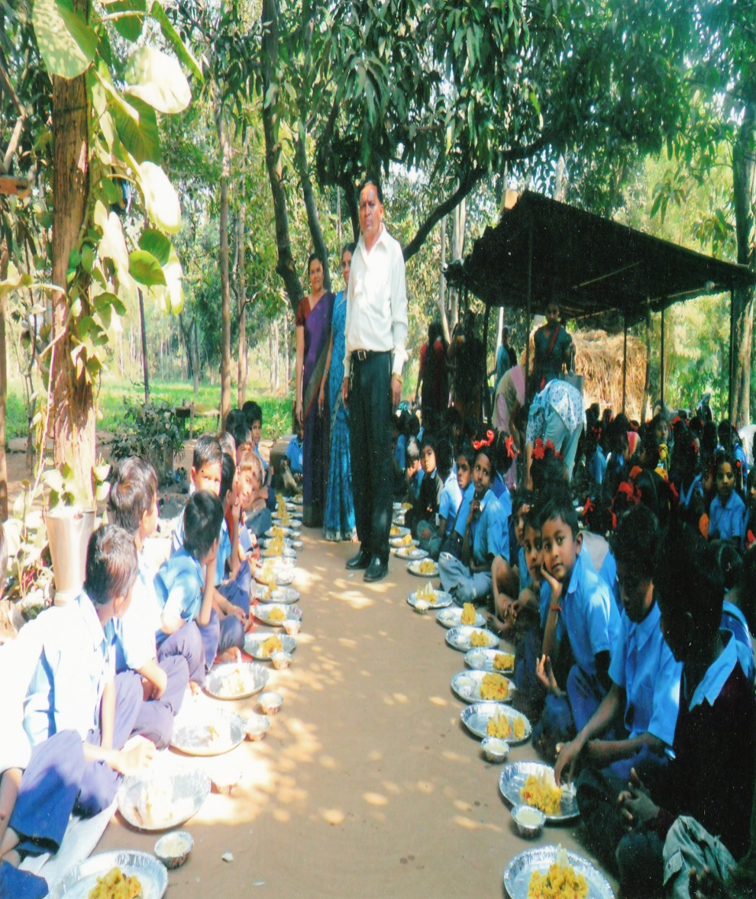
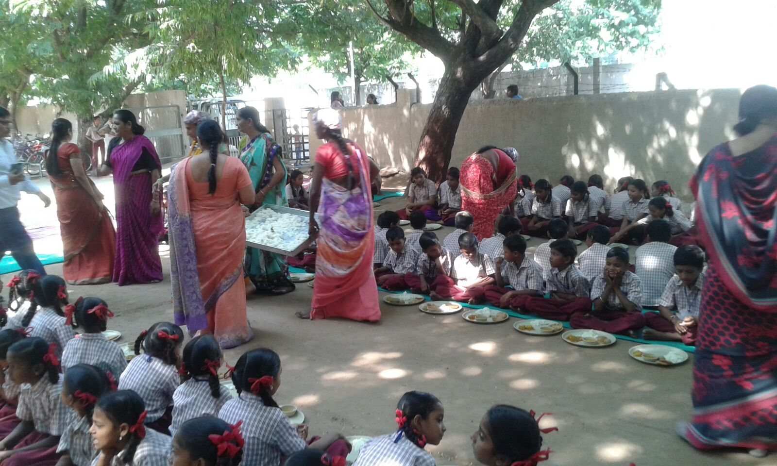
State Government Initiatives Tithi Bhojan - An approach with Community participation

Slide 23
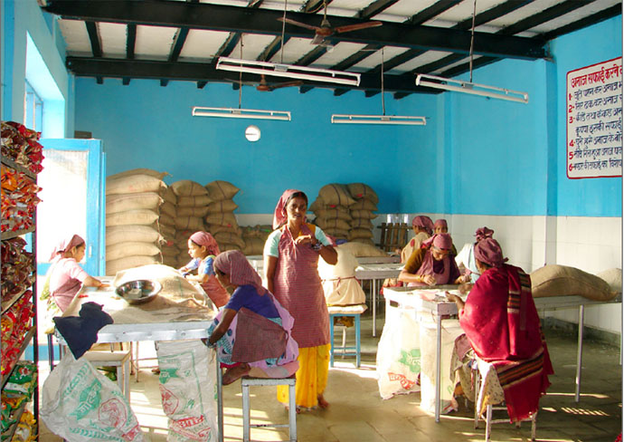
State Government Initiatives Anna Triveni Yojana - Free Food Grain to Tribal Girls
Benefit of the scheme is given to the tribal girls.
This benefit is extended for the maximum two tribal girls in the family.
60kg (per term 30 kg) food gains (10kg wheat,10kg Rice,10kg Corn) is given to the tribal girls in a year.
Expenditure in 2018-19 : Rs. 67.80 Cr.
Criteria : must have more than 70 % annual attendance

Slide 24
State Government Initiatives Centralized Modern Kitchens in MDM
The aim and objective of the MDM program was to achieve universalization of elementary education by enhancing enrollment, retention and attendance and improving the nutritional status of children health.
Centralized Modern kitchen concept takes care of quality of food, hygiene of food and uniformity of food in addition to above parameters.
At present Four NGO namely Stree Shakti, Akshaya Patra Foundation , Paras Agro Society & Nayak Foundation are serving cooked food under the MDM Scheme from their centralized kitchen in 7 districts, 3327 schools.

Slide 25
State Government Initiatives
Centralized Modern Kitchen in MDM
Sr. | Organization | Area served | Centers | Beneficiary in Lakhs
1 | Akshayapatra | Corporations of Ahmedabad (W),Bhavnagar, Surat and Vadodara Gandhinagar (3 blocks) Ahmedabad rural (1 block), Vadodara (3 blocks) | 1555 | 335585
2 | Nayak Foundation | Navasari | 740 | 72164
3 | Stree Shakti | Corporations of Ahmedabad (E) and, Valsad (4 blocks) | 950 | 110858
4 | Paras Agro | Corporations of Rajkot | 82 | 27983
Total |  |  | 3327 | 546590

Slide 26
Proposed Centralized Modern Kitchen in MDM
Education department has communicated with Akshaya Patra Foundation to serve MDM in 4 blocks as shown below.
Sr. No. | Organization | Area served | Centers | Beneficiary in Lakhs
1 | Akshaya Patra Foundation | Jamnagar Rural and Lalpur taluka | 92 | 15780
2 | Akshaya Patra Foundation | Kutch and Bhuj taluka | 183 | 50575
Total |  |  | 275 | 66355
Education department has also Requested Gujarat Cooperative Milk Marketing Federation Ltd.,Anand (AMUL) to take up the cause of serving the students of the state by way of providing them Mid Day Meal through centralized kitchens.

Slide 27
Proposed Centralized Modern Kitchen in MDM
Education department has approached CSO (Civil Society Organizations) like AMUL to serve meal under MDM for following benefits.
As NGOs serving food under mid day meal scheme proved very successful and effective in providing nutritious food to the children, especially in remote, backward and rural area.
Uniformity in meal and quality of food in all schools.
Easy to monitor entire food supply chain
More hygienic food/ Centralized lab testing.
High Nutritious value- Steam based cooking.
Prevention of likely hazards like fire, food poisoning etc.
Prevention of likely Kitchen accident, i.e. Children safety
Sparing of time of teacher deployed from MDM duty.

Slide 28
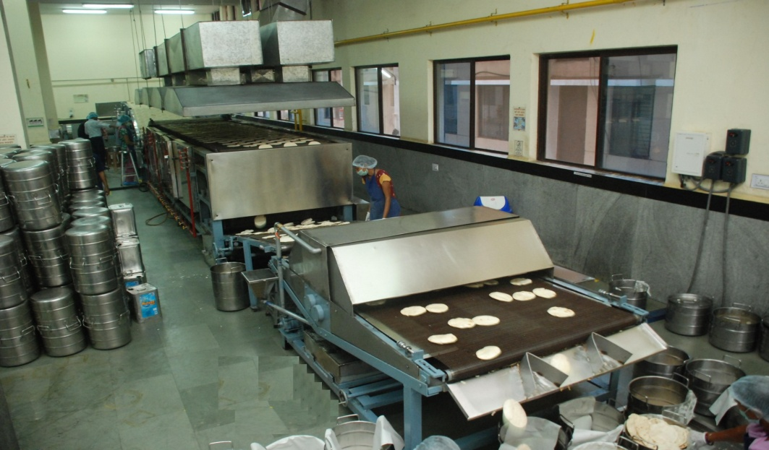
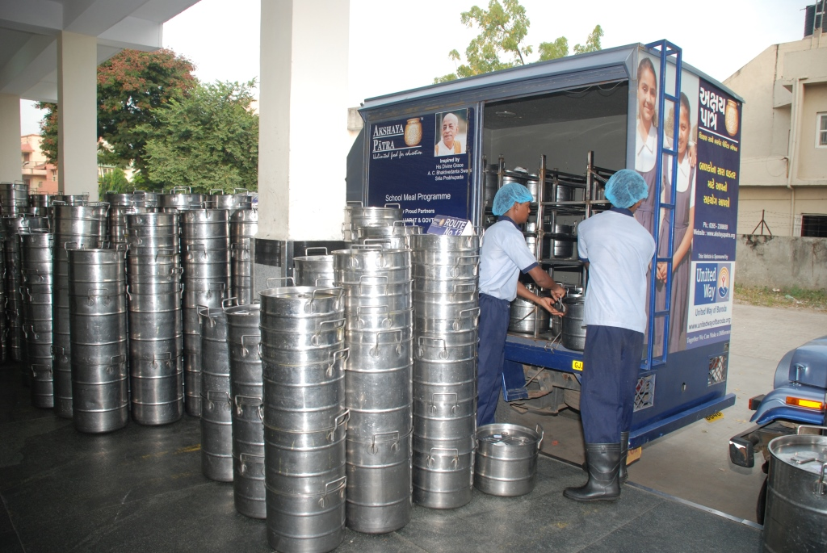
NGO Participation

Slide 29
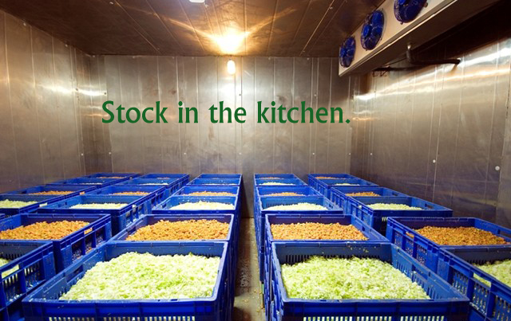

Slide 30
State Government Initiatives
Website/Mobile Application for AMS and Data collection
AMS : Automated Monitoring System
From 01-07-2016 to 30-04-2017 data was collected through IVRS system, thereafter from 05-06-2017 onwards website/Mobile application is operational.
Using web services real time data transfer to NIC, Delhi and CM dash board.
URL:- https://mdm.gujarat.gov.in/
.

Slide 31
State Government Initiatives
Food Grain Supply and Monitoring System
Stock Management & Distribution:
Software program for monitoring of the entire food grain distribution and supply system, covering FCI godown to GSCSC office, district godown, Deputy Collector MDM (District office), Mamlatdar MDM (Block office) and FPS.
Distribution Monitoring & Confirmation:
Monitoring of timely lifting, dispatch, and unloading of Food Grains at block level, quantity of Food Grain lifted, delay in supply chain and corrective measures.
Demand Generation:
online permit generation at block level.
Monitoring access from block level to state level.
Master data management.

Slide 32
Annual Work Plan & Budget
2019-20

Slide 33
Annual Work Plan & Budget
Share | Budget (Rs. In Lakh) | % of Budget
Central Share (60%) | 39824.88 | 44.22
Central Share (100%) | 5059.93
State Share (40%) | 26510.18 | 26.12
State Share (100%) | 30105.17 | 29.66
Total | 101500.16 | 100.00

Slide 34
Annual Work Plan & Budget: 2019-20
Component | Actual 2018-19 (Rs. in Lakh) |  |  | Proposal 2019-20 (Rs. in Lakh)
 | Central | State | Total | Central | State | Total
Cost of Food grain | 3260.85 | 0.00 | 3260.85 | 3260.89 | 0.00 | 3260.89
Cooking Cost | 32304.85 | 21500.22 | 53805.07 | 34022.30 | 22653.01 | 56675.32
Honorarium to Cook Cum Helper | 5779.74 | 3853.16 | 9632.9 | 5779.74 | 3853.16 | 9632.90
Transportation Assistance | 978.25 | 0 | 978.25 | 978.27 | 0.00 | 978.27
Management, Monitoring and Evaluation (MME) | 761.83 | 0 | 761.83 | 792.74 | 0.00 | 792.74
Total | 43085.52 | 25353.38 | 68438.90 | 44833.94 | 26506.17 | 71340.11
Flexi fund @ 5% for new interventions | 0 | 0 | 0 | 2202.06 | 0 | 0
Kitchen Devices | 0 | 0 | 0 | 0 | 0 | 0
Kitchen-cum-Store | 0 | 0 | 0 | 0 | 0 | 0
Total | 43085.52 | 25353.38 | 68438.90 | 47036.00 | 26506.17 | 73542.17

Slide 35
Proposals

Slide 36
Proposal
Additional Requirement for Drought
In financial year 2018-19 draught is declared in 51 Talukas of 11 districts from 01/12/2018 in Gujarat.
As per Hon’ble Supreme court order, MDM is to be continued in Drought affected areas during vacation period.
So we need additional
Wheat :- 2862.25 MT
Rice :- 2862 MT
Total (Wheat+ Rice) Price = Rs.143.11 Lakhs
Additional Cooking cost = Rs. 1666.62 Lakhs.
Total Expenditure is Rs. 1809.73 Lakhs

Slide 37
Proposal
Flexi Fund Plan
Kitchen garden – RS. 5.87 cr.
For remaining amount detail plan will submitted in next 2 months.

Slide 38
Thank You…

