Slide 1
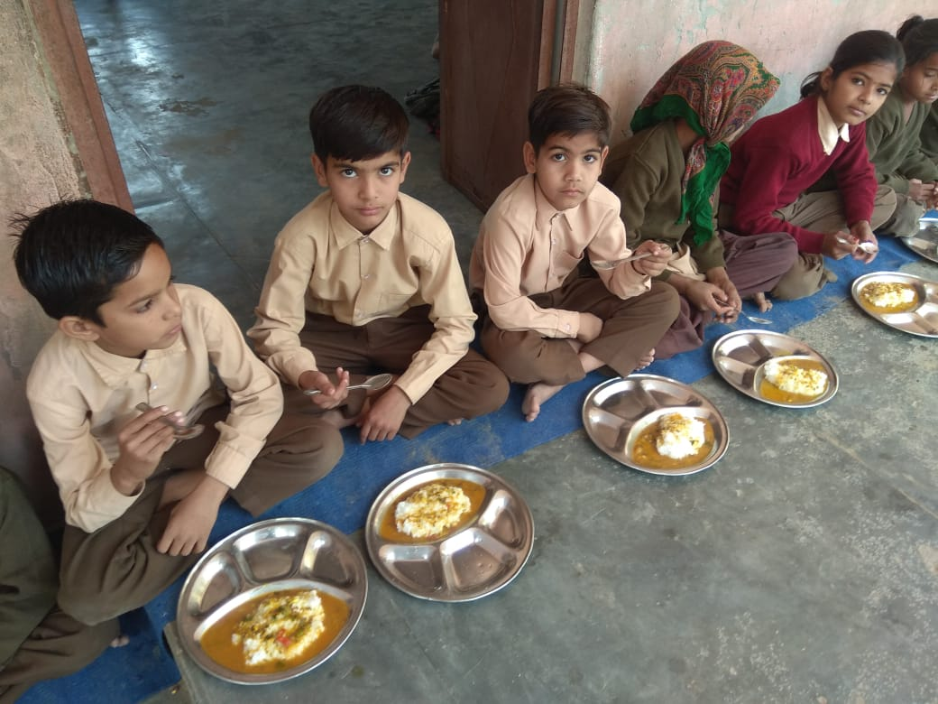
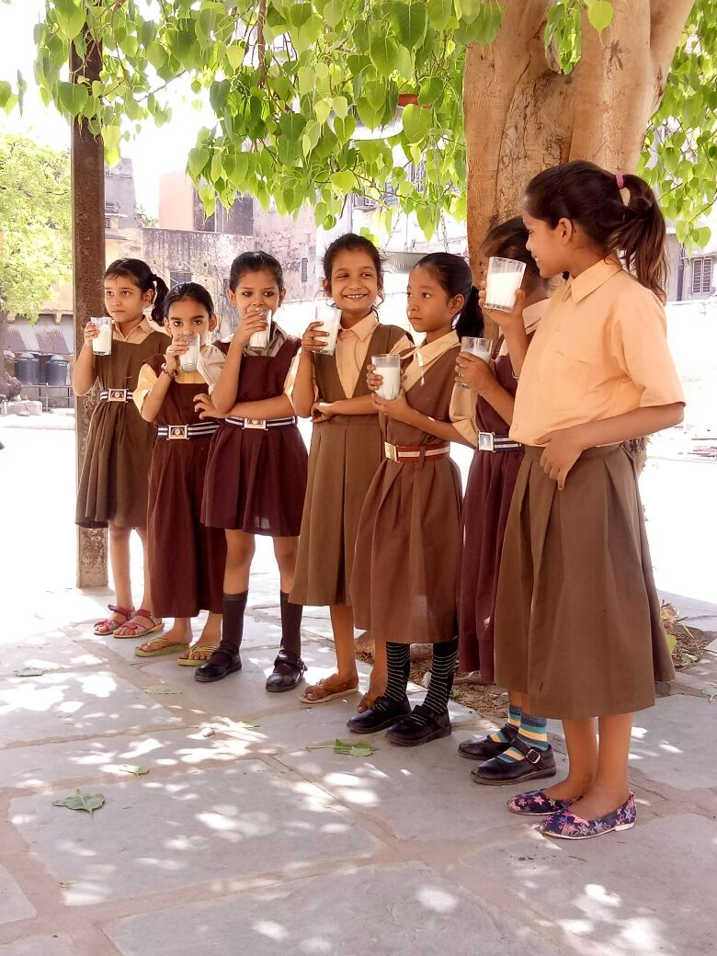
PAB 2019-20 Mid Day Meal SCHEME, Government of Rajasthan

Slide 2
OBJECTIVES
Enhancement in nutritional status of school going children.
Encourage enrollment and regularity in attendance.
Promoting harmony among children
Providing nutritional support to children in drought affected areas during summer vacations.

Slide 3
ADMINISTRATIVE STRUCTURE
Minister – School Education Department
Principal Secretary - School Education Department
Deputy Commissioner (I&M)
Deputy Commissioner (Adm.)
Commissioner - Mid Day Meal
Additional Commissioner (F)

Slide 4
MDM : BEST PRACTICES
Milk is provided to school children up to class I st to VIII th on daily basis i.e. six days a weak
All the 33 districts are following e-transfer mechanism.
100% LPG Gas connections have been provided under MDMS in the State.
40% schools have installed Multi tap Water Facility.
Capacity Building of Cook-cum-Helpers.
Almost 1.09 lakh Cook-cum-Helpers have been trained about hygiene, cleanliness, cooking techniques & storage of food grains. Also health check-up of CCHs was done during this training.
Laboratory Testing of MDM Samples through NABL Accredited Laboratories.
SMS based Automated Monitoring System was rolled out in the state from Aug. 2016.

Slide 5
MID DAY MEAL-MENU
S. N. | WEEK DAY | MENU
1 | Monday | Chapati – Vegetable
2 | Tuesday | Dal, Vegetable-Rice
3 | Wednesday | Chapati - Dal
4 | Thursday | Khichdi (Dal, Rice, Vegetable etc)
5 | Friday | Chapati – Dal
6 | Saturday | Chapati – Vegetable
Seasonal fruit once in week
Additional item :- Hot Milk Provided daily

Slide 6
FOOD GRAIN, NUTRITIVE VALUE & COOKING COST
CLASSES | FOOD GRAIN (Per student per day) | NUTRITIONAL VALUE |  | COOKING COST (Per student per day) (Rs.)
 |  | CALORIE | PROTEIN
1 to 5 | 100 GM (Wheat/Rice) | 450 Cal | 12 GM | 4.35
6 to 8 | 150 GM (Wheat/Rice) | 700 Cal | 20 GM | 6.51

Slide 7
MONITORING MECHANISM
1. | State Steering & Monitoring Committee (SSMC) (Chief Secretary + 13 Pr. Secretaries/ Secretaries & HoD’s +MPs & MLAs + Nominated Members )
2. | District Steering & Monitoring Committees (DSMC) (District Collector + MP+ MLAs + Nominated Members)
3. | Block Steering & Monitoring Committees (SDO + Nominated Members) (BSMC)
4. | DLOs’ Regular Inspections as per Norms
5. | Sudden Inspections - Twice a Year
6. | Mid-Day-Meal-MIS-System (MIS)
7. | SMS based Automated Reporting & Monitoring System (ARMS)
8. | GOI-Joint Review Mission (JRM)

Slide 8
CENTRAL-STATE SHARING
S. No. | Item | Central Share | State Share
1 | Cost of Food grain | 100 % | -
2 | Transportation | 100% | -
3 | MME | 100% | -
4 | Utensils | 60% | 40%
5 | Cook Cum helper | 60% | 40%
6 | Cooking Cost | 60% | 40%
*State of Rajasthan share in 1320/- honorarium to cook cum helper is 720/-.Rest amount of Rs 600/- is shared by the Central Government.

Slide 9
PERFORMANCE DURING 2018-19
(up to March 2019)

Slide 10
INSTITUTIONS
No. of Institutions Covered : 66493
(On 30th September 2018)
Classes | (Govt + LB) Schools | GA Schools | Special Training Centers | Madarsas/ Maqtab | TOTAL
1-5 | 30427 | 0 | 461 | 1422 | 32310
1-8 | 33203 | 0 | 24 | 214 | 33441
6-8 | 729 | 0 | 0 | 13 | 742
TOTAL | 64359 | 0 | 485 | 1649 | 66493

Slide 11
EnROLMENT
Enrolment: 62.65 Lakh
(On 30th September 2018)
Classes | (Govt + LB) Schools | GA Schools | Special Training Centers | Madarsas/ Maqtab | TOTAL
1-5 | 3971889 | 0 | 26932 | 104601 | 4103422
6-8 | 2145368 | 0 | 1308 | 15248 | 2161924
TOTAL | 6117257 | 0 | 28240 | 119849 | 6265346

Slide 12
MDM- Beneficiary Students
Beneficiary Students 2018-19
S.N. | Quarter | Primary | % | Upper Primary | % | Total | %
1 | 1st | 2866562 | 71.66 | 1601868 | 72.08 | 4468430 | 71.87
2 | 2nd | 2874224 | 71.85 | 1603390 | 72.15 | 4477614 | 72.00
3 | 3rd | 2896225 | 72.40 | 1618946 | 72.85 | 4515171 | 72.62
4 | 4th | 3033633 | 73.93 | 1655874 | 76.59 | 4689507 | 75.26
Average |  | 2917661 | 72.46 | 6480078 | 73.41 | 18150722 | 72.93
Note:-Number of beneficiaries of Quarter 1st & 2nd are shown on the basis of enrollment of 30th September 2017 and of Quarter 3rd & 4th on the basis of 30th September 2018.

Slide 13
COOKING AGENCIES
MDM Cooking Agencies | Schools Covered | Children Covered (In Lakh )
Centralized Kitchens (11) | 4108 | 4.20
AMSS & SHGs (236) | 1204 | 1.32
School Management Committees (SMCs) | 61181 | 57.13
Total | 66493 | 62.65

Slide 14
PUBLICE-PRIVATE–PARTNERSHIP (PPP)
CENTRALIZED KITCHENS FUNCTIONING in RAJASTHAN
DISTRICT | ORGANIZATION | Schools Covered | Children Covered
Ajmer | Akshaya Patra Foundation | 108 | 17625
Alwar | QRG Foundation | 402 | 55702
Jaipur | Akshaya Patra Foundation | 1183 | 132644
 | Annamrat Foundation | 829 | 49929
Jodhpur | Adamya Chetna Trust | 261 | 33720
 | Akshaya Patra Foundation | 131 | 13883
Rajsamand | Akshaya Patra Foundation | 587 | 48678
Bhilwara | Akshaya Patra Foundation | 82 | 12223
Jhalawar | Akshaya Patra Foundation | 147 | 15410
Udaipur | Akshaya Patra Foundation | 199 | 22112
Bikaner | Akshaya Patra Foundation | 179 | 18800
TOTAL (11) |  | 4108 | 420726

Slide 15
GAS CONNECTION
LPG Connections : Status of Completion
No. of Schools | LPG Connections Available in Schools
66493 | 66493

Slide 16
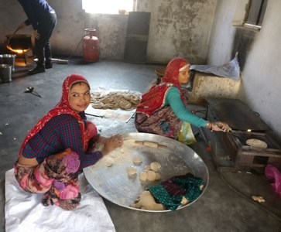
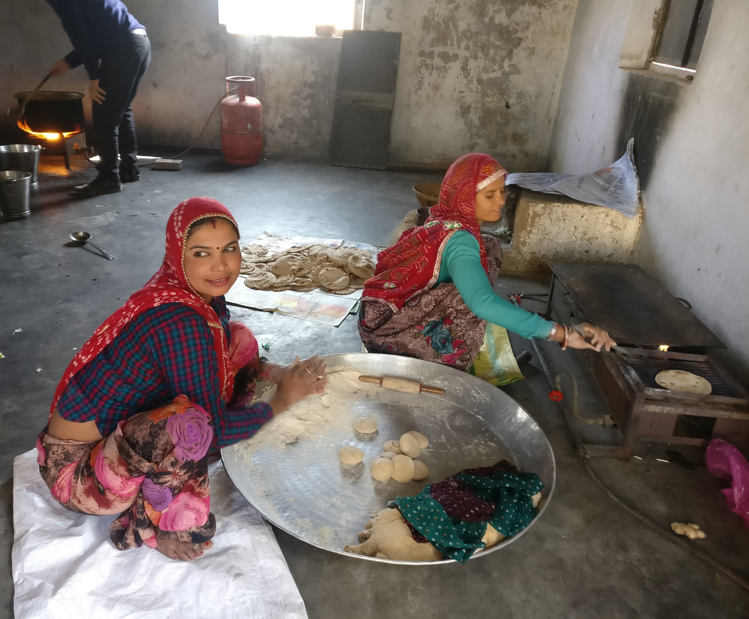
COOK – CUM - HELPER
Cook-cum-Helpers Strength
CCH |  | No. of Cook-cum-Helpers
Female |  | 98387
Male |  | 11535
Total |  | 109922
Cook-cum-Helper Honorarium (Per Month) -1320/-
 | SC |  | ST | OBC | Minority |  | Others | Total
Male | 1123 |  | 3604 | 4891 | 306 |  | 1611 | 11535
Female | 10960 |  | 15906 | 53715 | 3600 |  | 14206 | 98387
Total | 12083 |  | 19510 | 58606 | 3906 |  | 15817 | 109922

Slide 17
LABORATORY TESTING OF MDM
Nutritive values were analyzed in MDM samples through NABL Accredited Laboratories.
121 Samples were analyzed which were collected from Centralized Kitchens and concerned Schools.
Out of 121 samples, 00 samples were found below norms.
Directions have been issued to the concerned institutions to improve the quality of MDM & provide MDM as per GOI Guidelines.
No. of Districts | Number of samples |  | Result (No. of samples)
 | Collected | Tested | Meeting norms | Below norms
5 | 121 | 121 | 121 | 00

Slide 18
MDM- Monitoring & Inspections
MDM-Inspections 2018-19 [Up to March, 2019]
Inspections By DLOs | Inspections By State Officers | Intensive Inspections* (Aug., 2018 & Feb., 2019) | Total
70721 | 39 | 15993 | 86753
* Total 86753 Schools were inspected in August, 2018 & Feb., 2019 under Intensive Inspection programme.

Slide 19
MDM- SMS based Automated Reporting & Management System
SMS based Automated Reporting & Monitoring System (ARMS) was rolled out in the State from August, 2016.
For this purpose a portal (mdmhp.nic.in) developed by National Informatics Center (NIC) Himanchal Pradesh is being used.
At present 66493 Govt. Primary & Upper Primary Schools are being benefited through MDM Scheme in State.
Data of 66,493 schools has been ported on the portal and information of beneficiary students of 45,000 Schools is being received on daily basis by SMS on toll free no 15544.

Slide 20
MDM: MIS Report (up to oct. 2018)

Slide 21
MDM-Food Grain Status 2018-19
FOOD GRAIN MANAGEMENT : 2018-19 ( in MT )
Food Grain | Opening Balance 01-04-18 | Allocation 2018-19 | FCI Lifting | Consumed Tanta | Balance (As on 31.03.19)
WHEAT | 3314.23 | 90627.71 | 86626.25 | 87829.73 | 2110.75
RICE | 2110.83 | 38840.45 | 36339.14 | 37132.97 | 1317.00
TOTAL | 5425.06 | 129468.16 | 122965.39 | 124962.70 | 3427.75

Slide 22
MDM-Budget Approved by PAB for 2018-19
S. No. | Item | Central Share (Rs in Crore) | State Share (Rs in Crore) | TOTAL (Rs in Crore)
1 | Cost of Food grain | 29.78 | 0.00 | 29.78
2 | Transportation | 9.71 | 0.00 | 9.71
3 | MME | 7.68 | 0.00 | 7.68
4 | Cook Cum helper | 66.69 | 44.46 | 111.15
5 | Cooking Cost | 320.69 | 213.43 | 534.12
6. | Kitchen Devises Replacement | 4.38 | - | 4.38
Total |  | 438.93 | 257.89 | 696.82

Slide 23
MDM-Expenditure up to 31March 2019
S. No. | Item | Central Share (Rs in Crore) | State Share (Rs in Crore) | TOTAL (Rs in Crore)
1 | Cost of Food grain | 25.23 | 0 | 25.23
2 | Transportation | 5.39 | 0 | 5.39
3 | MME | 7.70 | 0 | 7.70
4 | Cook Cum helper | 69.25 | 83.10* | 152.35
5 | Cooking Cost | 313.79 | 209.19 | 522.98
6 | Kitchen Devises Replacement | - | - | -
 | TOTAL | 421.36 | 292.29 | 713.65
*State is bearing additionally Rs.320 per month per CCH from own resource.
Notes:
*

Slide 24
MDM : Expenditure
Budget provision, Release and Expenditure
(FY. 2018-19)
In Crore
Budget Provision | Budget Allocation | Expenditure (till March 2019)
452.69 | 445.00 | 471.75

Slide 25
MDM : Annapoorna doodh yojana
Launch Date of Scheme: 02 July 2018.
Annapoorna Doodh Yoajana Started with the distribution of milk thrice in week which was extended for six days from 01 September 2018.
Students from class 1 to 8 of schools covered under Mid day Meal programme are eligible for Annapoorna Doodh Yoajana.
Quantity of milk per student per day:-
Class 1 to 5=150 ml
Class 6 to 8=200 ml
Source for procurement of milk:-
Urban - Purchase of pasteurized toned milk from SARAS Dairy Booth by SMC/SDMC.
Rural- Purchase from Registered Women Dairy Cooperative Societies (WDCS) in the Panchyat on priority by the SMC/SDMC
Upper limit of Mil purchase rate (Rs. Per student per day):-
Urban – Rs. 40/- Ltr.
Rural- Rs. 35/- Ltr.

Slide 26
MDM : Annapoorna doodh yojana
Budget provision, Release and Expenditure
(FY. 2018-19)
In Crore
Budget Provision | Expenditure (till March 2019)
696.82 | 713.65

Slide 27
MDM : Issues
Enhancement of honorarium to cook-cum-helpers
Requirement of the Funds for AMS
Requirement of the funds for milk Testing.
Requirement of the funds from state Government for extra Gas Cylinder for Annapoorna Doodh Yojana.

Slide 28
Proposal for
2019-20

Slide 29
INSTITUTIONS
No. of Institutions Covered : 66493
(On 30th September 2018)
Classes | (Govt + LB) Schools | GA Schools | Special Training Centers | Madarsas/ Maqtab | TOTAL
1-5 | 30427 | 0 | 461 | 1422 | 32310
1-8 | 33203 | 0 | 24 | 214 | 33441
6-8 | 729 | 0 | 0 | 13 | 742
TOTAL | 64359 | 0 | 485 | 1649 | 66493

Slide 30
EnROLMENT
Enrolment: 62.65 Lakh
(On 30th September 2018)
Classes | (Govt + LB) Schools | GA Schools | Special Training Centers | Madarsas/ Maqtab | TOTAL
1-5 | 3971889 | 0 | 26932 | 104601 | 4103422
6-8 | 2145368 | 0 | 1308 | 15248 | 2161924
TOTAL | 6117257 | 0 | 28240 | 119849 | 6265346

Slide 31
MDM- Proposed Beneficiary Students
Beneficiary Students : 48.86 Lakh
S.N. | Category | Enrollment | No. Of beneficiaries* | % of beneficiaries
1 | Primary | 4103422 | 3185316 | 77.62%
2 | Upper Primary | 2161924 | 1701019 | 78.68%
Total |  | 6265346 | 4886335 | 77.98%
* A 10% increase in performance up to March, 18 has been taken. The No. of students is likely to be increased in the F.Y. 2019-20.

Slide 32
MDM- Proposed Working Days in F.Y. 2019-20
S. No. | Month | Total No. of Days in the month | Holidays |  |  |  |  | Academic Calendar (No. of Days) | Anticipated No. of Working Days (3-8) | Anticipated No. of working days for NCLP schools | Remarks
 |  |  | Vacation Days | Holidays Except Vacation period |  |  | Total Holidays (4+7)
 |  |  |  | Sundays | Other School Holidays | Total
1 | 2 | 3 | 4 | 5 | 6 | 7 | 8 | 9 | 10 | 11 | 12
1 | April,19 | 30 | 0 | 4 | 2 | 6 | 06 | 24 | 24 | 25
2 | May,19 | 31 | 22 | 1 | 0 | 1 | 23 | 08 | 08 | 27
3 | June,19 | 30 | 18 | 2 | 0 | 2 | 20 | 10 | 10 | 26
4 | July,19 | 31 | 00 | 4 | 0 | 4 | 04 | 27 | 27 | 26
5 | August,19 | 31 | 00 | 4 | 3 | 7 | 07 | 24 | 24 | 27
6 | September,19 | 30 | 00 | 5 | 1 | 6 | 06 | 24 | 24 | 26
7 | October,19 | 31 | 12 | 4 | 2 | 6 | 18 | 13 | 13 | 27
8 | November,19 | 30 | 00 | 4 | 1 | 5 | 05 | 25 | 25 | 26
9 | December,19 | 31 | 07 | 5 | 0 | 5 | 12 | 19 | 19 | 26
10 | January,20 | 31 | 06 | 4 | 1 | 5 | 11 | 20 | 20 | 27
11 | February,20 | 29 | 00 | 4 | 0 | 4 | 04 | 25 | 25 | 24
12 | March,20 | 31 | 00 | 5 | 4 | 9 | 09 | 22 | 22 | 26
Total |  | 366 | 65 | 46 | 14 | 60 | 125 | 241 | 241 | 313
* This information is based on the Academic Calendar prepared by the Education Department Less : Distt. Collector 2 Leave +H.M. Power 02+Teacher Conference 04 = Total 8 Days (-) 08
Anticipated No. of average Working Days between April, 2019 & March 2020= 233
II. Anticipated No. of average Working Days per NCLP School between April, 2019 & March, 2020 = 313

Slide 33
MDM- Cook Cum Helpers
Category | No. Of Cook Cum Helper
Primary | 67499
Upper Primary | 42423
Total | 109922

Slide 34
Requirement of Food Grain for 2019-20 (Including Drought)
S.N. | Category | Rice (in MTs) | Wheat (in MTs) | Total (in MTs)
1 | Primary | 22805.74 | 53213.29 | 76019.03
2 | Upper Primary | 18678.29 | 43582.70 | 62260.99
Total |  | 41484.03 | 96795.99 | 138340.02

Slide 35
Budget Requirements for 2019-20
S. No. | Item | Central Share (Rs in Crore) | State Share (Rs in Crore) | TOTAL (Rs in Crore)
1 | Cost of Food grain | 31.80 | 0 | 31.80
2 | Transportation | 20.74 | 0 | 20.74
3 | Additional Transportation Cost for Dal | 2.90 | 0 | 2.90
4 | MME | 11.23 | 0 | 11.23
5 | Cook Cum Helper | 67.34 | 80.81 | 148.15
6 | Cooking Cost | 360.54 | 240.36 | 600.90
7 | Replacement of Kitchen Devices | 7.55 | 5.04 | 12.59
8 | Kitchen Garden/ IT Innovation | 35.25 | - | 35.25
9 | Milk Providing Cost | 0 | 645 | 645
Total |  | 537.35 | 971.21 | 1508.56

Slide 36
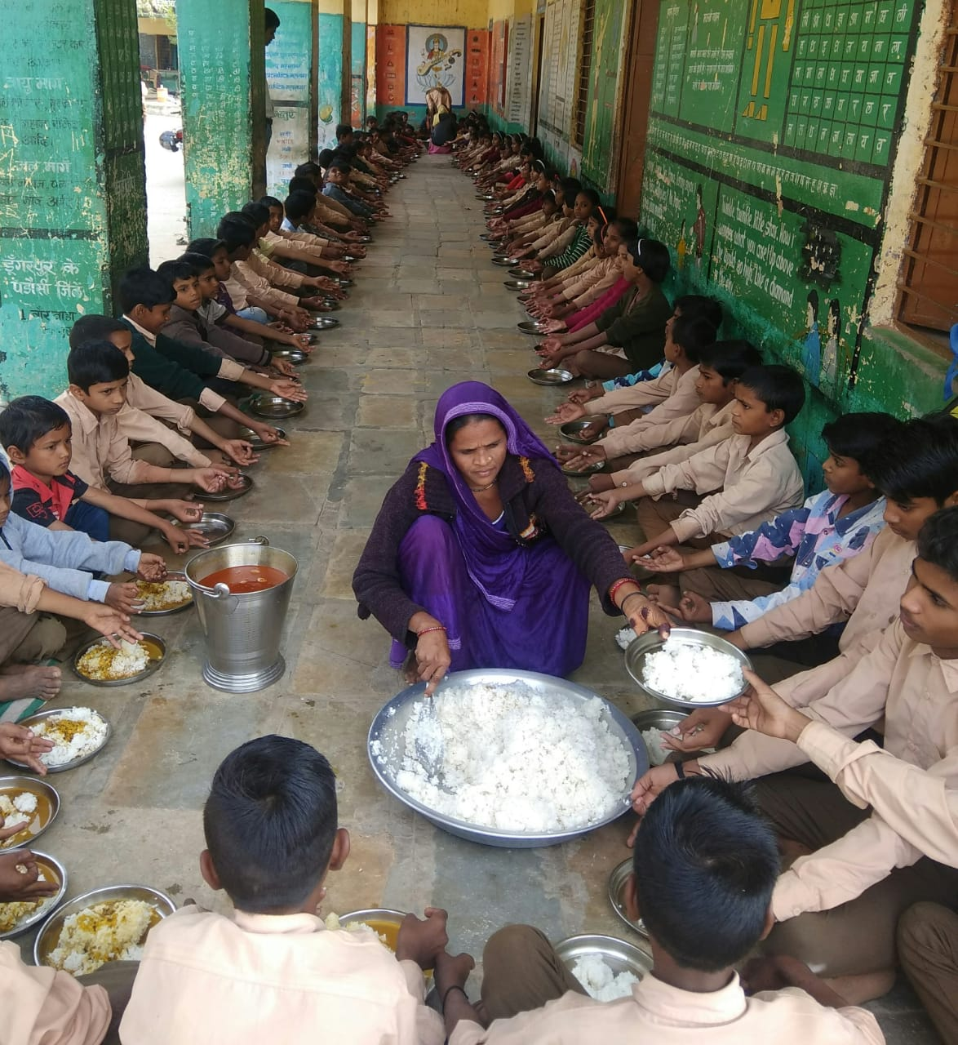
MDM Scheme

Slide 37
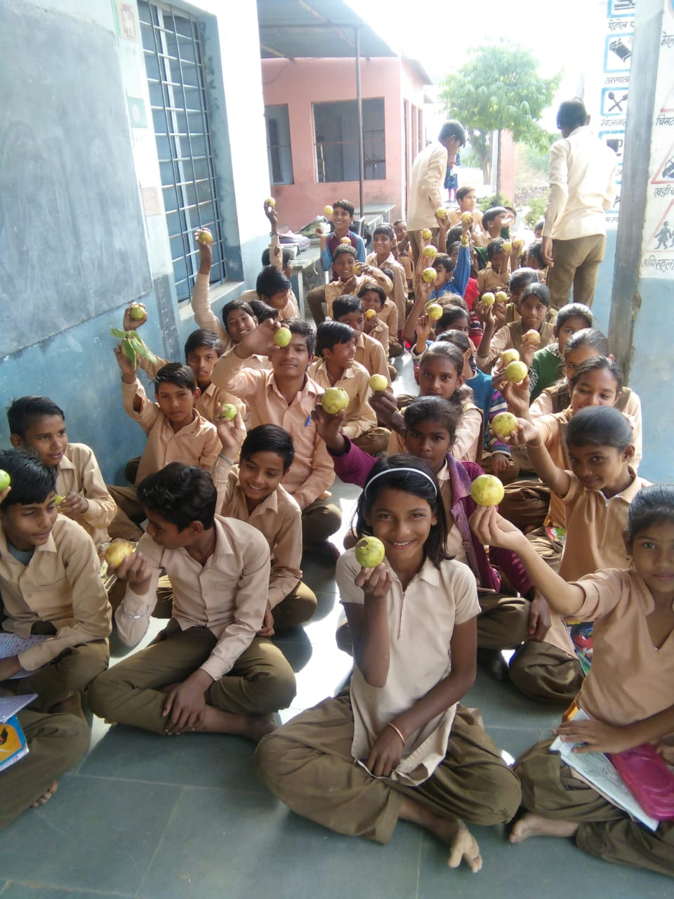
Mdm - Fruits Distribution

Slide 38
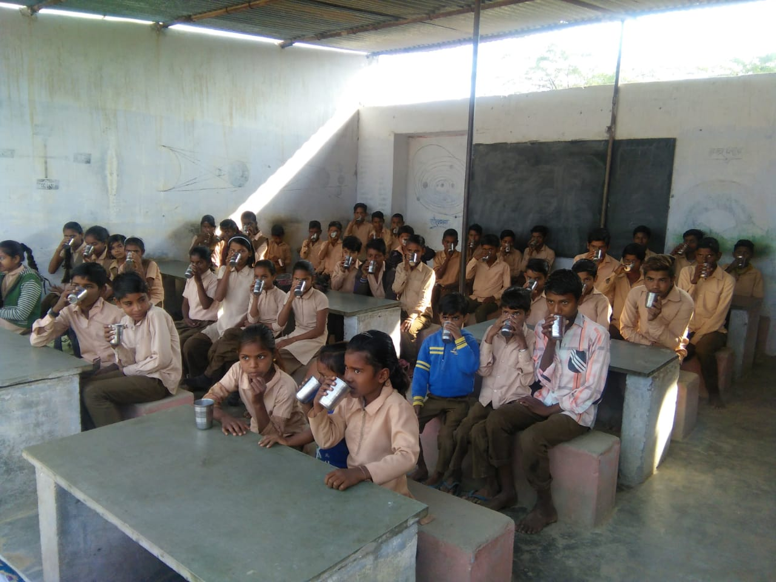
Milk distribution(annapoorna Doodh yojana)

Slide 39
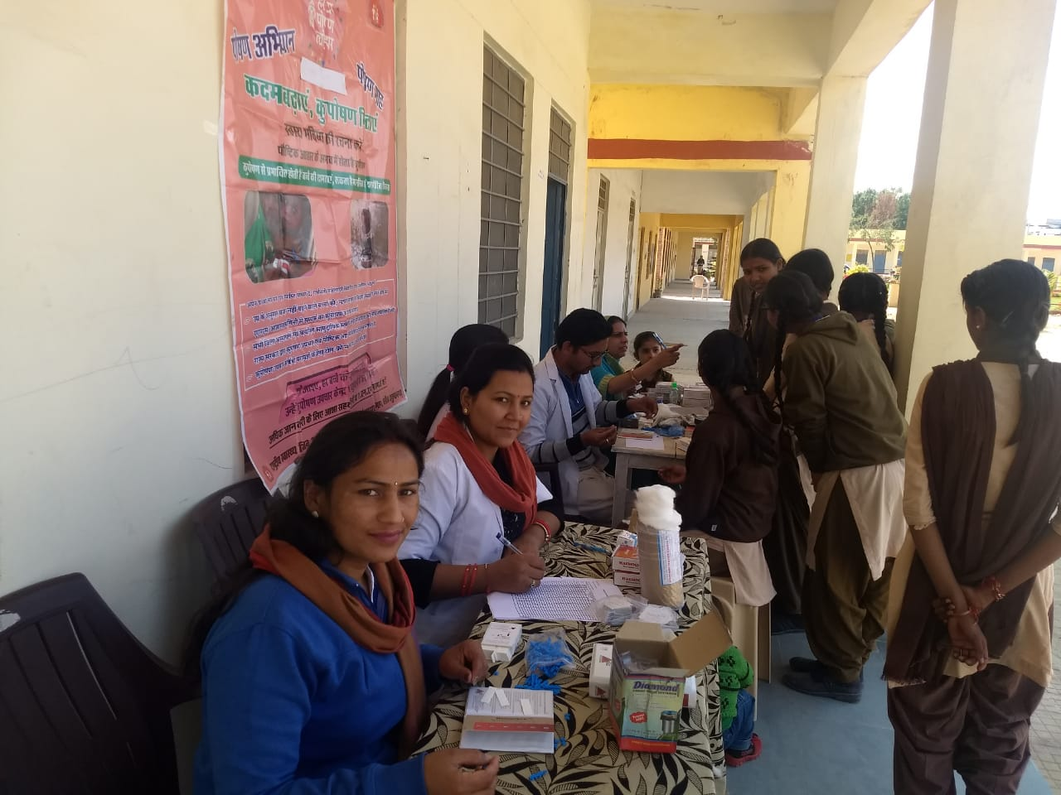
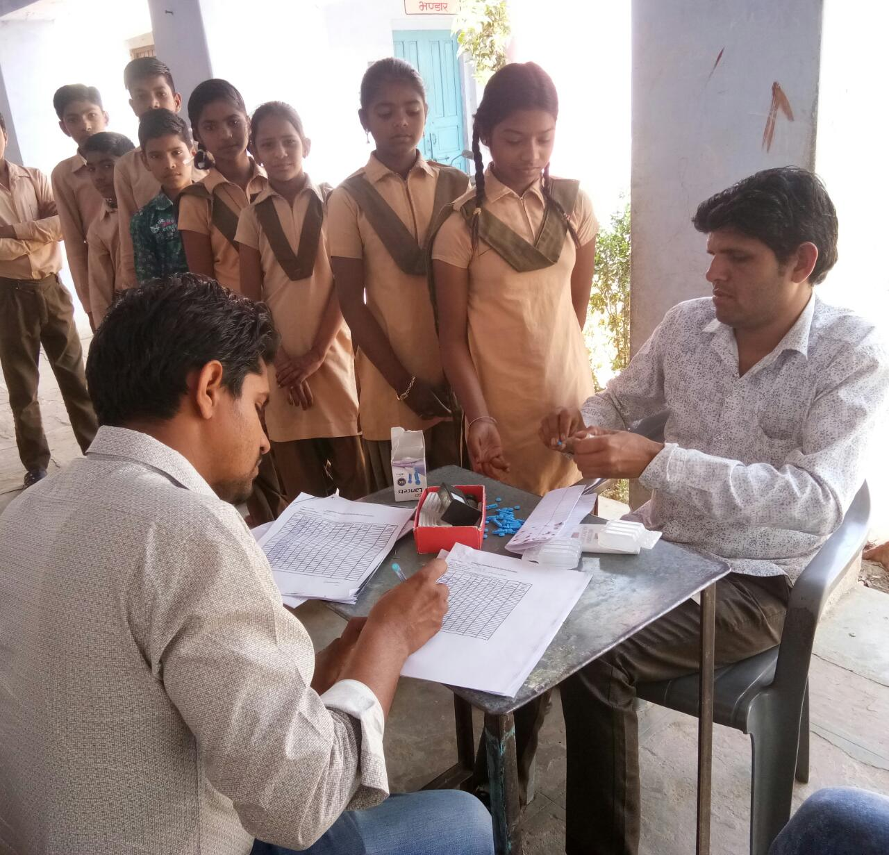
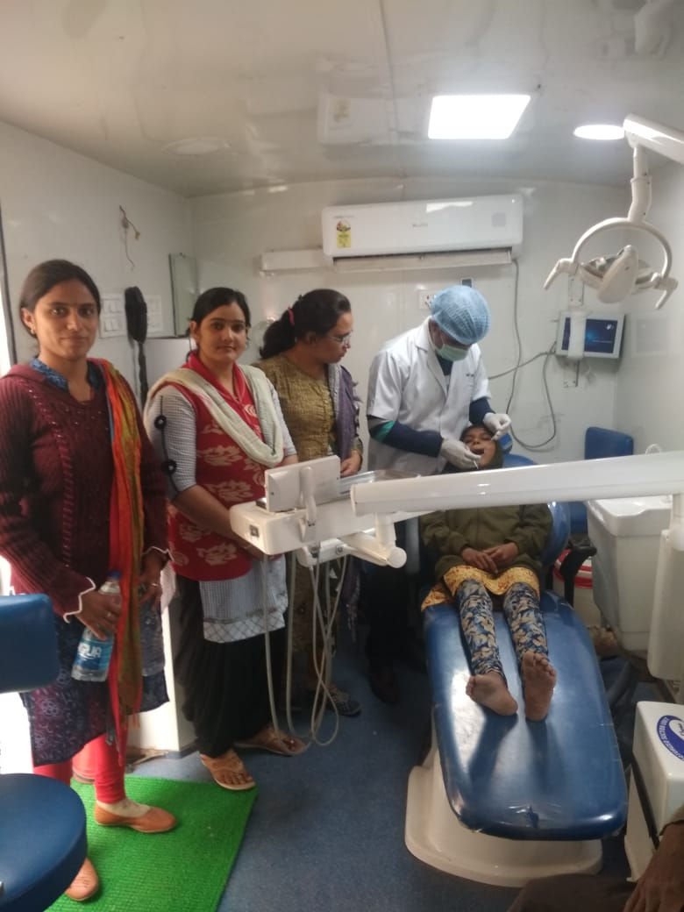
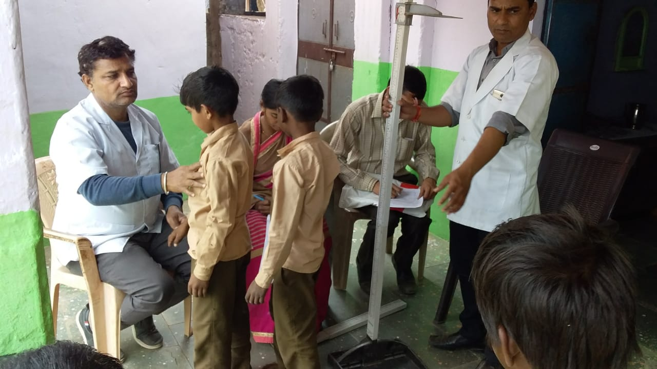
MDM – Health checkup

