Slide 1
PAB MEETING
2019-20
UTTARAKHAND
08-05-2019

Slide 2
Flow of Presentation
Number of Institution, Enrollment and Beneficiaries, Engaged Cooks and Kitchen Cum Stores details
Food grains Utilization, FCI Payment and Health check details
Budget Utilization for the Financial year 2018-19
Initiatives
Annual work plan and Budget proposal for the FY-2019-20
Pictures relating to initiatives

Slide 3
Institutions Covered Under MDM Mar 2019
Primary |  | Upper Primary |  | Total Schools (Primary & Upper Primary)
PAB Approval | Served Institutions | PAB Approval | Served Institutions | PAB Approval | Served Institutions
12356 | 12045 | 5308 | 5299 | 17664 | 17344
Enrollment & Beneficiaries under MDM Mar 2019
Primary |  | Upper Primary
PAB Approved Enrolment | Average Beneficiaries | PAB Approved Enrolment | Average Beneficiaries
365687 | 347250 | 259866 | 247982
Closed schools Primary Upper Primary
Coverage percentage

Slide 4
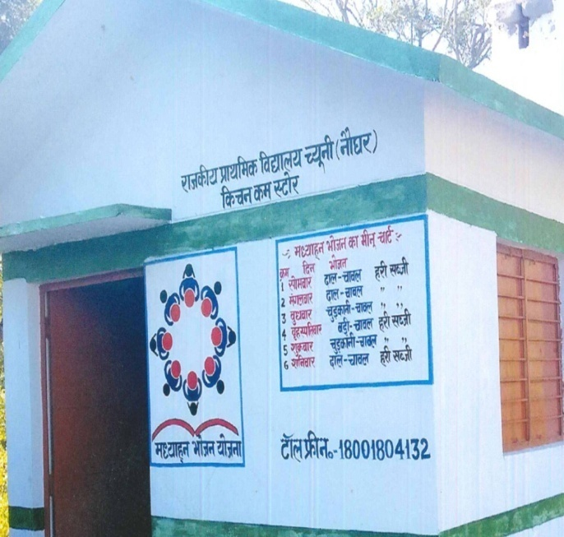
Cooks Engaged
Primary | 17070
Upper Primary | 9462
Total Cooks | 26532
Kitchen Cum Stores
Total Kitchen Cum Stores sanctioned | 15933
Total Constructed | 15666
In Progress | 83
Unstarted | 211
Cooks (Bhojanmata) in uniform
Districtwise 211 KCS Unstarted
1.SLSMC has decided not to construct KCS where enrolment is less than 10.
2. Due to change in plinth area, 27 KCS extra constructed.
The Logo, Menu and toll free number displayed

Slide 5
Food grains Utilizations (In MTs) April 2018 –March 2019
Level | Annual Gross Allocation by GOI | Lifting by DSOs from FCI | Released by DSOs to Schools
PS | 7445.72 | 7445.72 | 8409.04
UPS | 7901.07 | 7901.07 | 8968.17
Total | 15346.79 | 15346.79 | 17377.21*
* Previous year foodgrains also included
FCI Payment April 2018 –March 2019
Level | Bills Submitted by FCI |  | Payment made to FCI
 | Quantity (In MTs) | Amount (In Lac) | Quantity (In MTs) | Amount (In Lac)
PS | 7445.72 | 227.77 | 7445.72 | 227.77
UPS | 7901.07 | 241.64 | 7901.07 | 241.64
Total | 15346.79 | 469.41 | 15346.79 | 469.41
Notes:
Done

Slide 6
Health Check Up Status (April 18-March 2019)
Total Schools Covered | Total Children examined | Children identified with different Diseases | Children referred to nearest PHC/Hospital | No. of Spectacles distributed
18173 | 752667 | 134394 | 20097 | 4122
Details
National Deworming Day 8th February 2019
Health check up in School by RBSK Teams
Notes:
Done

Slide 7
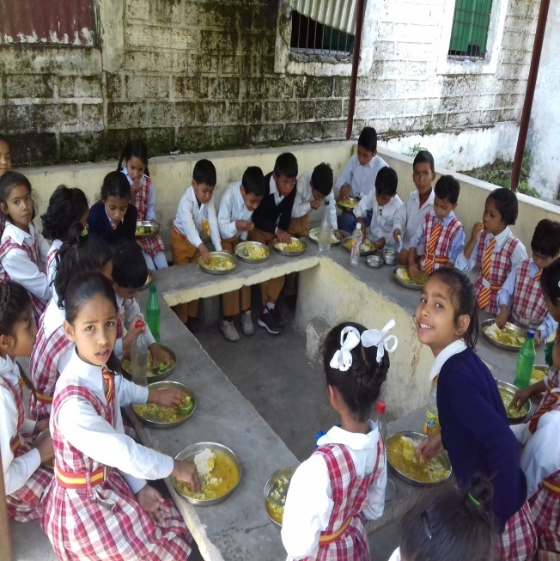
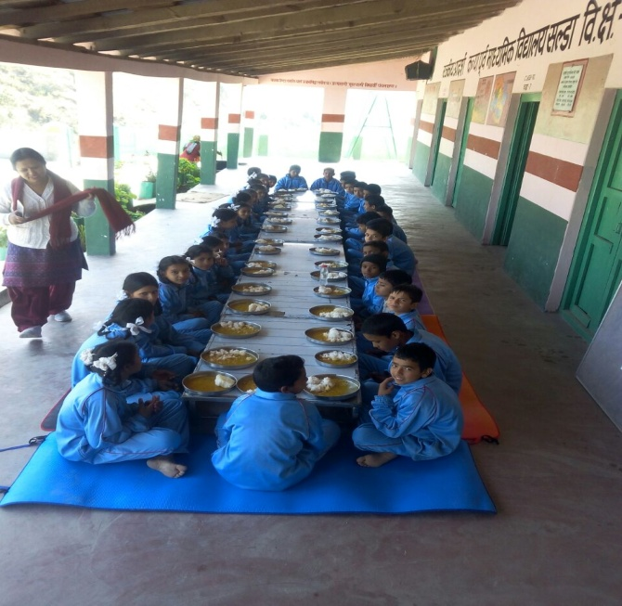
Budget Utilization (Rs. in Lac) 2018-19
Total Approval | 18415.79
Opening Balance (Central+State) | 2047.76
State Releases including Central Share | 14748.66
Total Available Amount | 16796.42
Expenditure | 14953.81
% of Expenditure against Release+OB | 90%
MDM distribution in schools

Slide 8
Initiatives
“The Hans Foundation” provides gas connection to 5519 schools.
A new innovative concept of “Apna Kitchen Apna Bhojan” has been introduced in the state to develop work culture among children and to promote the will of working together and co-operation.
Iron Kadhai
The state provides Iron Kadhai to 4169 Schools.

Slide 9
Initiatives
Food Quality Test
The MDM cell undertook a “Food Quality Testing” with the help of “Punjab Biotechnology Incubator, Mohali”. The food samples were taken from 10 schools in Rudraprayag and Chamoli district. (Reports awaited)
Kitchen Garden
At present, 1281 schools have functional Kitchen Gardens.

Slide 10
Initiatives
Social Audit
USAATA
(Uttarakhand Social Audit, Accountability and Transparency Agency) conducted “Social Audit” of MDM Scheme in Haridwar district.
Vishesh Bhoj
The concept of “Vishesh Bhoj” has also been introduced in Mid Day Meal scheme, A total of 909 schools organized Vishesh Bhoj in 2018-19.

Slide 11
Initiatives
Additional Nutrition
In addition to daily menu of MDM, additional food Items “Atirikt Poshan” for nutritional support is also provided in schools once a week (Rs 5 per child per week) that include Eggs, fruits & other nutritional items i.e. Gud Papdi, Ramdana laddu etc.
Cooks Uniform
State govt. provides Rs. 1000 per year to all cooks(Bhojanmata) for procurement of uniform.

Slide 12
Annual work plan and Budget proposal by State for 2019-20 MDM
Uttarakhand |  |  |  |  |  | Rs. In Lacs
S.No | Head | Level | Central Assistance | State Assistance | Total | Remark
1 | Cooking Assistance | PS (347250 children) | 3272.17 | 368.22 | 3640.4 | @4.35 Per child/day,90:10 (3.91+0.44)
 |  | UPS (247982 children) | 3502.15 | 388.46 | 3890.61 | @6.51 Per child/day, 90:10 (5.86+0.65)
2 | Cooking Assistance (gas) | PS+UPS-(0) | 0 | 0 | 0
3 | Kitchen cum Store | PS+UPS - (0) | 0 | 0 | 0 | As per Plinth area1,2,3,4,
 |  |  |  |  |  | Kitchen Cum Store is being proposed
4 | Repair of kitchen cum stores constructed ten years ago | PS+UPS - (4786) | 430.92 | 47.88 | 478.8 | @10000 Per Kitchen,90:10 (9000+1000)
5 | Kitchen Devices (New) | PS+UPS (40) | 5.81 | 0.65 | 6.45 | Unit Cost
 |  |  |  |  |  | @10000 per KD for Enrolment range 1 to 50.
 |  |  |  |  |  | @15000 per KD for Enrolment range 51 to 150.
 |  |  |  |  |  | @20000 per KD for Enrolment range 151 to 250.
6 | Kitchen Devices (Replacement) | PS+UPS (10394) | 1102.64 | 122.52 | 1225.15 | @25000 per KD for Enrolment range 251 to above.
7 | Transportation (food grains) Subsidy | PS - 8368.73 MT | 210.6 | 0 | 210.6 | 100% GOI @ Rs. 2516.48/MTs
 |  | UPS- 8964.55 MT | 225.59 | 0 | 225.59
8 | Gunny bags (Khali Bore) | PS+UPS | 0 | 10 | 10 | Received in state Govt. Account through Bank Challan
9 | MME | PS | 146.61 | 0 | 146.61 | 2.7% of Cooking Assistance,Transportation Subsidy ,
 |  | UPS | 133.39 | 0 | 133.39 | Honorarium of cooks & cost of foodgrains.
10 | Honorarium of cooks | PS - 18777 | 1689.93 | 2065.47 | 3755.4 | Rs 1000 per month, 90:10, Rs 1000 additional by State Govt.
 |  | UPS - 10410 | 936.9 | 1145.1 | 2082
11 | Additional Honorarium of cooks | PS - 18777 | 0 | 375.54 | 375.54 | State Govt. is Paying additional Honorarium Rs.2000 to all cooks under MID day meal scheme
 |  | UPS - 10410 | 0 | 208.2 | 208.2
12 | Incentive of cooks | PS - 18777 | 0 | 187.77 | 187.77 | State Govt. is Paying Rs. 1000 as an incentive to all cooks under MID day meal Scheme.
 |  | UPS - 10410 | 0 | 104.1 | 104.1
13 | Cooks uniform | PS - 18777 | 0 | 187.77 | 187.77 | State Govt. is Paying additional uniform, Rs 1000 to all cooks under MID day meal Scheme
 |  | UPS - 10410 | 0 | 104.1 | 104.1
14 | Atirikt Poshan | PS (347250 children) | 0 | 694.5 | 694.5 | State Govt. is Paying additional fooditem Rs 5 to all children covered under MID day meal Scheme
 |  | UPS (247982 children) | 0 | 495.96 | 495.96
15 | Cost of Foodgrains | PS | 257.34 | 0 | 257.34 | @ 3000 per MT+Mandi tax@2.5%
 |  | UPS | 275.66 | 0 | 275.66 | @ 3000 per MT+Mandi tax@2.5%
16 | Salary Staff |  | 0 | 40 | 40 | Govt. Staff only
17 | Flexi fund @ 5% for new interventions | PS+UPS | 532.52 | 0 | 532.52 | 5% of Cooking Assistance,Transportation Subsidy , MME, Honorarium of cooks & cost of foodgrains.
 | Total |  | 12722.22 | 6546.24 | 19268.46

Slide 13
Photo gallery
Notes:
Suavere poquito

Slide 14
PS Khaliyan RUDRAPRAYAG
Vishesh
Bhoj
PS Kafal Pani TEHRI

Slide 15
UPS Billekh Navin ALMORA
Vishesh
Bhoj
PS Naughar Garur BAGESHWAR

Slide 16
Vishesh
Bhoj
PS Matli Dunda UTTARKASHI
Vishesh Bhoj organised by Joint Magistrate Ranikhet, Almora in
PS MAYU MATILA TARIKHET

Slide 17
Mushroom Production in
PS Jajar Chingri
Didihat Pithoragarh

Slide 18
Amla Pickles preparing by Children in
PS Jajar Chingri
Didihat Pithoragarh

Slide 19
PS Bhaisuri BAGESHWAR
PS Kilkileshwar US Nagar
Vegetables Production in
Kitchen Garden

Slide 20
Additional Nutrition
Honey Distribution in
GHSS Maipata
Dehradun

Slide 21
Additional Nutrition
Eggs/ Banana
Distribution in schools

Slide 22
PS Haldi US Nagar
GIC Chapradhar Tehri Garhwal
Bhojanmata Vardi
(Cooks Uniform)
UPS Teliwala Haridwar

Slide 23
Iron kadhai in schools
District Pithorgarh Schools

Slide 24
Handwash

Slide 25
Thank You

