Slide 1
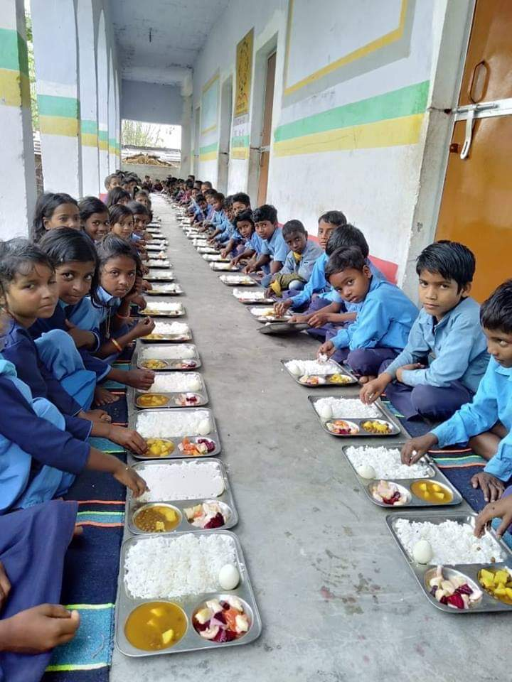
ANNUAL WORK PLAN & BUDGET-2020-21 PAB MEETING 12.06.20 Directorate of MDM EDUCATION DEPARTMENT GOVT. OF BIHAR

Slide 2
GOAL
100% coverage of school attending children from class I to VIII
Ensuring quality, hygiene, fixed quantity and timeliness.
Timely payment – Honorarium to cook-cum-helper, vendor payment, etc.
Accurate and timely reporting

Slide 3
Initiative
Development Management institute(DMI) ,Bihar has been engaged for evaluation of centralized kitchens run by NGOs.
State has increased honorarium of CCH by Rs. 500/- per month (total Rs.1500/-per month) from its own resources.
In five AES affected blocks of Muzaffarpur district, milk is being provided to children once in a week from state own resources.

Slide 4
STEPS TAKEN TO ENRICH THE SCHEME
LPG connection with stove and fire extinguisher have been provided in all the 70180 schools.
In compliance to Hon’ble Supreme court of India direction, state is providing Egg/Fruit once in a week from its own resources.
Cook-cum-helpers are paid honorarium through their bank account.
In case of death of CCH, ex gratia amount of Rs. 4 lac is given to the next kin of deceased.
Total Rs.48.84 crore ex gratia has been given under this head till 31.03.20 from State funds.

Slide 5
Monitoring System
Dopahar(IVRS) has been functional since April 2012 for effective monitoring of the scheme and to capture daily data in real time.
Follow up action is taken on regular basis
A Web based MIS is in place since June 2012 to procure data pertaining to MDM for following purposes-
Reporting
Monitoring
Fund Flow Management
Food Grain Flow Management

Slide 6
GRIEVANCE REDRESSAL
A toll free no 1800-345-6208 has been installed at directorate level since 2014 for redressal of complaints.
E.mail address and telephone numbers of all district level officers and state level officers are in public domain on website dopahar.org .

Slide 7
Initiatives – Ranking of District performance
Performance based ranking of the districts has been started since December 2018.
Criteria for ranking are :-
No of MDM Served School
Average per day beneficiary against enrollment
MDM working days
School Inspections
FCI payment
Quarterly SMC meeting
Monthly Cook-cum-helper honorarium payment
MIS Entry status
Dopahar (IVRS) response

Slide 8
Monitoring-Special Inspection Drive
Tablet based Special inspection drive was conducted during 15.7.19 to 31.08.19 for ensuring hygienic condition of kitchen shed for safe and hygienic food to the children.
All departmental officers/ staff participated during this special inspection drive for success of this drive.
All Tablet based Inspection with photographs have been uploaded on website .

Slide 9
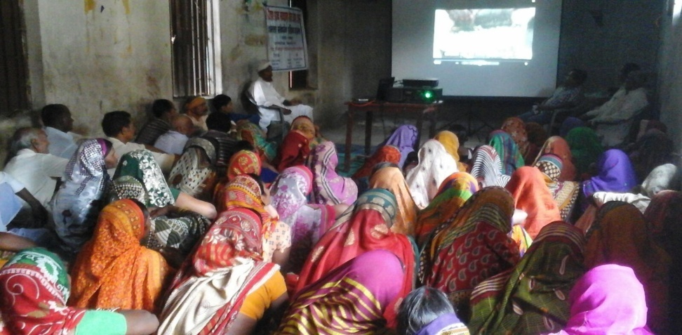
Best Practices One day training programme for all cook-cum-helpers was organized in all districts on a rotational basis during 1st April 2019 to 30th june 2019 for preparation of safe, hygienic and nutritious food.

Slide 10
Ankuran :School Nutri Garden
Nutri garden has been setup in 8270 schools
Vegetable grown in these gardens used for MDM.
Weekly iron folic acid supplement given to all the children and monitoring is done through MIS.

Slide 11
Ankuran :-Nutri Garden visited by Hon’ble C.M ,Bihar in Primary School Abidpur, Bajpatti , Sitamarhi

Slide 12
Media Clip:- Nutri Garden

Slide 13
Media Clip:- Nutri Garden

Slide 14
ISSUES
During lock down period from 14.3.20 to 31.5.20, state govt. decided to transfer amount equivalent to cost of foodgrain and conversion cost to children bank account through DBT. A sum of Rs. 257 crore (Two hundred fifty seven ) has been transferred by the state govt. for foodgrains.
Request letter and reminder for reimbursement of this amount has been sent.

Slide 15
ISSUES
As per Hon’ble Supreme court of India direction, one egg/fruit is being given to children once in a week since November 2017, cost of which should be shared on 60:40 basis. 60% share of central govt which comes to Rs.158 crore per annum should be reimbursed to the state govt.
In last PAB 2019-20, decision was taken to provide flexi fund to the state govt. to supply milk in 8 districts. No funds received.

Slide 16
ISSUES
Increase in monthly honorarium of cook-cum-helper from Rs. 1000/- to Rs. 2000/-per month.
Increase in cook-cum-helper honorarium from present 10 months to 12 months

Slide 17
THANK YOU

