Slide 1
Government of Tamil Nadu
Mid Day Meal Scheme Programme Approval Board
Meeting on 29.05.2020

Slide 2
Mid Day Meal Scheme Programme Approval Board
Government of Tamil Nadu
Meeting on 29.05.2020
Notes:
NOTE: To replace a picture, just select and delete it. Then use the Insert Picture icon to replace it with one of your own!

Slide 3
Noon Meal Centres and Beneficiaries for 2020-2021
S.No | Stage | No. of Centres | No. of Beneficiaries | No. of Working Days
1 | Primary (1st to 5th STD) | 26,875 | 23,71,316 | 220
2 | Upper Primary (6th to 8th STD) | 16,162 | 18,89,808 | 220
3 | NCLP | 209 | 4,726 | 312
Total |  | 43,246 | 42,65,850

Slide 4
Proposed Budget for the year 2020-2021 in the ratio 60:40 [Central : State]
Component wise Budget Proposed for 2020-2021 are as follows:-
Rs. in Lakhs
S.No | Components | Ratio [Central:State] | Amount proposed for 2020-2021 [Central Share 60%] | Amount proposed for 2020-2021 [State Share 40%]
1 | MME | 100 : 0 | 1270.24 | 0
2 | Transport Assistance | 100 : 0 | 1721.20 | 0
3 | Cost of Food grains | 100 : 0 | 3442.41 | 0
4 | Cooking Cost | 60 : 40 | 34194.40 | 22813.66
5 | Honorarium to Cook-cum-Helper | 60 : 40 | 7687.80 | 5125.20
Total |  |  | 48316.05 | 25775.26

Slide 5
Rice Fortification
Government of Tamil Nadu under the Innovative Initiative is piloting rice fortified with 9 micro nutrients as per FSSAI guidelines, in 5 districts under MDM / ICDS. The blending machines have been installed in the TNCSC godowns in 5 Districts & production has been started and the scheme is implemented from November 2019.
Rice Fortification: Fortified Rice with 9 Nutrient Contents (Vitamin A, Vitamin B1, Vitamin B2, Vitamin B3, Vitamin B6, Vitamin B12, Folic Acid, Iron and Zinc) are provided to all Nutritious Meal and Anganwadi Centres in five Districts namely, Dharmapuri, Madurai, Thanjavur, Thoothukkudi and the Nilgiris on pilot basis from November 2019. A sum of Rs.529.25 lakhs has been provided under Tamil Nadu Innovative Initiatives (TANII).
S.No | Districts | ICDS Beneficiaries | Nutritious Meal Beneficiaries
1 | Dharmapuri | 31,440 | 1,36,312
2 | Madurai | 39,570 | 1,54,141
3 | Thanjavur | 37,408 | 1,52,455
4 | Thoothukudi | 26,108 | 1,22,499
5 | The Nilgiris | 6,383 | 35,400
Total |  | 1,40,909 | 6,00,807

Slide 6
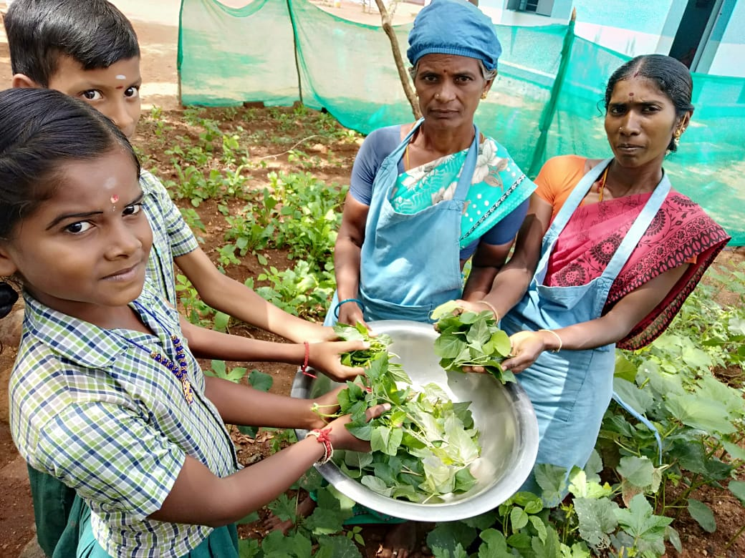
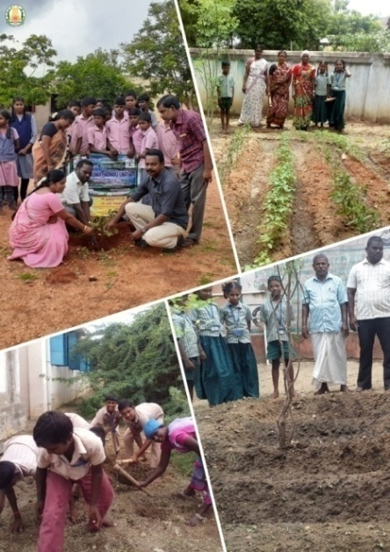
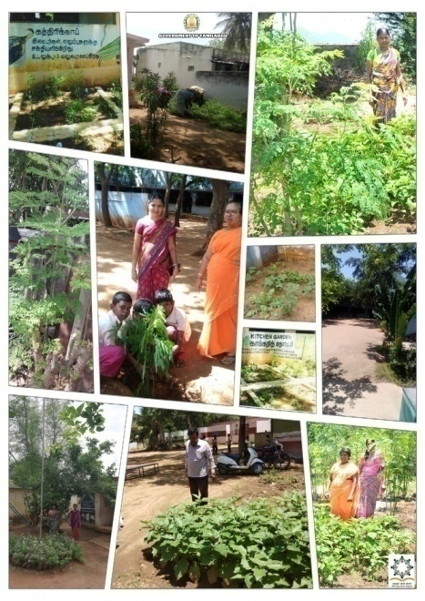
Information on Kitchen Gardens
“School was the Garden of Childhood, Where kids as bud are blossoms to become flowers.”
No. of Districts | Total No. of Institution & Setting up of KG is possible | No. of Institution already having KG
32 | 43,246 | 6,099
No. of institutions Sanctioned for setting up of KG [2019-2020] | No. of Institutions Proposed for setting up of KG during 2020-2021 | Name of the Krishi Vigyan Kendra (KVK)
10,024 | 27,123 | Horticulture/Agriculture Dept., Local KVK, Community, NGO’s, School’s own initiative
Namakkal District

Slide 7
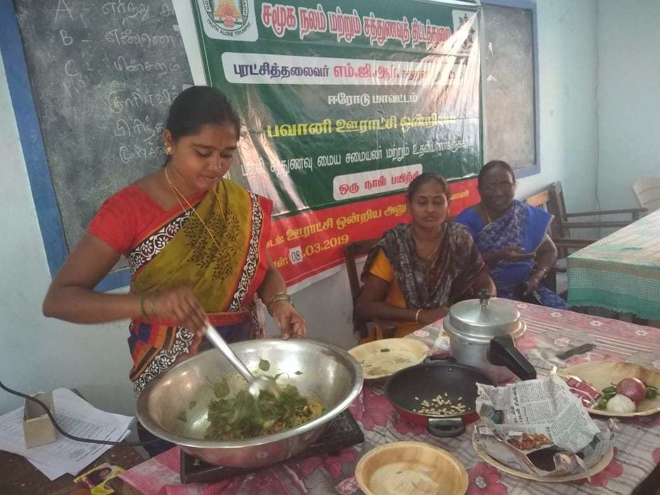
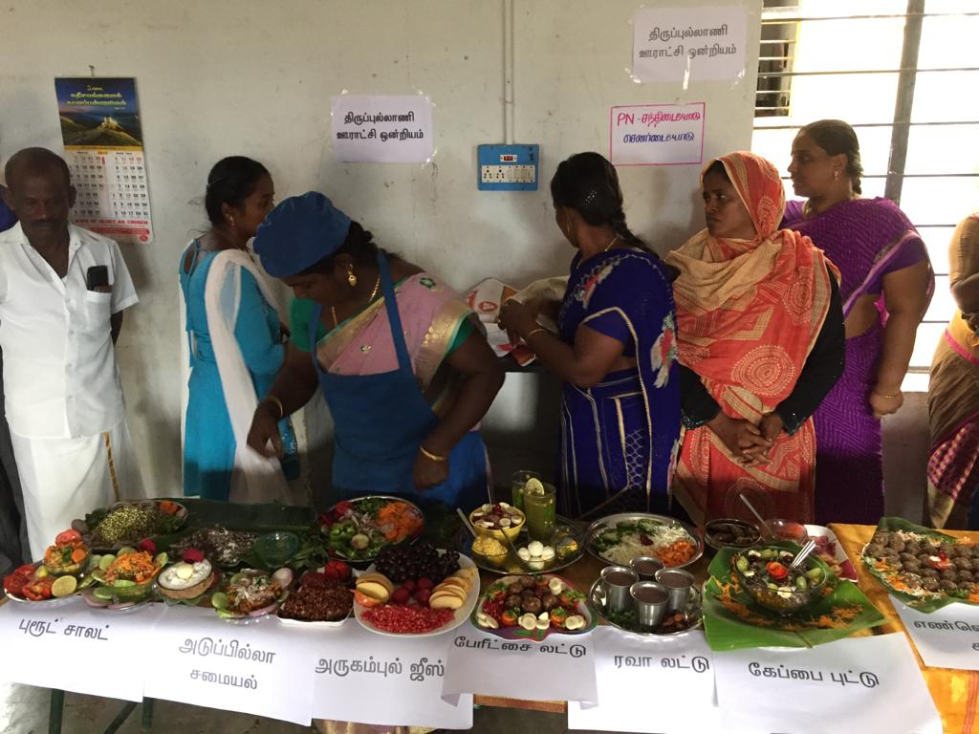
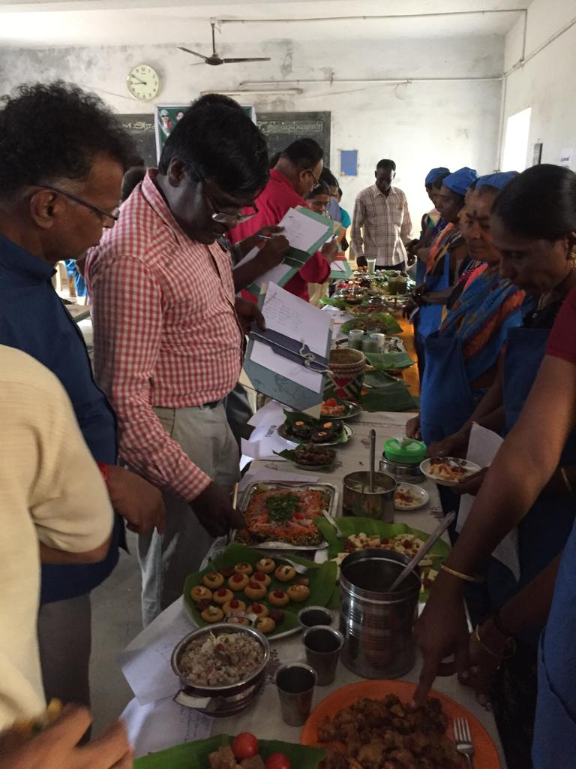
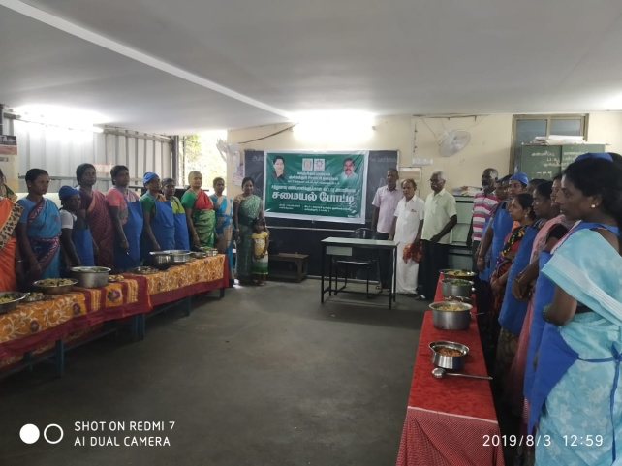
Cooking Competition
Government orders have been issued to award the best organizer, Cook and Cook cum Helpers in each District. The work of the each category of Noon Meal Employees will be graded on various parameters like affection towards the children, Maintenance of kitchen, Vessels, usage of good quality masalas & condiments, kitchen garden, additional features done with the participants of public, local NGO’s etc.,
Erode District
Ramnad District
Kanyakumari District
Dindigul District

Slide 8
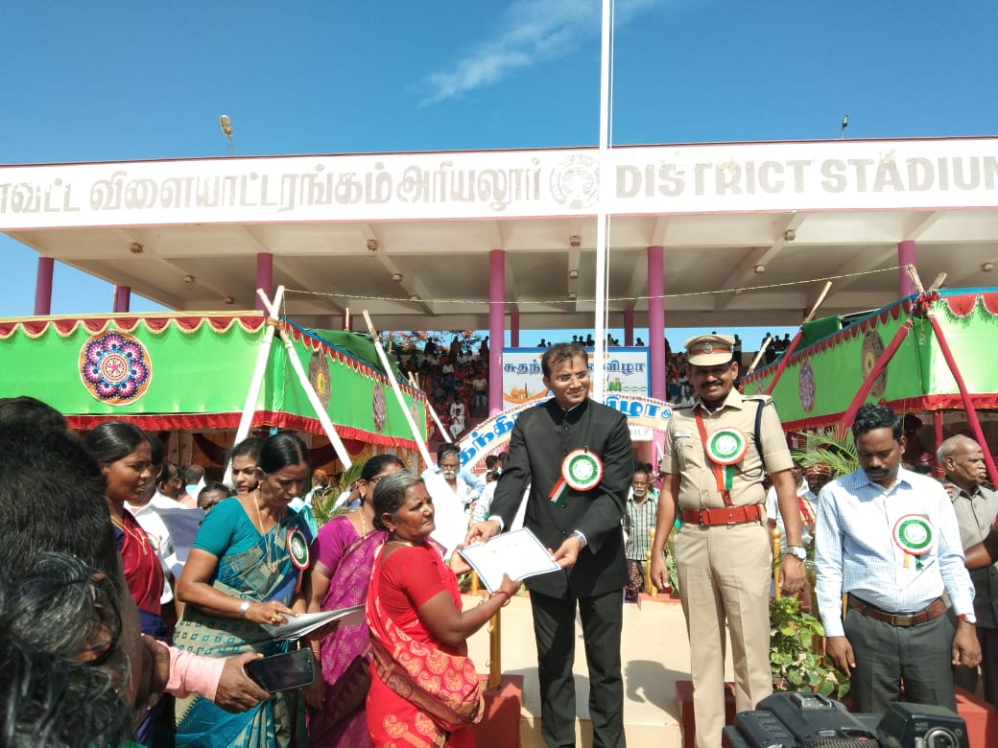
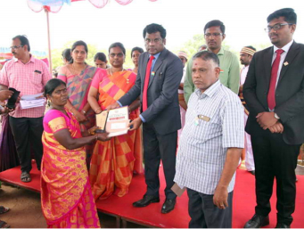
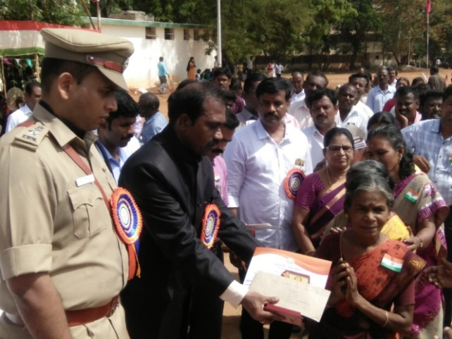
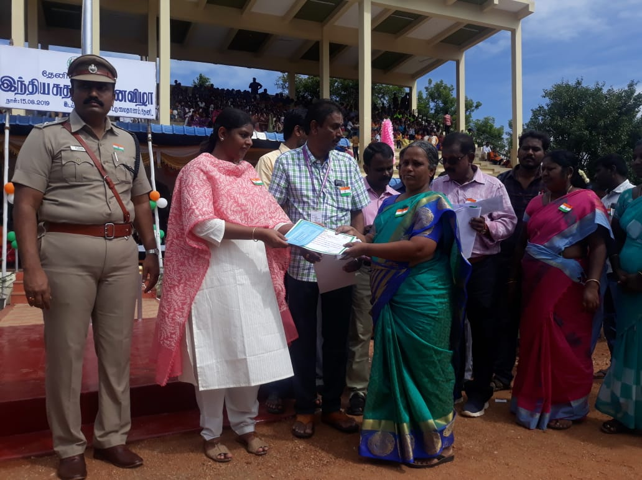
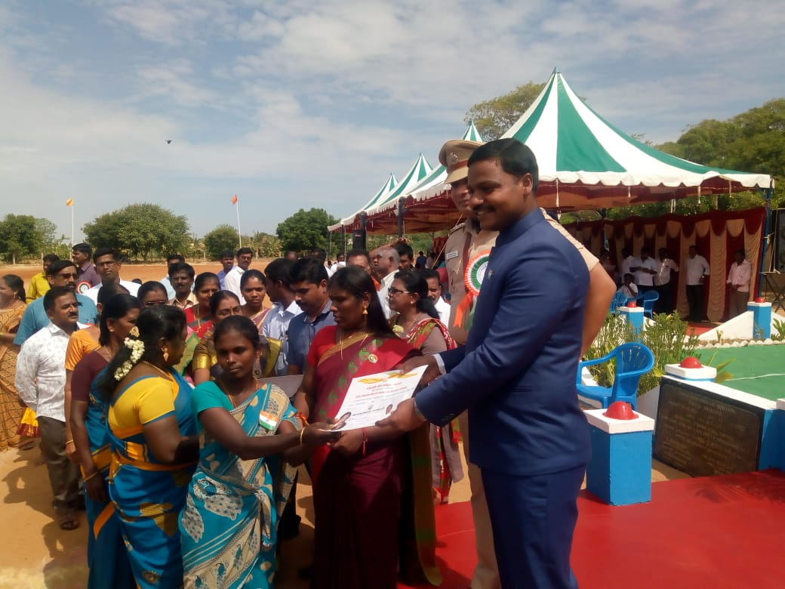
Award
Cash award of Rs.5000/- has been distributed along with a Certificate to the Noon Meal Employees in each district based on their performance.
Ariyalur District
Sivagangai District
Theni District
Ramanathapuram District
Tiruvannamalai District

Slide 9
Supply of Kitchen Devices
In order to maintain quality and uniform rate, State level Tender for the supply of 6,319 Kitchen Devices for a sum of Rs. 9.15 Cr under various rates Rs.10,000 sets, Rs. 15,000 sets, Rs. 20,000 sets and Rs. 25,000 sets have been called for. Tender has been finalized.

Slide 10
Proposal for Non recurring Fund (Kitchen Devices & Kitchen Shed)
Rs. in Lakhs
S.No | Components | Central Share | Minimum Mandatory State Share | Total
PAB Approvals for flexible Funds
School Nutrition (Kitchen) Gardens (27,123 - Centres) |  | 813.69 | 542.46 | 1356.15

Slide 11
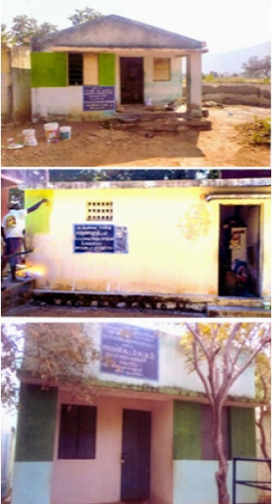
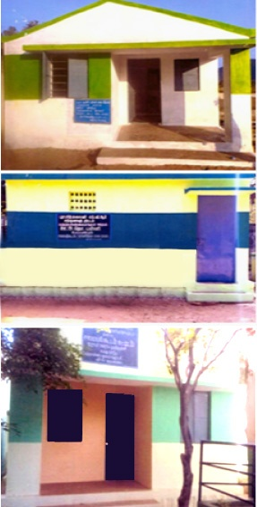
Minor Repairs
Repairing of 2167 Noon Meal Centre’s at the rate of Rs. 10,000 each amount was distributed to the districts to carry out the repair works. The works are under progress and will be completed soon.

Slide 12
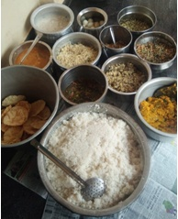
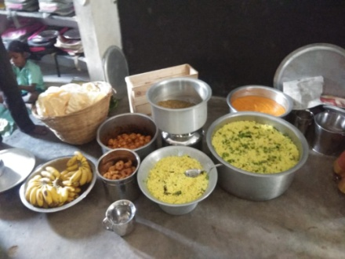
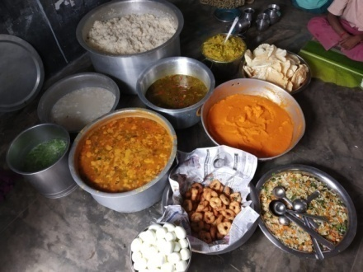
TITHI BHOJAN
Nal Virunthu

Slide 13
Thank You

